Slide 1
CASE PRESENTATION
DR NAGENDRAN BALARAMAL,
CLINICAL ONCOLOGY TRAINEE, NATIONAL CANCER INSTITUTE

Slide 2
History of presenting illness
40/Male
History of slipped disc in 2015, conservative management under HUKM
Worked as storekeeper
Smoker with 20 pack years
ECOG 0
Presented with unhealing ulcer at right lateral border of tongue since December 2018
Associated with bilateral neck swelling for 3 months preceding presentation

Slide 3
Investigation
17/5/2019 Right Tongue Biopsy: Moderately differentiated squamous cell carcinoma
30/5/2019 CT Head, Neck & TAP
Right tongue mass 4.2 x 3.5 x 3.2cm crossing midline Right submandibular LN 1.8 x 1.2cm Right level II & III LN 3.2 x 2.7cm No distant metastasis
Clinical staging T4aN2bM0

Slide 4
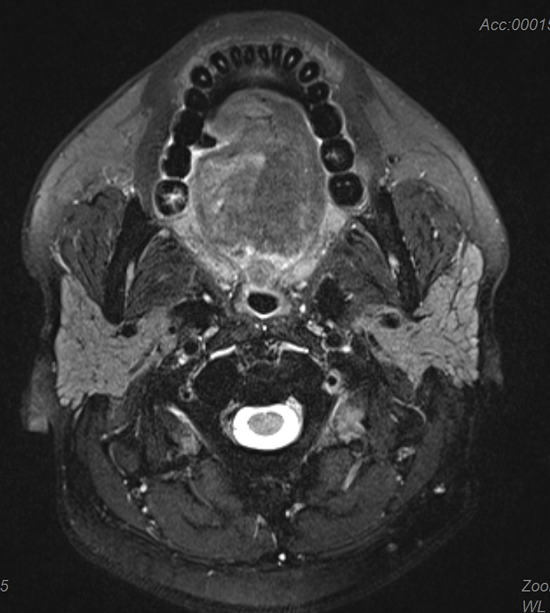
Oncological treatment
Received 3 cycles of neoadjuvant TPF chemotherapy from June to August 2019
MRI post neoadjuvant chemotherapy (August 2019) -Right hemitongue involvement with contralateral and extrinsic muscle involvement -Bilateral Level 1B Lymphadenopathies Radiological staging: T2N2b

Slide 5
Oncological treatment
Underwent wide excision of tumor with right partial glossectomy & segmental
mandibulectomy, bilateral neck dissection and reconstruction with pectoralis major
myofascial flap on 3/9/2019
HPE post operatively shows close margin of 2mm at the inferior aspect and bilateral neck nodes with extracapsular spread
Decision made for adjuvant CCRT. Patient underwent adjuvant intent CCRT to Faciocervical Region 66Gy/33#/6.5 weeks with concurrent Cisplatin 40mg/m2 weekly (6/11/2019 – 23/12/2019)
Dental clearance completed prior to radiotherapy

Slide 6
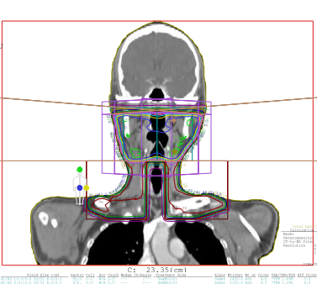
Radiotherapy planning

Slide 7
Surveillance
Patient was on surveillance
However as patient had difficulty swallowing post operatively,
he was planned for refashioning surgery.
Completed 30 sessions of hyperbaric oxygen therapy (HBOT) at Hospital Tuanku Mizan on 18/8/2022
Underwent secondary reconstruction of tongue with left radial forearm free flap via mandibulotomy, left neck exploration on 1/9/2022

Slide 8
Osteoradionecrosis
3 months post operatively, patient noted to have fistula formation from submental area. There was also small necrotic bone exposure over anterior floor of mouth/lingual site.

Slide 9
OPG on 2/12/2022 shows radiolucency area over mandibulotomy site with bone gap suggestive of Osteoradionecrosis (ORN) features

Slide 10
Management of osteoradionecrosis
Copious irrigation with Chlorhexidine
Referred to Hospital Tuanku Mizan for HBOT -Completed 30 dive HBOT on 18/1/2023
Started on Pentoxifylline 400mg BD 8/52
Completed further 10 dive HBOT on 17/2/2023

Slide 11
Points of discussion
Risk factors for development of osteoradionecrosis in this particular patient
(Extensive tumor, Radiation field, Radiation Technique)
Management of osteoradionecrosis

Slide 12
Thank you

