Slide 1
Cancer ECHO UM
Case presentation
Renal Cell Carcinoma
8th February 2023 Jasmin Munchar

Slide 2
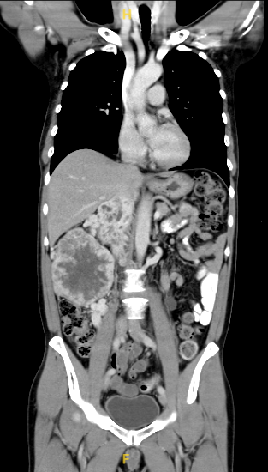
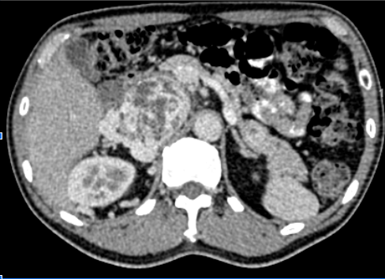
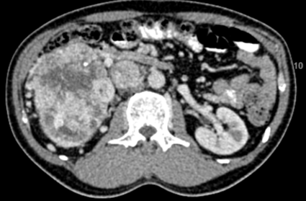
Clinical history
55 / Male
Software engineer
Comorbidities: Diabetes mellitus (diet-controlled)
Family history: Father had a head & neck malignancy (unsure)
Painless hematuria July 2020.
Physical examination: Fit man, ballotable mass right abdomen
CT thorax, abdomen, pelvis Aug 2020
*Discuss images*
*Next step*

Slide 3
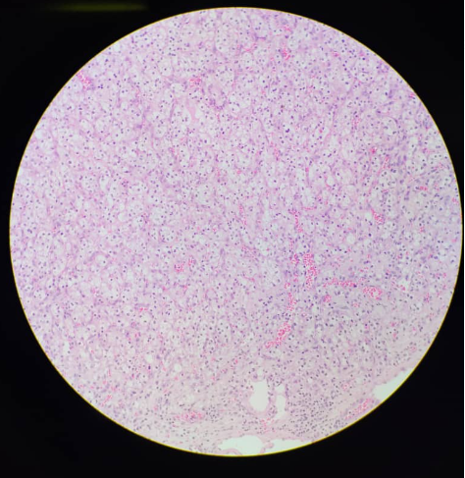
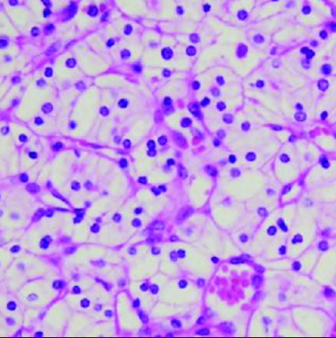
Biopsy
CT guided biopsy 14/08/2020
- Histology: Clear cell renal cell carcinoma
Your next step of management?

Slide 4
Unresectable localized disease
Tumour board meeting Aug 2020: - Locally advanced disease with extensive tumour thrombosis
- Not resectable - For systemic therapy
(IMDC Intermediate risk)
Hb : 11.3 g/L ✅
Neutrophil : 4.9%
Platelet : 389 x 10^9/L
Calcium : 2.3 mmol/L
ECOG : 0
<1 year from diagnosis to start of systemic treatment: ✅
In your practice, what systemic therapy would you offer?
Notes:
Ask experts: What is the role of systemic therapy in locally advanced RCC

Slide 5
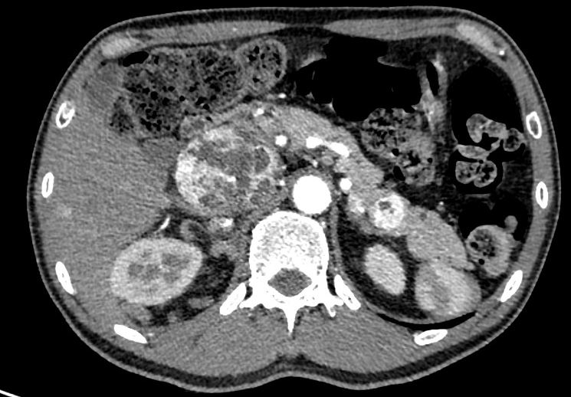
Oligometastatic disease
CT angiography
He was offered systemic treatment but did not start due to financial reasons.
He was monitored while awaiting for a clinical trial.
Follow up, clinically well.
CT 26th October 2020: Stable disease.
CT 25th January 2021: Stable disease.
March 2021
Gross hematuria
CT angiography March 2021: - Stable renal mass - No active arterial bleeding - New pancreatic tail lesion metastasis
Notes:
Tell the story: Bleeding, he was considered for embolization thus a CTA was performed. Incidentally found pancreatic mets.

Slide 6
So far..
55 years old Locally advanced right RCC Oligometastases - pancreas IMDC intermediate risk
May 2021
Started on nivolumab and cabozantinib. - IV nivolumab 240mg -2 weekly - Oral cabozantinib 60mg -alternate days
Note: Recommended cabozantinib dose: 40mg OD
Notes:
Jasmin: Recommended cabozantinib dose: 40mg OD however at the time, we didnt have access to 40mg thus, we used 60mg alternate days Polin: Invite expert to comment on alternate dosing

Slide 7
Tolerability towards treatment
Liver transaminases trend chart
Cabozantinib + nivolumab May 2021 -> Dec 2021
Side effects: G2 hypertension G1 oral ulcers
G1 liver transaminitis
G1 palmar-plantar erythrodysesthesia
Intervention Treatment break 1 week Anti hypertensive medication
LFT | May 2021 | June 2021 | July 2021 | August 2021 | Sept 2021
ALP (45-129 U/L) | 76 | 175 | 216 | 132 | 97
ALT (10-49 U/L) | 21 | 64 | 83 | 61 | 49
AST (<34 U/L) | 19 | 41 | 46 | 38 | 34
GGT (<73U/L) | 53 | 215 | 331 | 177 | 95
Notes:
Invite experts to share their experience with this combo

Slide 8
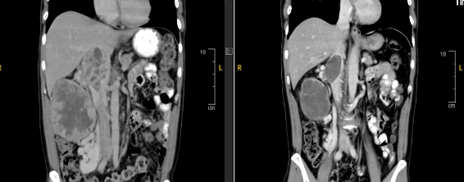
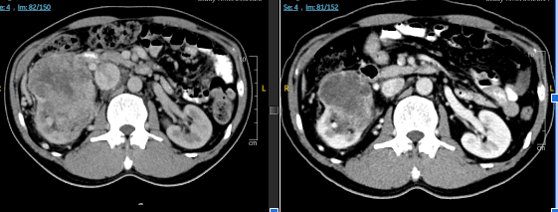
Response to treatment
CT March 2021
CT Aug 2021
Clinical response - Smaller renal mass within 2 weeks of treatment - Continued response until impalpable - No hematuria
Radiological response CT August 2021: - Smaller right renal mass - Smaller pancreatic tail lesion
So far, he had 4 months of nivolumab + cabozantinib
What do we do at this point?
Continue systemic treatment
Cytoreductive nephrectomy
Cytoreductive nephrectomy + metastasectomy

Slide 9
Surgery
Histopathology report
Cabozantinib + nivolumab since May 2021
Tumor board meeting August 2021 - Good tumor response - Likely resectable now He was planned for surgery, but due to the covid-19 pandemic, there were limited OT slots, his surgery scheduled for November 2021.
Continued nivolumab and cabozantinib until November 2021.
CT pre-operation 2nd November 2021: - Marginally smaller right renal mass - Stable pancreatic lesion - No distant disease
January 2022: Right open nephrectomy, IVC thrombectomy and IVC repair, distal pancreatectomy.
Right renal clear cell RCC
Distal pancreas tumour 1 x 1 cm
ypT3NxM1 (pancreatic metastasis)
Notes:
Point: Patient selection for metastatectomy:
- Are there certain patient-related / disease-related criteria ?
- In this case, pancreatic metastasis seem to have better prognosis compared to other sites, is the site of mets reflective on the tumor biology, perhaps more indolent?
If he had a different metastatic site, would surgery also be offered ?

Slide 10
55 years old Oligometastatic RCC Cabozantinib + nivolumab May - Nov 2021 Complete resection Complete remission What is your next step?
- Surveillance
- Continue cabozantinib + nivolumab
- Adjuvant pembrolizumab
Notes:
Invite audience for next step

Slide 11
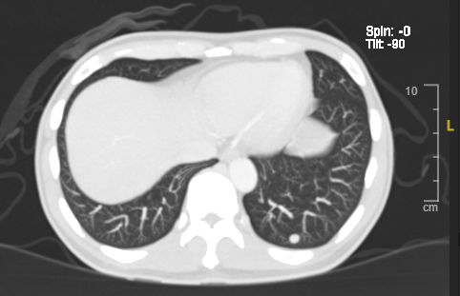
Surveillance
CT March 2022
He was offered - Surveillance - Continue cabozantinib + nivolumab - Adjuvant pembrolizumab
After discussion, opted for surveillance.
March 2022: New left lung solitary metastasis
What would you do now?
Notes:
Invite opinion

Slide 12
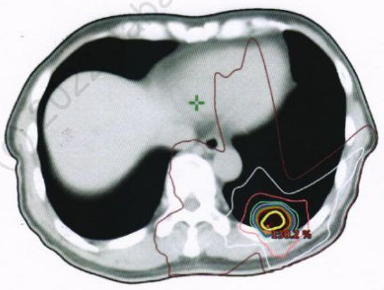
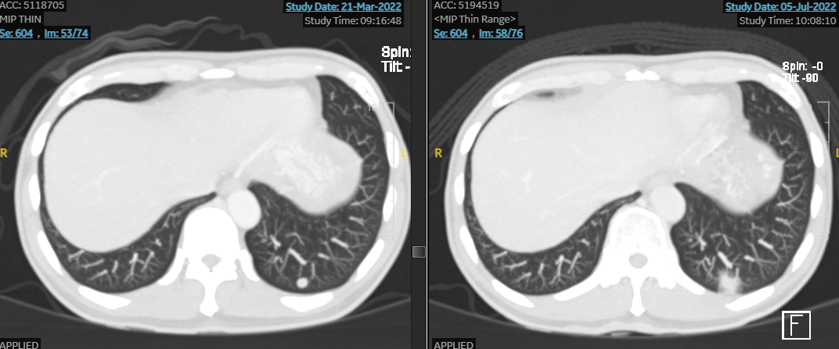
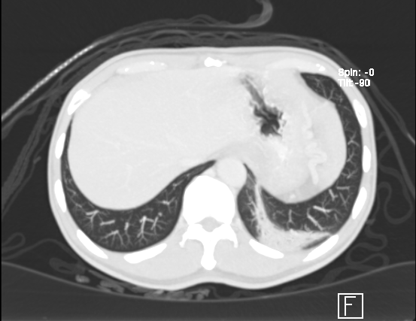
SBRT to lung lesion
Received SBRT to left lung lesion in June 2022 (60Gy/4#)
CT pre SBRT
CT post SBRT
CT 4 months post SBRT
Notes:
No need describe CT - invite audience to describe CT

Slide 13
Adjuvant pembrolizumab
After discussion, he was started on adjuvant pembrolizumab in July 2022.
Remains well, in complete remission.
CT January 2023: Complete response
What is your opinion?
Notes:
Point:
Ask content expert, would they have offered the same thing...
as patient did not quite fit into KN 564 criteria
**we discussed with pt surveillance vs pemrbo
**lack of evidence in this setting
**In the end we decided to proceed with pembro
he has had a few cycles so far and he is tolerating

Slide 14
Timeline summary August 2020 - January 2023
55 yo
IMDC intermediate risk
August 20
March 21
May 21
Jan 22
March 22
June 22
July 22
Jan 23
Initial diagnosis Locally advanced August 2020
Cabozantinib + nivolumab
Lung metastasis
Pembrolizumab
Pancreatic metastasis
Surgery
SBRT lung
Complete remission
OS: 2.5 years from initial diagnosis
Notes:
GLide through presentation

Slide 15
Interesting discussion points
Systemic treatment in locally advanced RCC
Alternative cabozantinib dosing
Therapy-related side effects
Role of surgery to primary and metastasectomy
Adjuvant therapy post metastasectomy
Local therapy to solitary metastasis

