Slide 1
Master’s Research Project: From Inception to Publication
Dr Sum Ying Ying
Clinical Oncologist
Hospital Pulau Pinang

Slide 2
Presentation Outline
Research Question
Logical flow in Research Introduction, Objectives & Methodology
Research Proposal Write up
Ethics Submission
Data Collection
Data Analysis
Manuscript Submission
Publication

Slide 3
What is Research?
Systematic investigation into materials and sources in order to establish facts and reach new conclusions (Oxford English Dictionary, 11th edition)
“...original investigation undertaken in order to gain knowledge & understanding.” (The Robert Gordon University, Scotland, UK)
“…organized and systematic way of finding answers to questions.” (College of Humanities, Brigham Young University, Utah, USA)

Slide 4
Logic of Research
…organized and systematic way of finding answers to questions
Research starts with QUESTIONS

Slide 5
Starting point is “Research Question”
It must be “worth to answer”
It should contribute to knowledge body
It should have considerable benefit to mankind
Research Question
Feasibility
Researcher - responsible to justify

Slide 6
Research Methodology
Systematic way
Organised way
Scientific way
INVESTIGATIONS
RESEARCH METHODOLOGY

Slide 7
Introduction
Introduction
Justify why the study is important
Objectives
Methods
Magnitude of problems
Gap
Benefits

Slide 8
Objectives
Introduction
Objectives
Specify the area/scope of the study .
Methods
General Objectives
Statement in general terms for the overall scope of the study (scope clear but actions not specific: to study, to explore, to investigate)
Specific Objectives
Specific action (to estimate, to determine, to identify, to compare, to assess…)

Slide 9
Methodology
Introduction
Objectives
Methods
Materials and Methods
Study Design
Population and Sample
Data Collection Procedures
Statistical Analysis
Ethical Considerations

Slide 10
Requirements
Trainees are required to attend the following courses preferably no later than year 3 of training:
(i) Research methodology course
(ii) SPSS/STATA course
(iii) Scientific writing course
(iv) Good clinical practice (GCP) course
**Endnote

Slide 11
Anatomy of Research Proposal
Title
Abstract
Table of Content
Background
Literature Review
Objectives
Methodology
List of References
List of Appendices (Patient information sheet, consent form)
Funding

Slide 12
Research Proposal Write up

Slide 13
Ethics Submission
What you need to prepare:
Study Protocol
Patient Information Sheet
Consent Form
Investigator’s CV/GCP

Slide 14
Ethics Committee Meeting

Slide 15
Research Proposal Write up

Slide 16
Ethics Approval

Slide 17
Data Collection

Slide 18
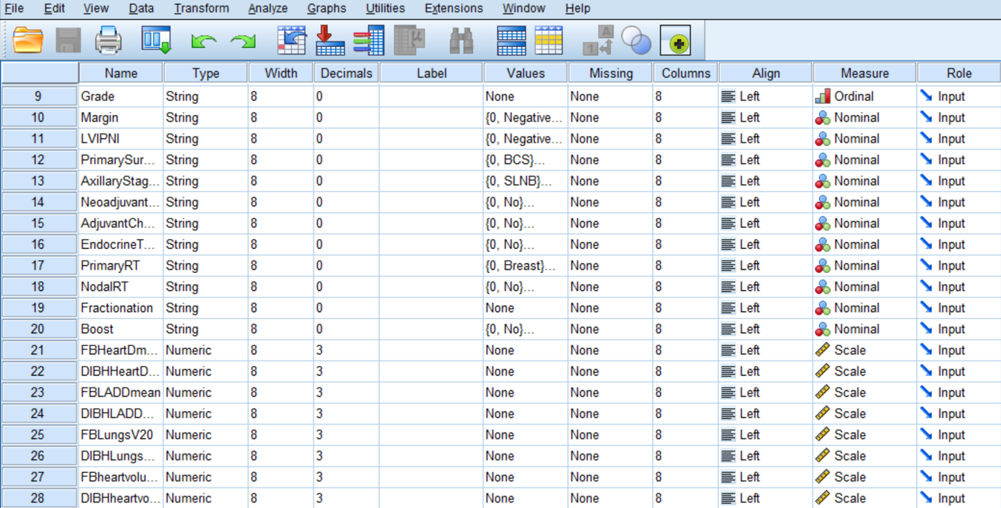
Data Analysis

Slide 19
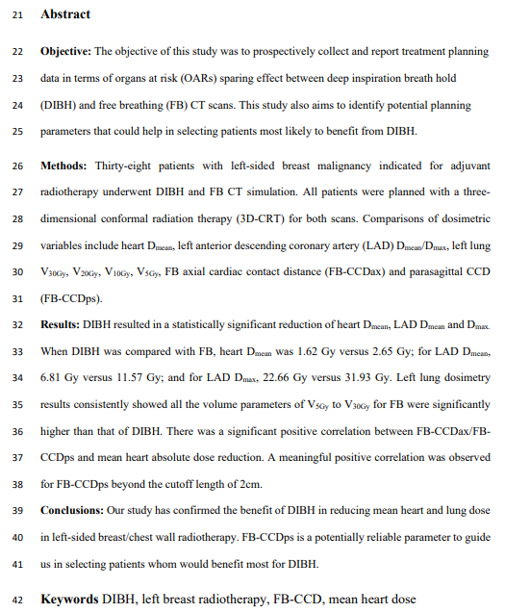
Manuscript Write Up

Slide 20
Manuscript Submission (Internal Review)
Research paper must be assessed by 2 internal reviewers appointed by Dept. of Clinical Oncology, UMMC and only upon recommendation by the internal reviewers can the paper be submitted to a journal for publication

Slide 21
Final date of Submission of Journal Article for Internal Review

Slide 22
Internal Review Report

Slide 23
Manuscript Submission
Research paper must be published in at least a scopus indexed journal though publication in an ISI journal is highly encouraged and should be considered first before submitting to a scopus journal

Slide 24
How to choose a Scopus Indexed Journal

Slide 28
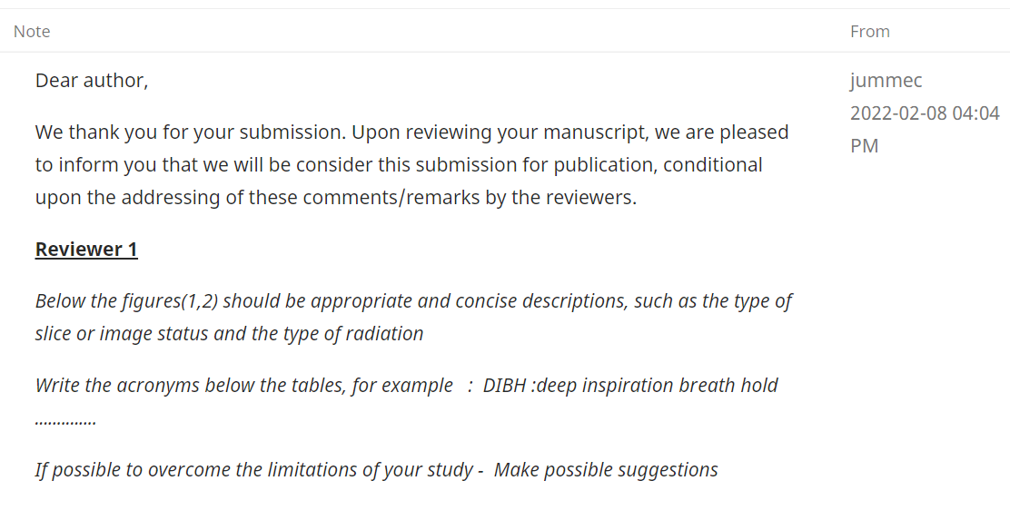
Manuscript Submission and Review

Slide 29
Correction Statements

Slide 30
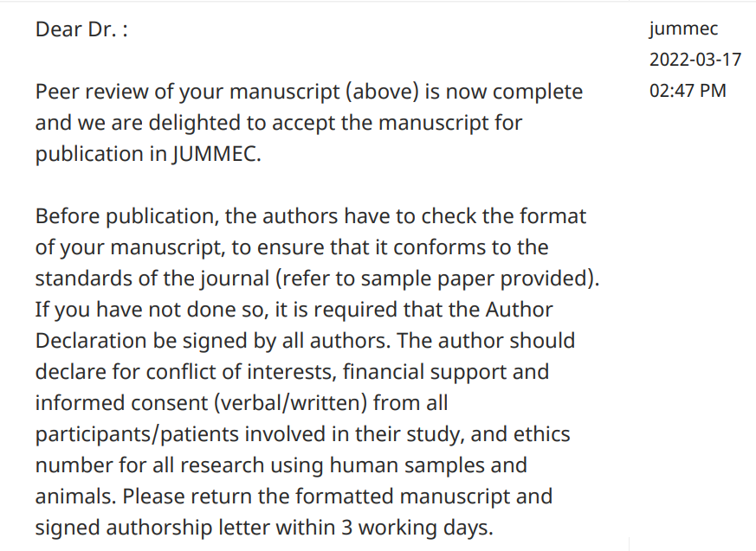
Acceptance for Publication

Slide 31
Proof of acceptance by the journal is sufficient as proof of publication. This proof of acceptance and a copy of the research paper plus research report must be submitted for Final Examination

Slide 32
Final date of Submission of Research Project prior to Final Examination

Slide 33
Final Product

Slide 34
Timeline
Manuscript Write up & Submission
January 2019
Ethics Approval
April 2019
Data Collection
June 2019 to March 2020
Data Analysis & Manuscript Write up
April 2020 to October 2021
Manuscript Submission
November 2021 (Internal Review)
January 2022 (Journal)
Acceptance for Publication
March 2022

Slide 35
Master of Clinical Oncology Research Project Flow Chart

Slide 36
Important deadline

Slide 37
Thank you and All the best!

