Slide 1
Prostate Radiotherapy
Sandya Subramaniam

Slide 2
Why is Prostate RT Important?

Slide 3
National Cancer Registry Malaysia 2012-2016

Slide 4
National Cancer Registry Malaysia 2012-2016

Slide 5
Importance of excellence in RT delivery
About 1000 cases per year, approximately half will receive Prostate RT
Only 30-40% will progress to metastatic disease
Insidious onset and progression
Most men with Prostate cancer will live long, fruitful lives and die from reasons other than prostate cancer
Therefore, they can and will experience LATE radiation side effects

Slide 6
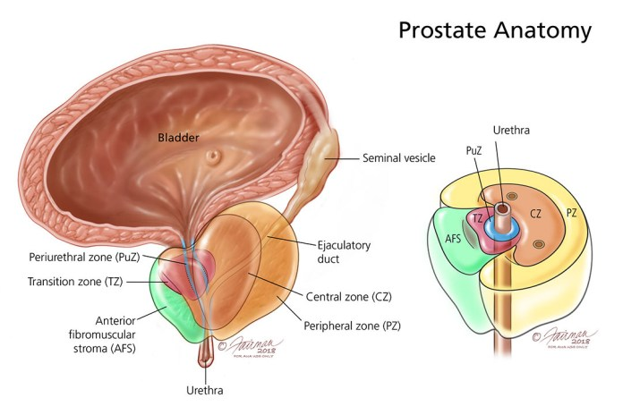
Anatomy

Slide 7
Aetiology

Slide 8
Family history/Hereditary Prostate cancer
Earlier disease onset
DNA Damage repair gene mutation eg BRCA1/2, ATM
Lynch Syndrome

Slide 10
Associated Risk Factors
Metabolic Syndrome
Dietary factors
Hormonally active medication eg testosterone
Infection/Chronic Inflammation
History of radiotherapy

Slide 11
Presentation

Slide 12
LUTS
Dysuria
Frequency
Nocturia
Incontinence
Decreased urinary stream
Hematuria
Bone pain
Constitutional symptoms

Slide 13
How do we proceed?

Slide 15
MPMRI

Slide 16
Multiparametric MRI
Diagnosis
Localisation
Risk Stratification
Staging

Slide 17
Imaging Technique
T2w + ≥2 functional techniques
T1 – limited use (to identify post biopsy haemorrhage)
Bowel artefacts reduced with anti peristaltic or endorectal coil
Usually contrast enhanced

Slide 18
Functional Techniques
T2w
Diffusion weighted (DWI)
Perfusion – Dynamic contrast enhanced (DCE)
Spectroscopy (MRIS)

Slide 19
T2w
Provides high spatial anatomy
Defines zones, SV, neurovascular bundles
Dominant sequence to detect transitional zone tumours

Slide 20
DWI
Functioning imaging that measures the motion of water molecules in tissue enabling calculation of Apparent Diffusion Coefficient (ADC)
Can help identify tumour from benign abnormalities (fibrosis, prostatitis, scar tissue, haemorrhage, post radiation changes)
Dominant sequence to detect peripheral zone tumours

Slide 21
DCE
Fast based T1w sequences pre, during and post Gadolinium
Assesses tumour angiogenesis – early and high amplitude enhancement followed by washout
Usually used as an adjunct to T2w/DWI
Dominant sequence to detect recurrence following therapy

Slide 22
PIRADS
Prostate Imaging Reporting and Data System
Reporting scheme for mpMRI in the evaluation of suspected prostate cancer
Each lesion can be scored 1-5 on DWI and on T2W, as well as by the absence or presence of dynamic contrast enhancement.
For the transition zone, the PI-RADS assessment is primarily determined by the T2W score and sometimes modified by the DWI score.
For the peripheral zone, the PI-RADS assessment is primarily determined by the DWI score and sometimes modified by the presence of dynamic contrast enhancement.

Slide 23
Each lesion is assigned a score from 1 to 5 indicating the likelihood of clinically significant cancer:
PI-RADS 1: very low (clinically significant cancer is highly unlikely to be present)
PI-RADS 2: low (clinically significant cancer is unlikely to be present)
PI-RADS 3: intermediate (the presence of clinically significant cancer is equivocal)
PI-RADS 4: high (clinically significant cancer is likely to be present)
PI-RADS 5: very high (clinically significant cancer is highly likely to be present)
PI-RADS X: component of exam technically inadequate or not performed

Slide 24
MRI Anatomy of Prostate Gland
Peripheral Zone
Thin layer of homogenous high T2 signal intensity
Transitional Zone
Heterogenous intermediate signal intensities
Central Zone
Surrounds ejaculatory ducts, low T2 signal intensity
Anterior Fibromuscular Stroma
Contiguous with detrusor muscle fibres and external urethral sphincter, low T2 signal intensity

Slide 25
Seminal Vesicles

Slide 26
Urethra

Slide 27
Penile Bulb

Slide 29
Peripheral Zone
70-75% of tumours
Best evaluated by DWI, in conjunction with T2w and DCE
DWI – hyperintense
ADC – hypotintense
DCE – early and intense enhancement

Slide 31
Transitional Zone
Primarily evaluated by T2w, with DCE and DWI confirmation
T2w – hypointense
DWI – hyperintense
ADC – hypointense
DCE – early and intense enhancement

Slide 35
Extraprostatic extension
Bulging prostatic contour
Irregular/spiculated margin
Obliteration of retroprostatic angle
Tumour-capsule interface >1cm
Breach of capsule with direct tumour extension or bladder wall invasion

Slide 36
Neurovascular bundle Invasion

Slide 37
Seminal Vesicle Involvement
Low T2 signal intensity
Restricted diffusion
Abnormal contrast enhancement
Obliteration of angle between base of prostate and SV
Direct tumour extension from prostate to SV

Slide 38
Staging & Classification

Slide 39
Gleason Score – Grade/Differentiation
The Gleason score is determined by adding the two most common grades. For example, the most common grade of the cells in a tissue sample may be grade 3 cells, followed by grade 4 cells. The Gleason score for this sample would be 7 (3+4)

Slide 41
ISUP Grade Group

Slide 43
Staging
PSMA PET
proPSMA trial; 302 patients were randomly assigned to conventional imaging with CT and bone scintigraphy or 68Ga-PSMA-11 PET/CT.
Accuracy of 68Ga-PSMA PET/CT was 27% higher than that of CT and bone scintigraphy
Conventional imaging had a lower sensitivity (38% vs 85%) and specificity (91%vs. 98%) than PSMA PET/CT.

Slide 44
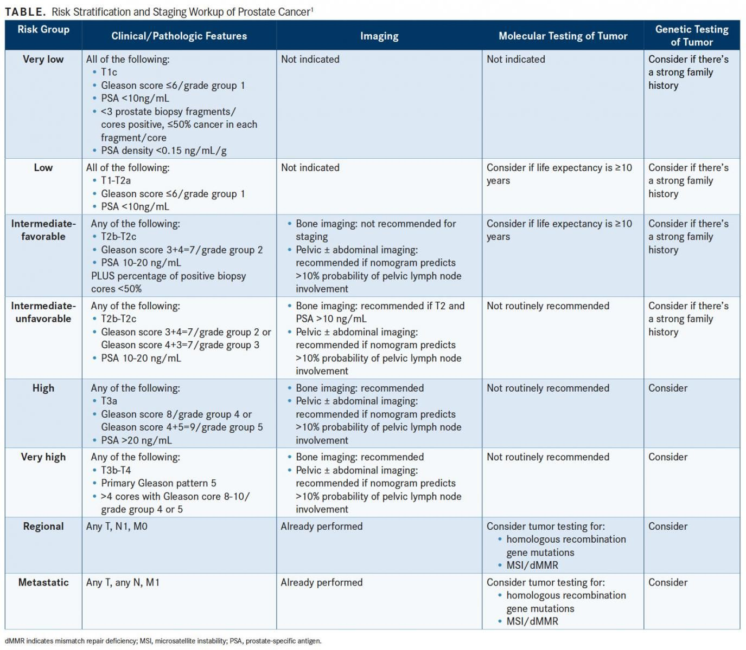

Slide 45
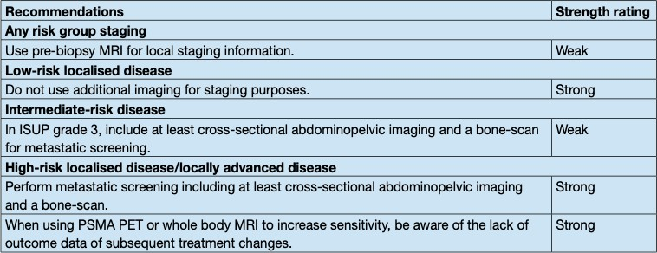

Slide 47
Low Risk

Slide 48
Intermediate/High Risk

Slide 49
Prostate Radiotherapy

Slide 50
Indications
Localised/Locally advanced Prostate cancer
Low Volume MHSPC
Bleeding/Pain etc

Slide 51
IMRT vs 3D
IMRT/VMAT + IGRT is the SOC
Allows dose escalation
Reduced GI & GU toxicity
Improved PSA RFS

Slide 52
Dose escalation
At least 74Gy improves
BCR
DFS
Disease specific mortality
Late toxicities ≥G3
GU 2-5%
GI 2-3%

Slide 53
GETUG AFU 18
Phase 3 RCT
505 patients with high risk PC 2009-2013
cT3-4, or
GS 8-10, or
PSA ≥ 20
Negative LN on CT/MRI
Randomized to RT 80Gy vs 70Gy
All received ADT x 3 years
All received pelvic node irradiation (46Gy)

Slide 54
5 year PFS 91.4% vs 88.1%, 10 year PFS 83.6% vs 72.2% HR 0.56, CI 0.4-0.76, p= 0.0005
5 year OS 93.4% vs 88.7%, 10 year SS 77% vs 65.9% HR 0.61, CI 0.44-0.85, p= 0.0039

Slide 55
No difference in late toxicities or QoL

Slide 56
Hypofractionation
Rationale – slowly proliferating cells are more susceptible to higher dose per fraction
Moderate hypofractionation – 2.5-3.4 Gy/#
Ultra hypofractionation - >3.4Gy/#

Slide 57
Moderate Hypofractionation
CHHiP
Predominantly intermediate, n=3216
74Gy/37# vs 60Gy/20# vs 57Gy/19#
60Gy/20# not inferior biochemical and clinical failure
PROFIT
Intermediate risk, n=1206
78Gy/39# vs 60Gy/20#
Non inferior biochemical failure
RTOG 0415
Low risk, n=1115
73.8Gy/41# vs 70Gy/28#
Non inferior DFS
HYPRO
Predominantly high risk, n=820
78Gy/39# vs 64.6Gy/19#/6.5 weeks (EOD)
Non inferior RFS

Slide 58
UltraHypoFractionation

Slide 59
HYPO-RT-PC
N=1200
42.7Gy/7# (EOD) vs 78Gy/39#
5 year FFS 84% in both groups
Acute ≥ G2 GU toxicity 28% vs 23%, p 0.057
Late toxicities same

Slide 60
PACE B
N=874
36.25Gy/5# (EOD) vs CRT (78Gy/39# or 62Gy/20#)
Acute ≥G2
GU 3% vs 2% (p=0.39)
GI 6% vs 3% (p=0.32)
No G4 events

Slide 61
Metaanalysis – Red Journal 2020 (Jackson)
N= 6116 pts across 38 trials
92% included low risk, 78% int risk, 38% high risk
Median follow up 39 months
5 year BRFS 95.3%
Late >G3 toxicities:
GU 2%
GI 1.1%

Slide 62
Intact Prostate

Slide 63
Simulation
Supine
Arms on chest
Hipfix/Vaclok, Knee rest, ankle part
No contrast (use contrast if treating Pelvic LN)
Pelvic Protocol
Fuse with planning MRI (ensure no endorectal coil used)

Slide 64
Bladder
250-300cc water 30 mins prior (comfortably full)
Rectum
Empty
Supp Dulcolax x 5 days prior and/or enema 2 days prior to sim and RT
Low residue diet
Aim for max AP diameter 4cm, measured at mid point of prostate

Slide 65
Assessment of Rectum for Prostate RT

Slide 66
Low Fibre, Low Residue Diet
Foods that will limit (not eliminate) the residue in the colon
Smooth in texture
Mechanically and chemically non irritating
Includes adequate fluids

Slide 68
HKL Rectal/Bladder Protocol

Slide 69
Organs At Risk

Slide 70
Bladder
Rectum
Femoral Heads
Penile Bulb
Bowel
Urethra

Slide 71
Bladder
Solid structure including the bladder wall and lumen

Slide 72
Rectum
From anus (at the level of ischial tuberosities) to rectosigmoid flexure/junction, includes lumen and rectal wall

Slide 73
Femoral Heads
-Proximal Femur
Lower level of ischial tuberosities to top of the ball of femur, including trochanters

Slide 74
Penile Bulb
Portion of bulbous spongiosum that lies inferior to urogenital diaphragm
Usually at the level of base of penis
Do not include shaft/pendulous portion of penis

Slide 75
Bowel
Above rectum, within 2-5cm of PTV
May be contoured as bowel bag

Slide 76
Target Volumes

Slide 77
Prostate
Start 1 slice above urogenital diaphragm or penile bulb (easier to visualize on CT/MRI)
Avoid obturator internus and levator ani muscles
Contour up to base of prostate

Slide 78
Seminal Vesicles
In continuity with base of prostate

Slide 79
Node Negative PCa

Slide 81
PTV3625
CTVpsv= Prostate + 1cm of SV
1cm SV
1. Grow Prostate by 1cm, isotropically
2. Boolean Prostate + SV
3. Crop 2 that is extending out of 1

Slide 83
Plan Evaluation

Slide 84
CTV4000

Slide 85
OAR Constraints

Slide 86
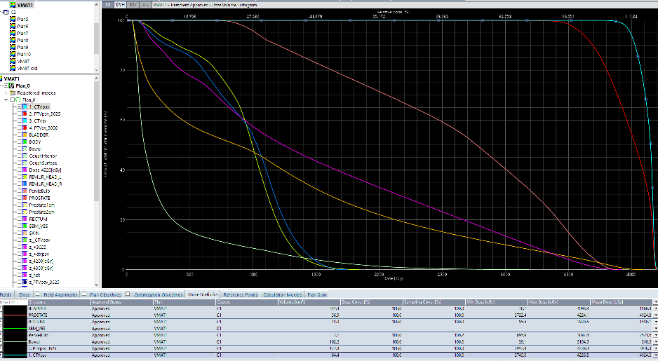

Slide 87
Node positive PCa

Slide 89
Moderate Hypo# 60Gy/20#
CTVp= Prostate + SV (whole or 1cm base)
PTVp6000= CTVp + margin
CTVn= Elective Pelvic LN (Contour as per PIVOTAL)
PTVn4400= CTVn + margin
CTVboost= gross LN (after 3-6 months ADT)
PTVboost5200-5400 (EQD2 60Gy) = CTVboost + margin

Slide 90
PIVOTAL LN Contouring

Slide 92
NRG Oncology Contouring Guidelines for PLN
Superior | Bifurcation of aorta into common iliac, or proximal inferior vena cava to common iliac, whichever is more superior (typically L4/5)
Inferior | Stop ext iliac at top of femoral heads (bony landmark for inguinal ligament)
Vascular expansion | 5-7mm
Structures edited out | Bone, bowel, bladder, muscle
Int-Ext Iliac | Width of interspace 1.5-3cm
Presacral | Include prevertebral, presacral and post mesorectal til base of S3
Internal Iliac | Post border extends to ant edge of piriformis following course of pudendal and inferior gluteal artery
Obturator | 1-2cm extending to post edge of obturator internus, ending where seminal vesicles join prostate

Slide 95
Prostate Bed Radiotherapy

Slide 96
Artistic Metaanalysis
N=2153 – RADICALS-RT, GETUG AFU17, RAVES
Inclusion –
T3/4
R1
Adjuvant vs Early Salvage RT
EFS 88% vs 89%
In SRT arm, only 30% received treatment
N+?

Slide 97
Adjuvant RT

Slide 98
pN+

Slide 99
Early Salvage RT – Risk Stratification BCR
Low risk
PSADT >1 year
ISUP <4
High Risk
PSADT <1 year
ISUP 4-5

Slide 100
SRT + ADT
RTOG 9601
Bicalutamide 150mg OD x 2 years
OS 76.3% vs 71.3%, HR 0.77, p=0.04
GETUG-AFU 16
Goserelin 10.8mg 3 monthly x 2 (total duration 6 months)
5 yr BPFS 80% vs 62%, HR 0.5, p<0.001
SPPORT
PBRT alone vs PBRT + ADT x 6 months vs PBRT + PLNRT + ADT x 6 months
FFP 70.9% vs 81.3% vs 87.4%

Slide 101
DADSPORT Metaanalysis
4 trials, 4452 patients
No improvement in OS with hormonal therapy

Slide 102
Salvage RT

Slide 103
EAU Guidelines 2023
A negative PET/CT scan should not delay salvage radiotherapy (SRT), if otherwise indicated.
Strong

Slide 104
Contouring of CTV (Prostate Bed)
EORTC
FROGG-RANZCR
Princess Margaret Hospital
RTOG
GFRU

Slide 105
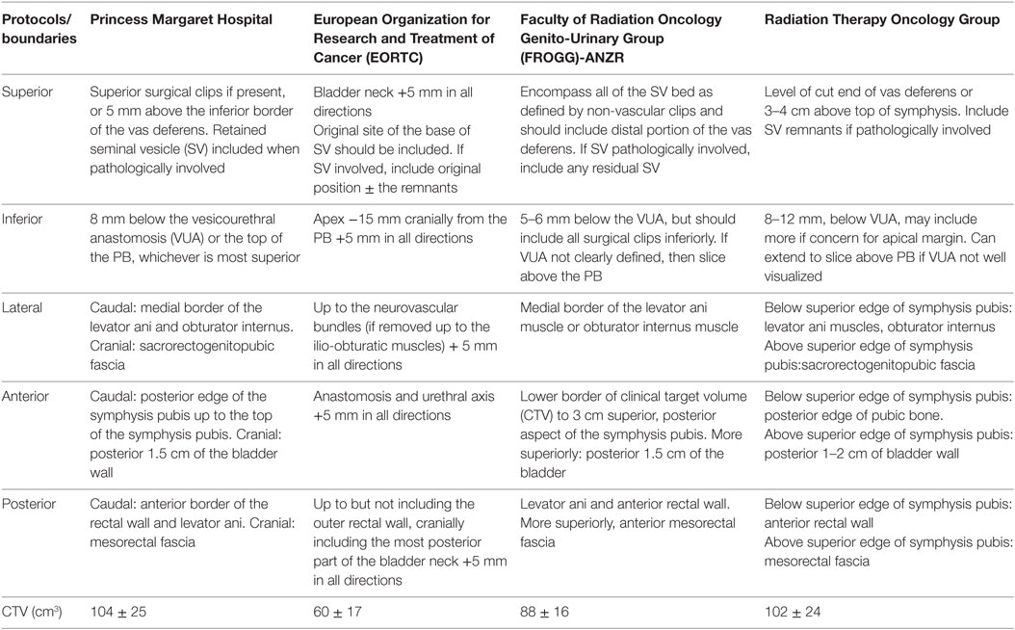

Slide 106
RTOG Contouring of Prostate Bed

Slide 107
GFRU Contouring of Prostate Bed

Slide 108
EORTC/ACROP 2023

Slide 109
Prostate Bed

Slide 110
Inferior border
VUA = slice below last slice where urine is seen in bladder
CTV starts 8-12mm below VUA
If VUA not identifiable, CTV starts on slice above penile bulb

Slide 111
Anterior border
Cranially:
-at level of SV bed, cover posterior 1-2cm bladder
Caudally:
-stop at posterior margin of pubic bone up to ½ or 2/3 of symphysis pubis

Slide 112
Posterior border
Stop at anterior rectal wall/mesorectal fascia if clearly visualized
Include surgical clips

Slide 113
Lateral border
Internal margin of internal obturator muscle (cranially) and levator ani muscle (caudally)

Slide 114
Superior border
Include a bridge of 3-5mm between SV bed
Include surgical clips

Slide 116
Metastatic Pca – Low Volume

Slide 117
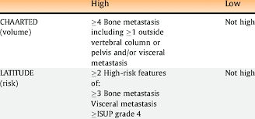

Slide 118
STAMPEDE – Synchronous Low Volume Mets
N=2061
SOC +/- RT
55Gy/20#/4 weeks (52%)
36Gy/6#/6 weeks (48%)
42% LV, 58% HV
N+ 64%

Slide 119
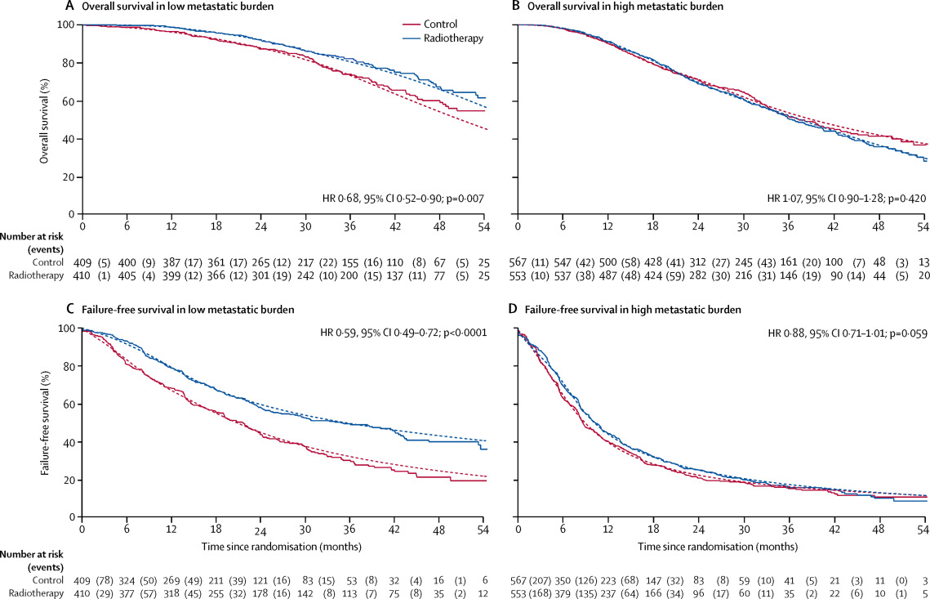

Slide 120
PEACE-1

Slide 125
3D (3-6F) or IMRT/VMAT
CTV = Prostate alone
PTV = 0.8cm post, others 1cm

Slide 126
Prostate RT

Slide 127
PTV V100% >95%

Slide 128
Verification

Slide 129
Why do we need geometric verification
Target delineation error
Setup uncertainty
Target position variation/organ motion
Interfraction
Intrafraction

Slide 130
Setup inaccuracies or errors can be divided into two categories:
Systemic set up error: a deviation that occurs in the same direction and is of similar magnitude for each fraction throughout the treatment time
Random set up error: a deviation that can vary in direction and magnitude for each delivered treatment fraction

Slide 131
Definition
X: Right-Left
Positive: Right
Negative: Left
Y: Superior-Inferior
Positive: Superior
Negative: Inferior
Z: Anterior-Posterior
Positive: Anterior
Negative: Posterior

Slide 132
OBI

Slide 133
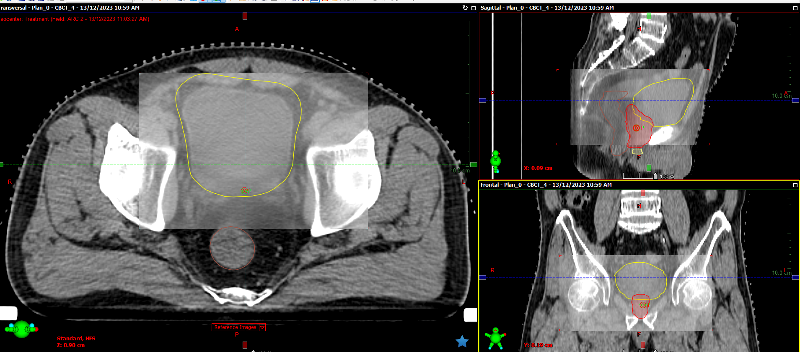
CBCT

Slide 134
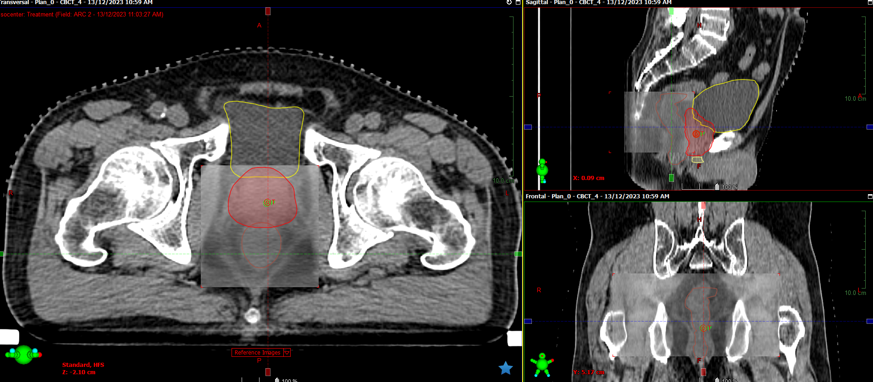

Slide 135
For all Prostate VMAT/IMRT – Daily OBI and CBCT
Aim
Match bony landmarks (OBI)
Match soft tissue:
Prostate – size, volume, location
Bladder filling
Empty rectum
Remember, aim is not to achieve the best but the same as simulation

Slide 136
Acknowledgement
Dr Muthukkumaran Thiagarajan
SBRT Protocol for HKL

Slide 137
Thank you

