Slide 1

Dental Care in Oncology Patients – Oncologists’ Perspective
Nisha Shariff | University Malaya Medical Centre
11 July 2023

Slide 2
Outline
Patient population
Treatment related bone loss
Adjuvant bisphosphonates in breast cancer
Bone metastases
Radiation therapy considerations

Slide 3
Patient population
Breast cancer patients
  On hormonal therapy (aromatase inhibitors)
  On adjuvant bisphosphonates (post menopausal)
  Ovarian function suppression (pre menopausal)
Cancer patients with bone metastases on bone targeting agents (to reduce skeletal related events)
Head and neck cancer patients undergoing radiotherapy

Slide 4
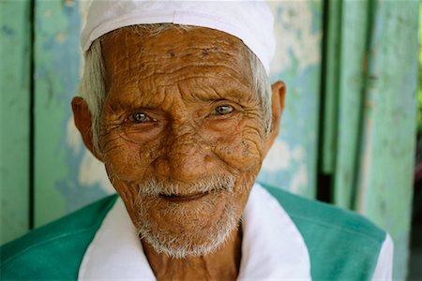





Slide 5
Treatment Induced Bone Loss

Slide 6
What is Osteoporosis
Osteoporosis: low bone mass and microarchitectural deterioration in the structural integrity of bone tissue resulting in high risk of fracture
Risk factors for osteoporosis:
  Age
  Hypogonadism
  Cigarette smoking/Alcohol consumption
  Impair mobility
  Low body weight
  Long term glucocorticoids
  Post menopausal
J Clin Oncol. 2022 Mar 1;40(7):787-800. doi: 10.1200/JCO.21.02647.

Slide 7
Treatments That Induce Bone Loss
Aromatase inhibitors 6%
Anti-androgens
Gonadotrophin Releasing Hormone Analogue
Chemotherapy induced ovarian failure
Letrozole, Anastrozole, Exemestane
Bicalutamide
Leuprorelin, Triptorelin
30-80% amenorrhoea
J Clin Oncol. 2022 Mar 1;40(7):787-800. doi: 10.1200/JCO.21.02647.
Eur J Cancer. 2021 Jul;152:193-203. doi: 10.1016/j.ejca.2021.04.038

Slide 8
Risk of Osteoporotic fractures
Bone mineral density score: T score of -2.5 or less
  ESMO recommendations ≤-2 or ≥2 risk factors for fracture
Risk assessment tools: US-adapted FRAX tool
  10 year probability of ≥20% for major osteoporotic fractures or ≥3% for hip fractures
Bone modifying agents are offered to reduce the risk of fracture
  Oral bisphosphonates: Alendronate, Risendronate, Ibandronate
  Intravenous bisphosphonate (zoledronic acid) 4mg 6 monthly
  Subcutaneous denosumab 60mg 6 monthly
J Clin Oncol. 2022 Mar 1;40(7):787-800. doi: 10.1200/JCO.21.02647.

Slide 9
Adjuvant Bisphosphonate in
Post Menopausal Breast Cancer

Slide 10
Bisphosphonate in early breast cancer are recommended for women with low estrogen status (high risk of recurrence)
  Not SC denosumab
Leads to prolongation of disease free survival and breast cancer specific survival and reduction in bone recurrence
  EBCTCG 2015 meta-analysis
  HR for bone recurrence 0.83 (0.73-0.92, 2p=0.004)
Ann Oncol. 2019;30(8):1194-1220.
Ann Oncol. 2020 Dec;31(12):1650-1663. doi: 10.1016/j.annonc.2020.07.019

Slide 11
Bone Metastases

Slide 12
Bone targeting agents are recommended for patients with metastases regardless of symptoms
Bone targeting agent reduce risk of skeletal related events
  IV zoledronic acid
  SC denosumab
Ann Oncol. 2021 Dec;32(12):1475-1495. doi: 10.1016/j.annonc.2021.09.019
J Natl Cancer Inst 2002;94:1458–68
Lancet 2011;377:813–22.

Slide 13
Toxicity of Bone Targeting Agents

Slide 14
Hypocalcaemia
12.4% with denosumab
5.3% with bisphosphonates
Osteonecrosis
2% in first year
Risk increases with duration
Nephrotoxicity
Higher with denosumab than bisphosphonates
Recommendation for 2 years then reassess
Risk with bisphosphonates
Given with calcium and vitamin D supplements
Renal dose adjustment
Curr Oncol. 2020 Aug;27(4):220-224. doi: 10.3747/co.27.6631

Slide 15
Radiotherapy in
Head and neck cancers

Slide 16
Indication for Radiotherapy
Radical as the primary treatment:
  Nasopharynx cancer
  Locally advanced oral cavity cancers
  Oropharynx cancer
  (Larynx cancers) – for larynx preservation
Adjuvant:
  Locally advanced tumours
  High risk features
Palliative:
  Pain
  Bleeding
  Obstruction

Slide 17
Who needs post op radiotherapy?
Adjuvant radiotherapy
  T3/T4 tumours
  Lymph node positive
  Extracapsular extension
  Close or positive surgical margins
  Lympho-vascular or perineural invasion
  High grade tumour
Bernier et al. NEJM 2004.; Cooper et al. NEJM 2004.

Slide 18
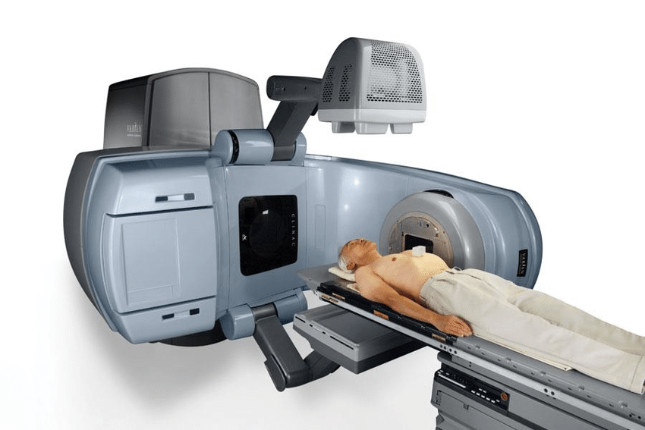
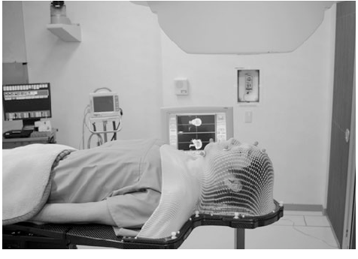
Prescription dose of radiotherapy
Treatment Intent | Radical | Adjuvant | Adjuvant
Risk | - | High risk | Intermediate-Low
Dose | 70Gy | 60-66Gy | 54-60Gy
Radiation prescribed in units of grays (Gy)
www.varian.com
Journal of neuro-oncology. 98. 213-9. 10.1007/s11060-010-0179-8.

Slide 19
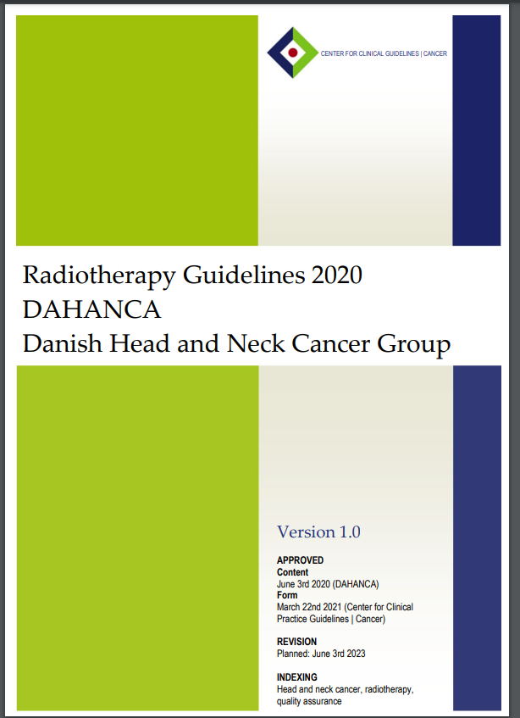
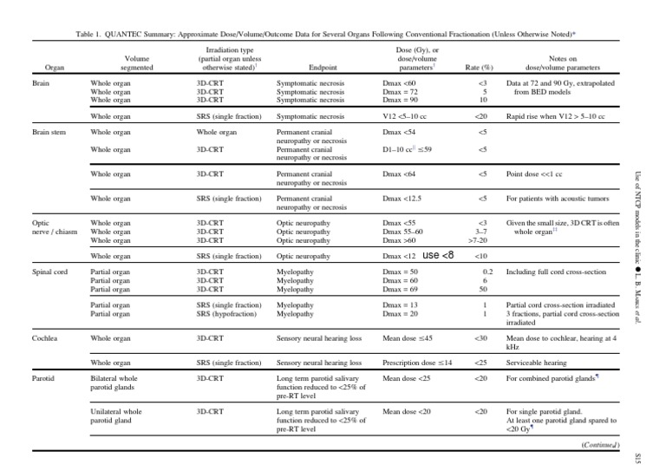
How much radiation is safe?
Structure | Dose | Endpoint
Mandible | Dmax≤72Gy | Osteonecrosis
Oral cavity | Dmean ≤30Gy | Xerostomia and mucositis
Parotid gland | Dmean ≤26Gy | Xerostomia
Guidelines:
DAHANCA Radiotherapy Guidelines
Radiotherapy tolerance tables
QUANTEC tolerance tables
PENTAC (paediatrics)
Emami et al
DOI: 10.1016/0360-3016(91)90171-y

Slide 20
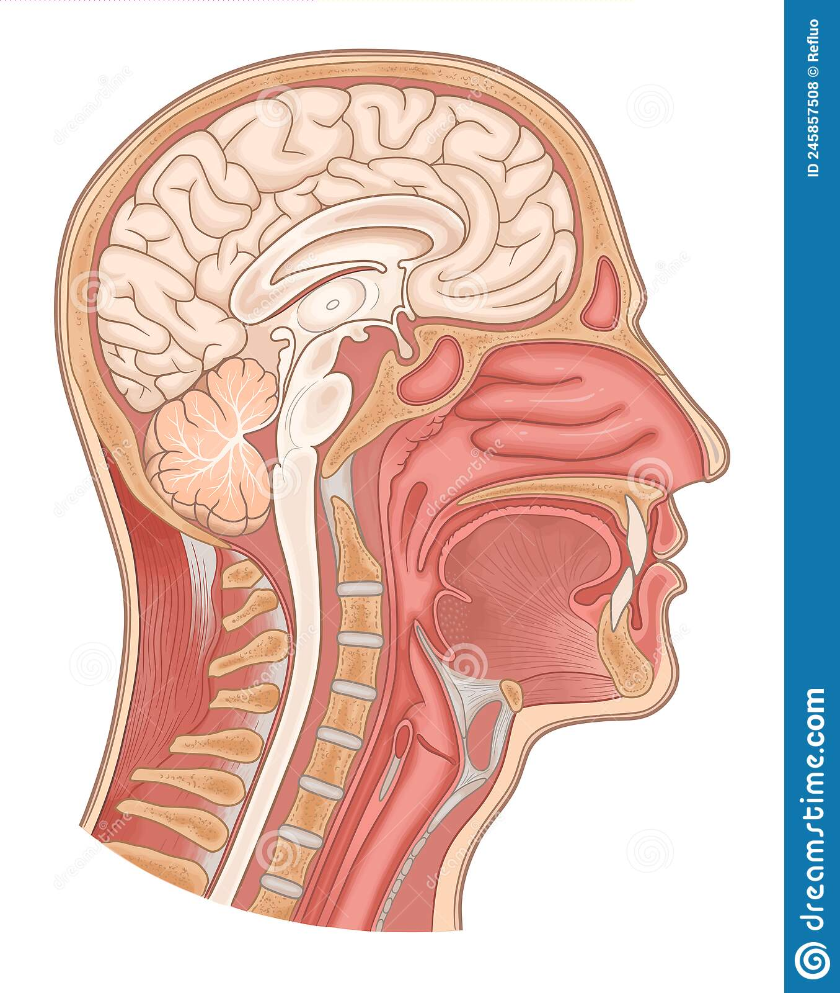
Toxicity is Geographical
Pituitary failure
Typical radiation field for nasopharynx cancer
Brainstem necrosis
Mucositis, xerostomia, loss of taste
Cord myelopathy
Osteonecrosis
Laryngitis, aspiration
Skin desquamation/fibrosis
Dysphagia

Slide 21
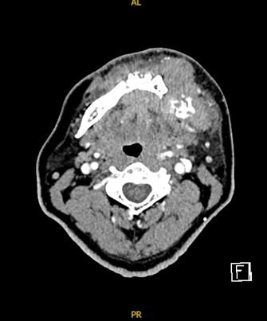
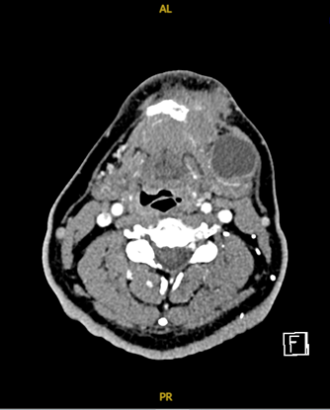
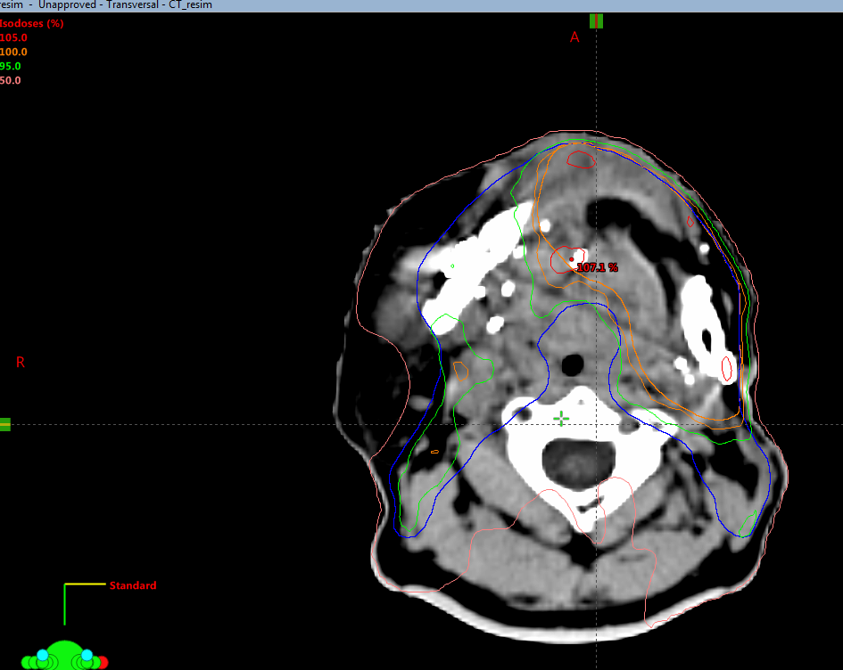
Mandible SCC pT4N3 66Gy/33#/6.5 weeks
Postop RT plan
Preop

Slide 22
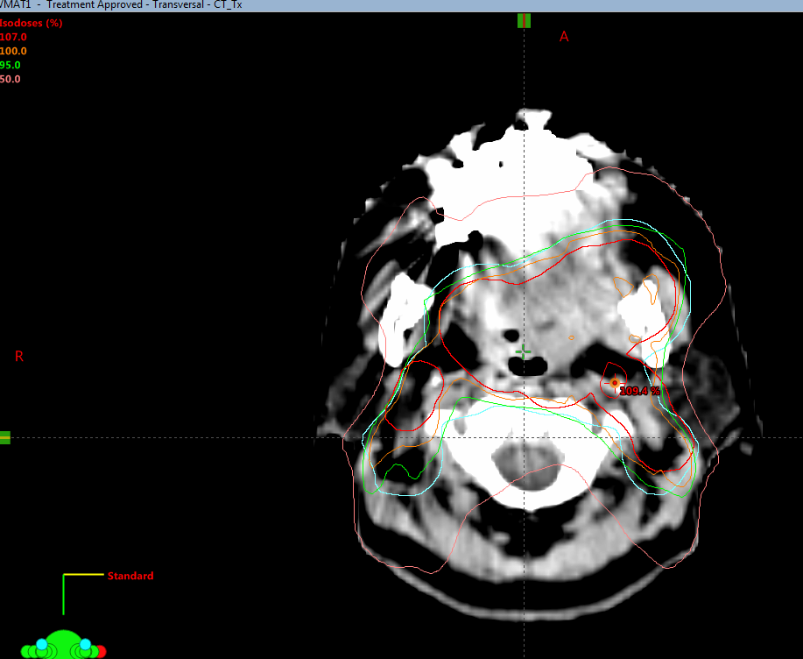
Oropharynx SCC cT4N2 RT 70Gy/35#/7 weeks
Radical RT plan
107% = 74.9Gy
100% = 70Gy
95% = 66.5Gy
50% = 35Gy
High dose region – mandible, teeth (more on left)

Slide 23
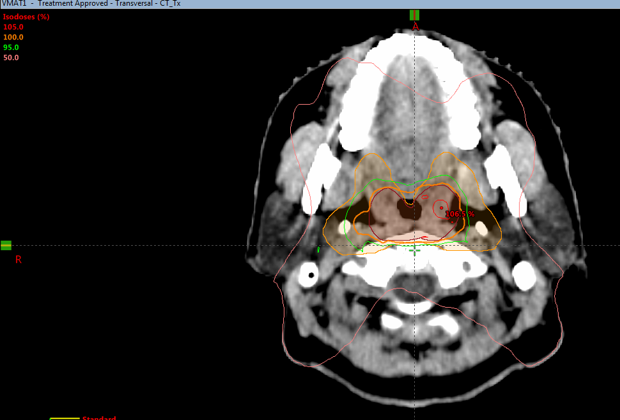
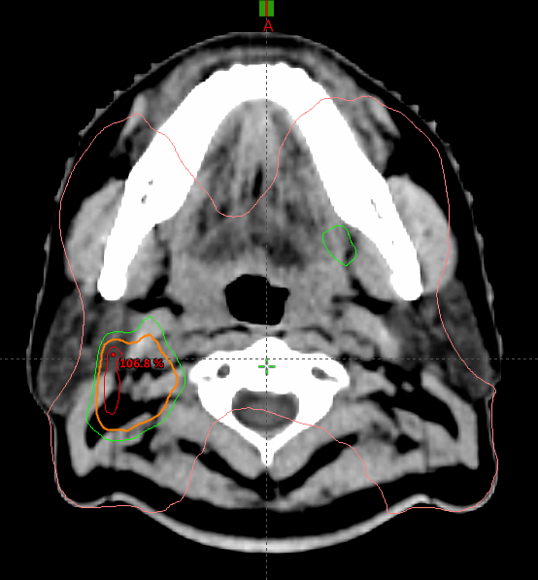
NPC cT1N2 70Gy/33#/6.5 weeks
Radical RT plan
Radical RT plan
107% = 74.9Gy
100% = 70Gy
95% = 66.5Gy
50% = 35Gy
High dose - oropharynx
Low dose – parotids, mandible, teeth

Slide 24
Thank you
nishams@ummc.edu.my

