Slide 1


Cancer ECHO UM
Case presentation
Endometrial Cancer
August 2024
Jasmin Munchar

Slide 2
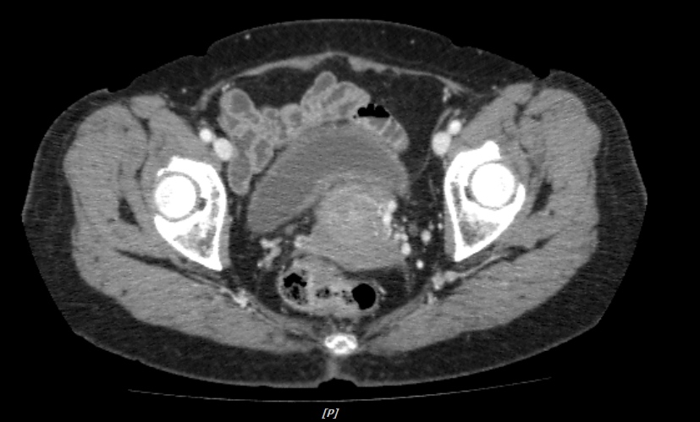
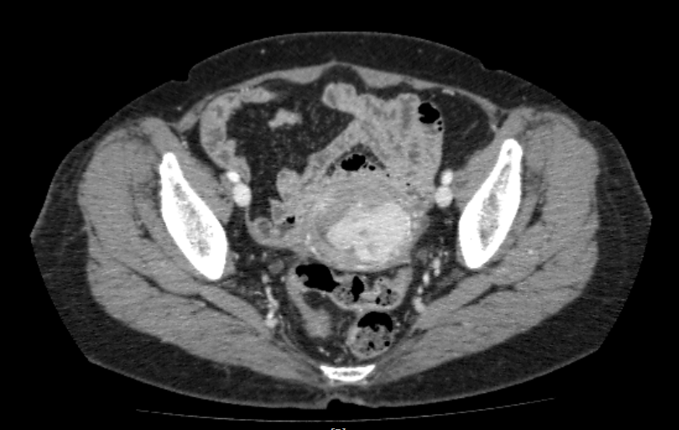
Clinical history
December 2020
71 years old
ECOG 1
Presented with per vaginal bleeding
Pipelle sampling
Endometrial carcinoma Grade 2
CT
Enlarged uterus 6 x 6 x 4cm
Heterogenous mass expanding endometrial cavity

Slide 3


Surgery
March 2021
Hysterectomy + BSO + omentectomy + bilateral pelvic lymph node dissection + appendicectomy
HPE
High grade serous carcinoma
Myometrial invasion <50%
No stromal invasion
No LVI
LN 0/21
p53 mutation present
What is the stage and risk group ?
How would you manage?

Slide 4
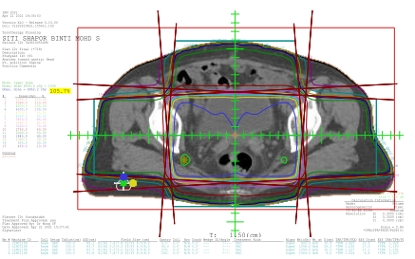
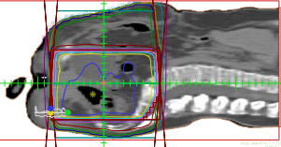
Adjuvant management
May 2021
Completed adjuvant EBRT to pelvis 46Gy/23#/4.5weeks
Vaginal dhobbies 5.5Gy x 2

Slide 5
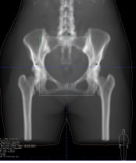
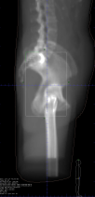
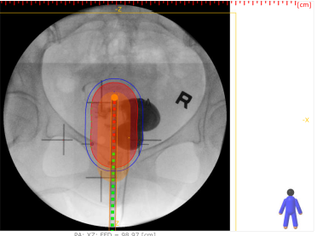
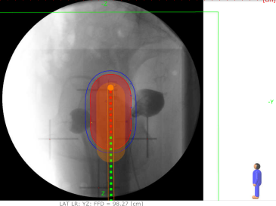
DRR of EBRT plan
Vaginal dhobbies

Slide 6

Surveillance
8 months later
CT Feb 2022
Enhancing lesion at left vaginal stump
New indeterminate lung nodules
PET CT Feb 2022
Background FDG activity at vaginal stump
Suggestive of post therapy changes / reactive granulation tissue

Slide 7
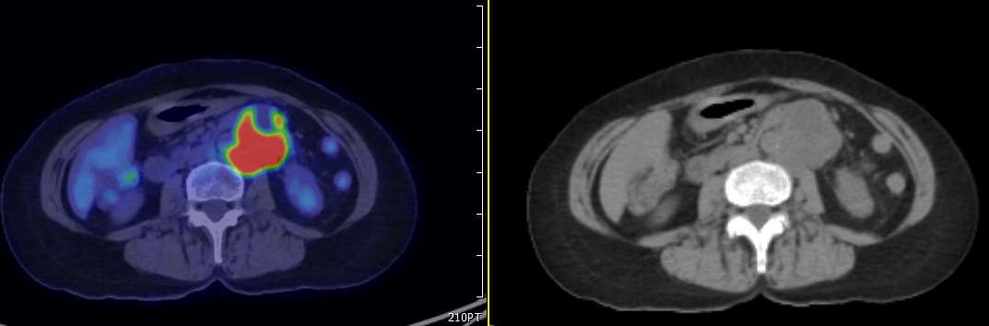
Metastatic disease
1.5 years later
PET Jan 2023
New liver metastasis in segment V and VII
New nodal metastasis in abdominal, retrocural, mediastinal, supraclavicular and cervical nodes.
Notes:
Almost 2 years from localized disease

Slide 8
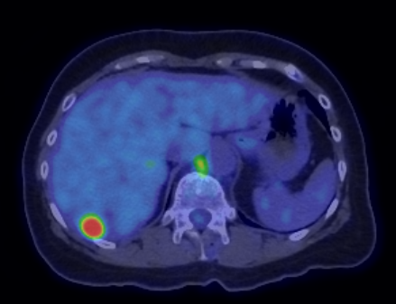
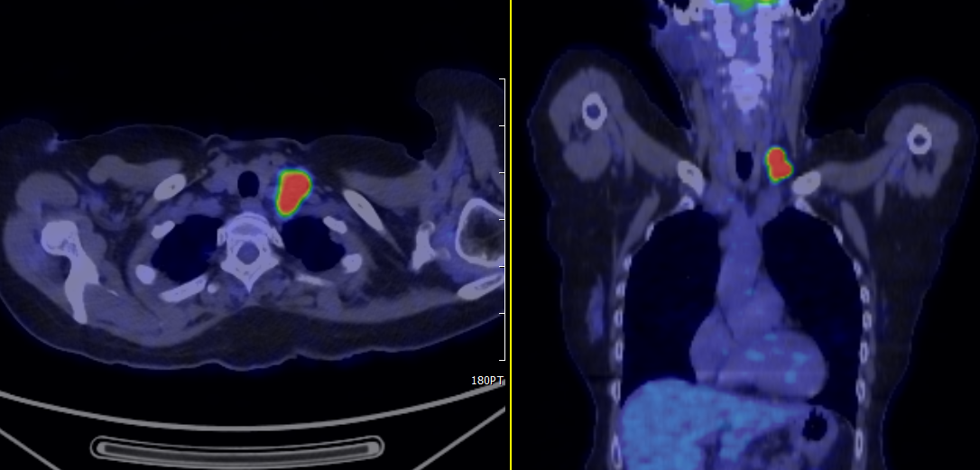
PET images
ECOG 1
Symptoms: Abdominal pain
How should we proceed

Slide 9
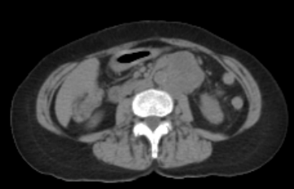
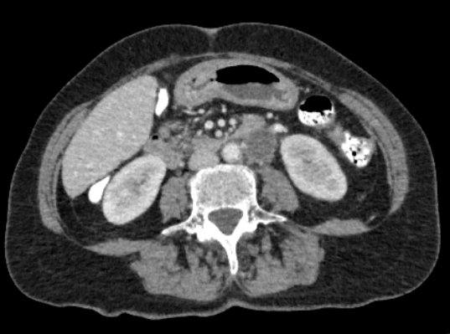
1st line palliative chemotherapy
Jan - June 2023
Completed paclitaxel and carboplatin
CT Interim
Improving liver para-aortic nodal metastasis
Resolved abdominal and SCF nodes
Pre chemo
Interim

Slide 10
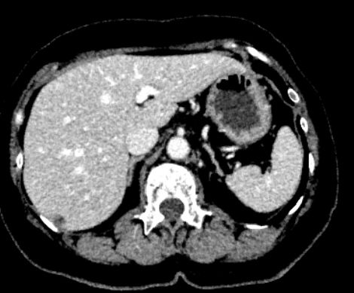
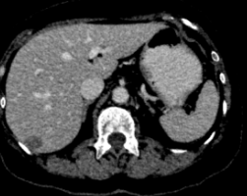
Post chemo CT: Progression in liver
2 months after chemo
CT
Larger liver metastasis
Stable para-aortic nodal metastasis
Interim
Post chemo
Notes:
2 months post C6 pacli/carbo: PD in liver

Slide 11
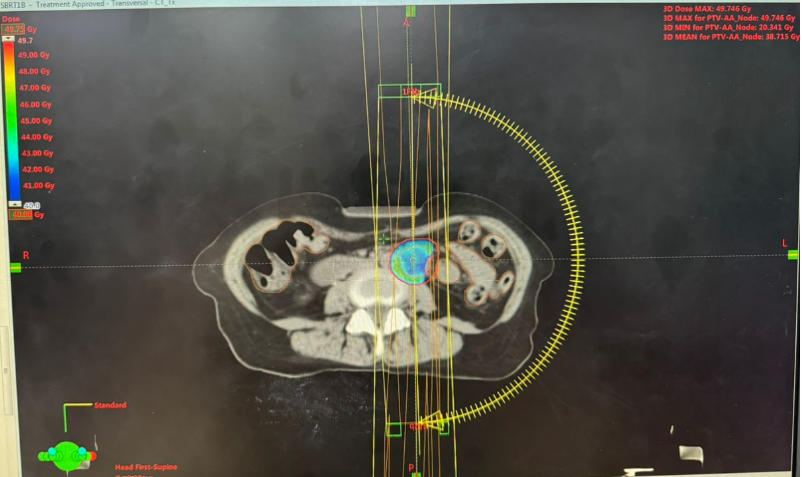
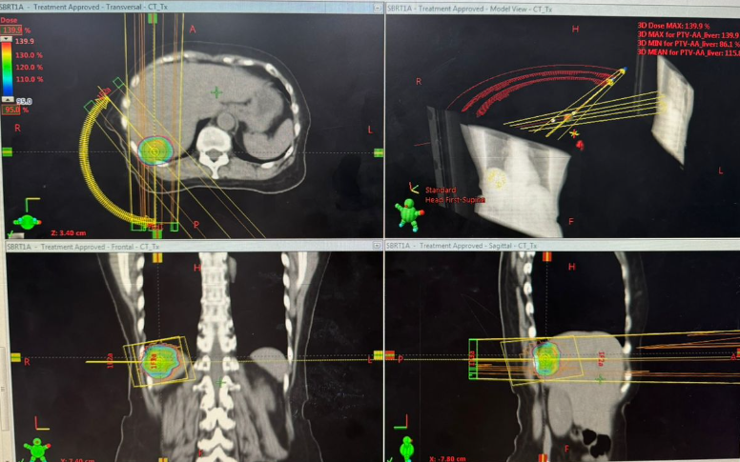
Metastasis Directed Local Therapy
August 2023
SBRT
1. Segment 7 liver lesion 50Gy/5#
2. Para-aortic node 40Gy/5#
Discussion:
Thoughts on local therapy
Modality of choice

Slide 12
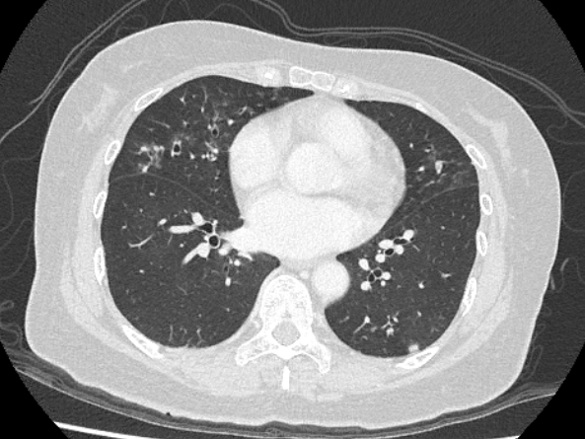
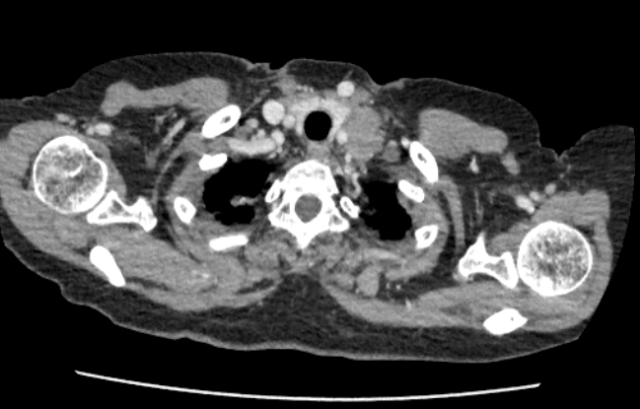
Disease progression
2 months later
Oct 2023
-Smaller para-aortic nodes and smaller segment VII liver lesion
-New segment 6 liver lesion
-New lung metastasis
-Larger abdominal nodes
Notes:
2 months after Mets directed therapy

Slide 13
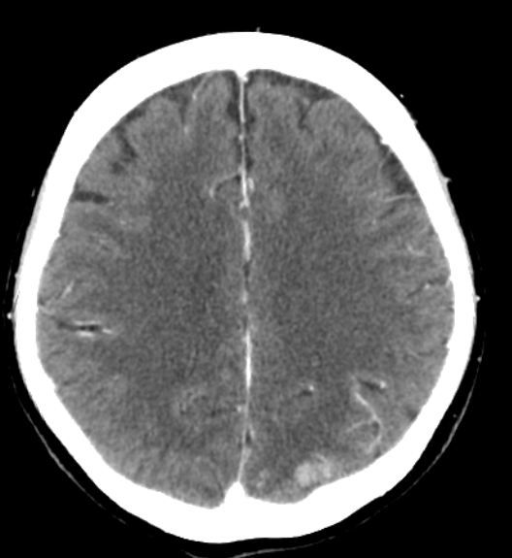
Second line treatment
Oct 2023
Pembrolizumab and lenvatinib
Side effects:
At cycle 3 developed hypertensive emergency
-Headache, blurring of vision, BP 200/100 mmHg
-CT brain: Left parietal hemorrhage

Slide 14
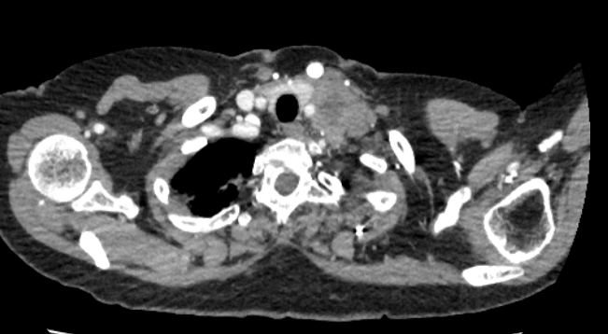
Disease progression
Dec 2023
-Lenvatinib withheld due to G4 toxicity
Jan 2024
-Developed new hoarseness of voice
-ENT review: Left vocal cord palsy (RLN compression from SCF node)
-Restaging CT TAP Jan 2024 showed disease progression in node, lung, liver

Slide 15
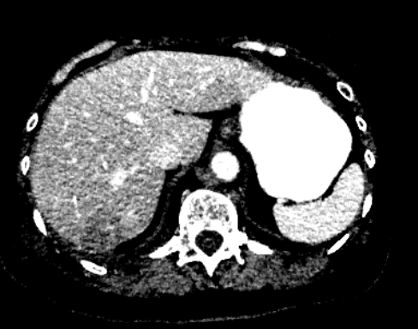
Oct 2023
Jan 2024

Slide 16
Third line chemotherapy
Feb 2024
ECOG 1-2
New symptoms
Rising Ca125
Re-challenge paclitaxel and carboplatin
Side effect:
Chemo only up to cycle 2
Complicated with Grade 3 infective diarrhea with microsporidium spp gastroenteritis
Chemo break 1 month
Notes:
NGS was sent after the infective AGE, to check for rare mutations (pt not fit for chemo anymore)

Slide 17
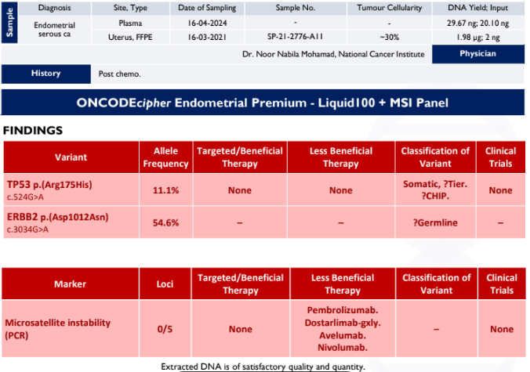
Supportive care
April 2024
Due to toxicities
Not suitable for chemotherapy
NGS
May 2024
ECOG slowly declined
Unfit for systemic therapy
Pain over abdomen
For symptomatic management
NGS: p53 mutation present, MSS

Slide 18
Timeline summary March 2021 - April 2024
71 yo
Endometrial cancer p53-mut
March 2021
May 2021
Jan 2023
Aug 2023
Oct 2023
Feb 2024
May 2024
FIGO 1a
Serous
p53-mut
High risk
1L pacli/carbo
2L Pembro/Lenva
Clinical progression
Symptomatic care
Adjuvant radiotherapy
SBRT to liver and node
3L re-challenge
Pacli/carbo

Slide 19
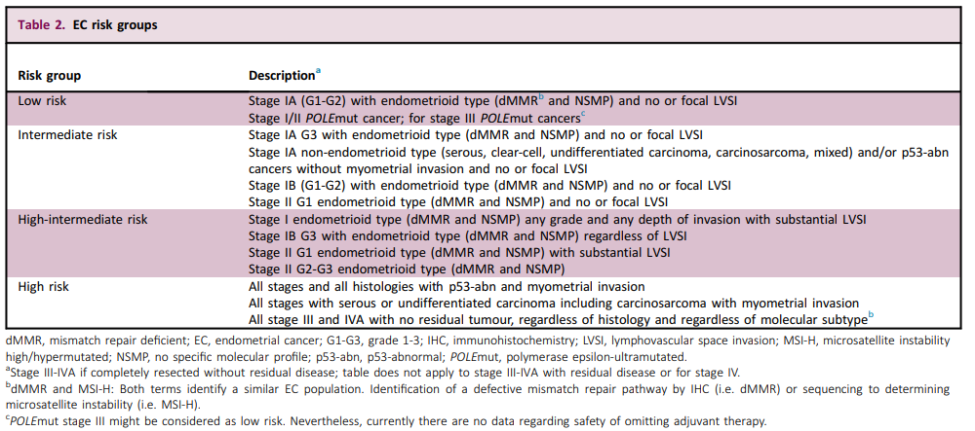
FIGO 2023 - Should we be more molecular-driven
Notes:
Food for thought

Slide 20


