Slide 1
Vmat radiotherapy planning head & Neck cancer
Zulaikha Jamalludin, PhD
Senior Lecturer / Clinical Oncology Physicist
University of Malaya Medical Centre

Slide 2
disclosure
I Have NO Financial Or Non-financial Relationships In The Products Described, Reviewed, Evaluated Or Compared In This Presentation

Slide 3
IMRT/VMAT
IMRT/VMAT is an advanced form of 3DCRT
The intensity of radiation beam is modulated/changed/adapted to:
Match the target contour/shape – increased the dose conformality to the target
Produce gradient of dose in surrounding normal tissues – minimizing dose to nearby organs at risk
Modulated intensity enable with advancement in:
Dynamic Multi-leaf collimator design – changing speed with gantry movement
Planning algorithm – inverse planning

Slide 4
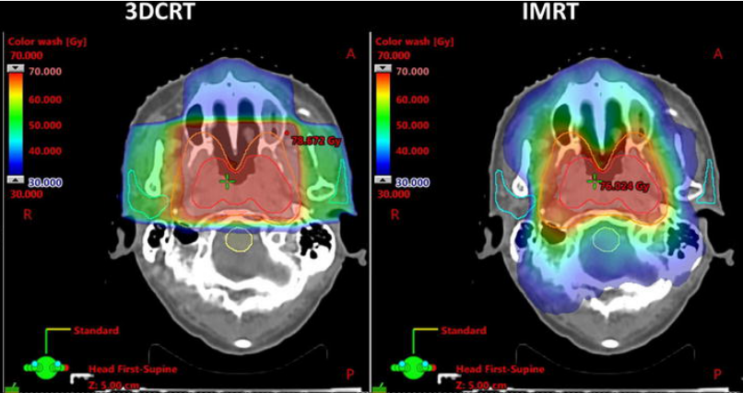
IMRT/VMAT
With IMRT/VMAT – possible to escalate the target dose while reducing the normal tissue doses
Unlike 3DCRT, the modulated intensity delivered to PTV with IMRT generate regions of high and low absorbed dose
Dose evaluation and reporting in IMRT evolved from previous ICRU for 3DCRT – attempt to retain a relationship with previous one

Slide 5
ICRU: 3dCRT ‘vs’ imrt
3DCRT
IMRT/VMAT
Single point dose specification, ICRU ref point
Uniform dose distribution
Low dose gradient
D min = minimum absorbed dose
D max = maximum absorbed dose
Volume-based dose specification, D50%, median absorbed dose
Non-uniformity dose distribution
High dose gradient
D near-min = D98%
D near-max = D2%

Slide 6
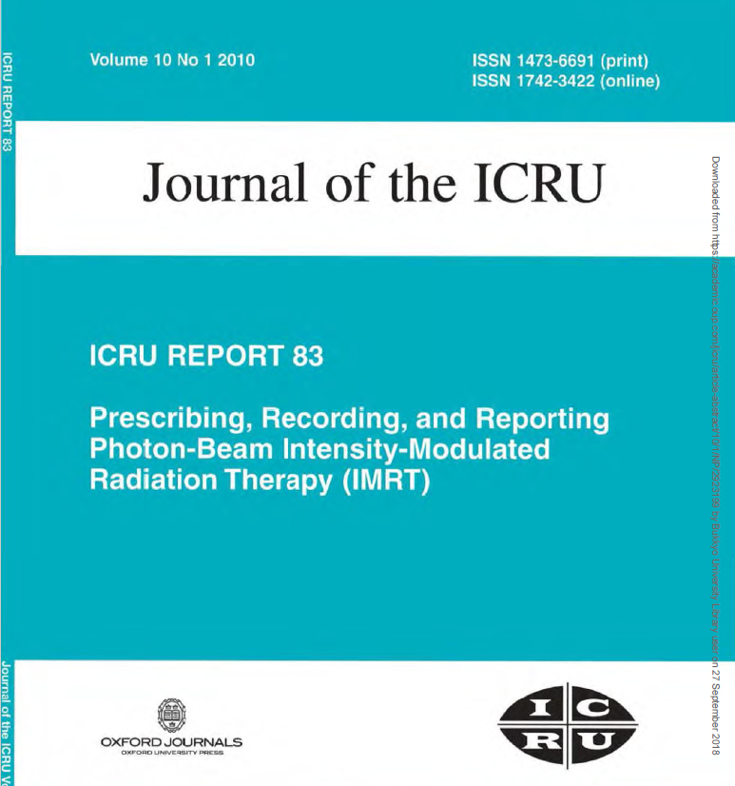

Slide 7
Planning aim: 3dCRT ‘vs’ imrt
3DCRT
IMRT/VMAT
Dose coverage aim: 95% isodose
Dose evaluation: 100%
Plan Dmax: < 107%
Dmax point location: less evaluation
Dose gradient: less evaluation
Irradiated volume: less evaluation
Dose coverage aim: 100% isodose
Dose evaluation: 98%, 95%
Plan Dmax: < 110%
Dmax point location: critical evaluation
Dose gradient: should give attention
Irradiated volume: should give attention

Slide 8
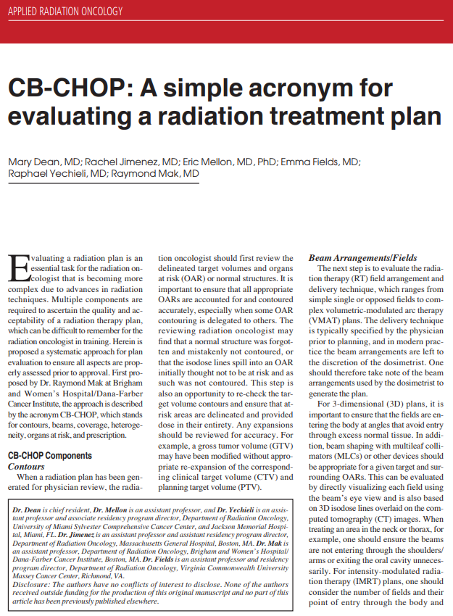
cb-chop
C
Contours:
Review target volumes and OARS
B
Beam Arrangements/Fields:
Appropriate and reasonable
C
Coverage:
Evaluate on graphic plan and DVH
H
Heterogeneity/Hot Spots:
Value and location
O
Organs at Risk:
Review specified constraints, corresponding isodose lines on plan, and DVH
P
Prescription:
Total dose, dose per fraction, and image guidance

Slide 9
Plan evaluation 1. Dose tolerance

Slide 10
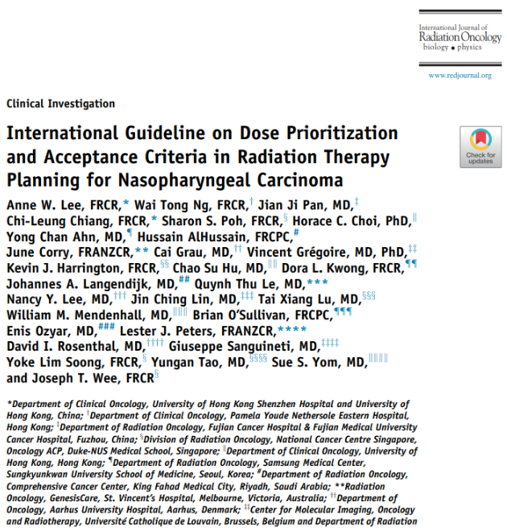
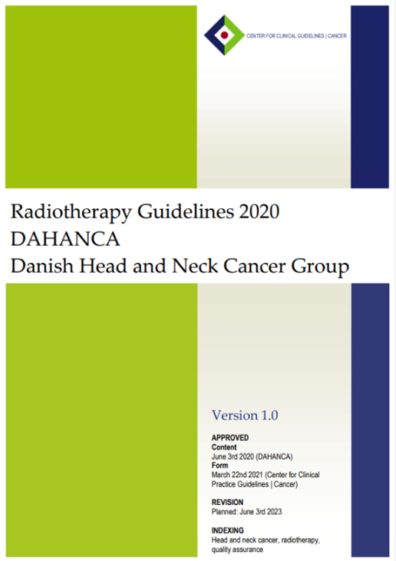
Dose tolerance protocol
Follow set of organs tolerance constraint – institutional protocol
QUANTEC
RTOG 0615
Combination

Slide 11
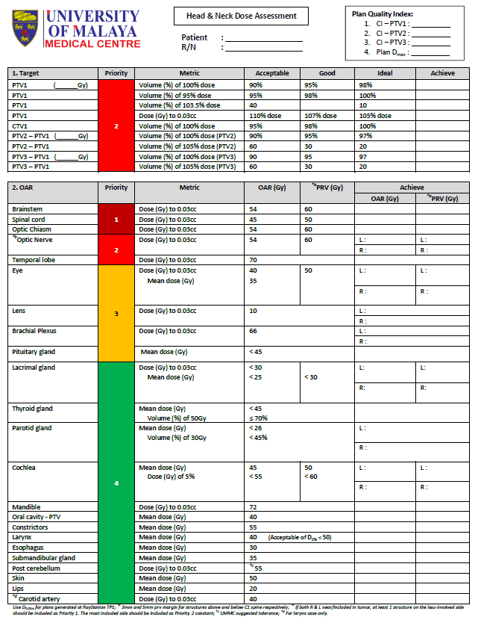
Serial organs that must be prioritized over target coverage
Serial organs that must be delineated, but not necessarily prioritized over target coverage
Organs at risk with some evidence for sparring, with serious but manageable toxicity
Poor evidence, uncertain endpoints or manageable toxicity.

Slide 12
Plan evaluation 1. Dose evaluation

Slide 13
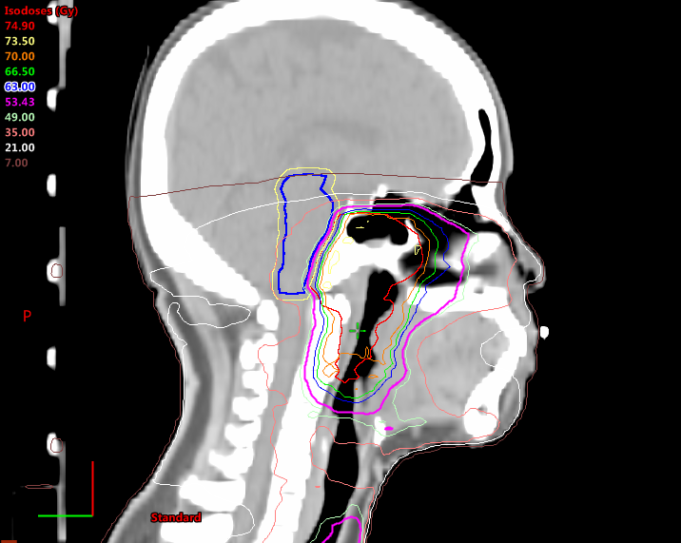
Serial organs that must be prioritized over target coverage
Brainstem
Optic chiasm
Spinal cord
'BOchS'
What to evaluate?
Dmax = maximum dose

Slide 14
Serial organs that must be prioritized over target coverage
Dmax: From dose statistic - DVH

Slide 15
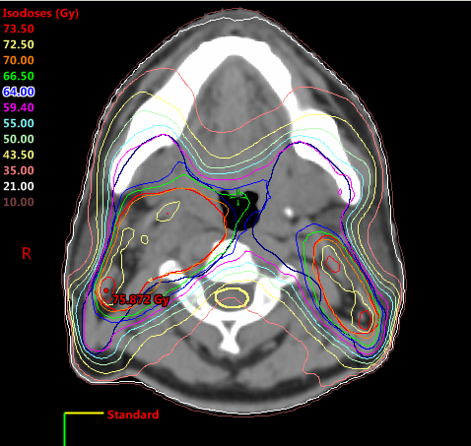
Organs of critical importance that must be prioritized over target coverage
Dmax: From axial slice
Find slice with max dose isodose line touching the organ
Evaluate the isodose gradient (steep vs non-steep)
Determine if need to reduce more without compromising coverage

Slide 16
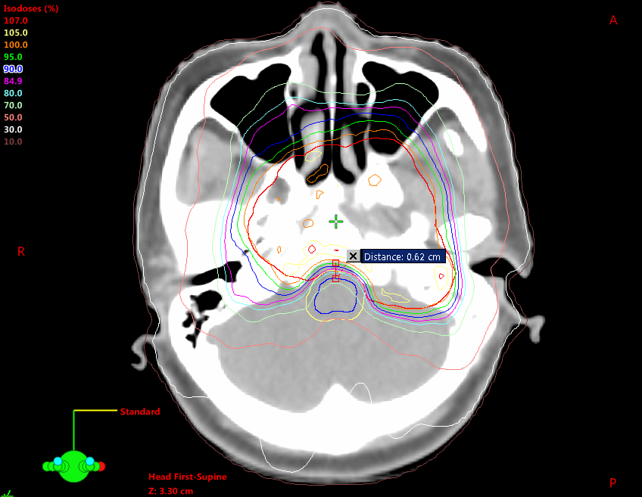
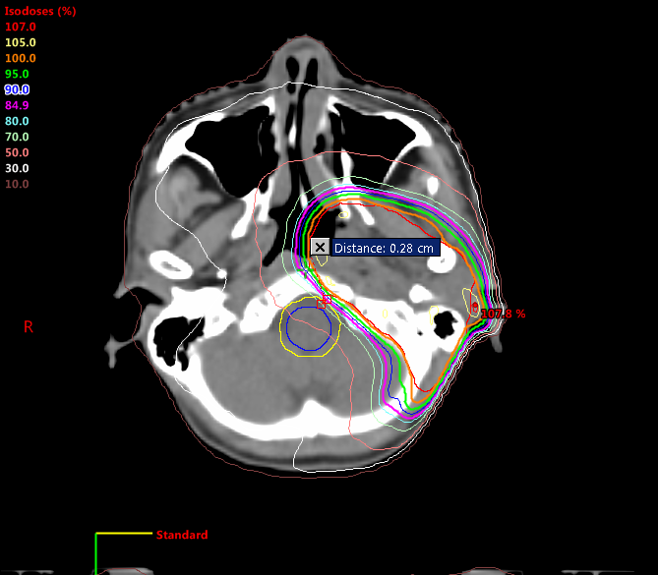
Serial organs that must be prioritized over target coverage
Brainstem
Optic chiasm
Spinal cord
'BOchS'
What to evaluate?
DG = dose gradient
AShARA
100% to 70% dose distance
85% to 70% dose distance (0.3-0.6)
85% to 50% dose distance (1.2-1.7)
Dose gradient evaluation
As ‘Sharp’ As Reasonably Achievable – AShARA

Slide 17
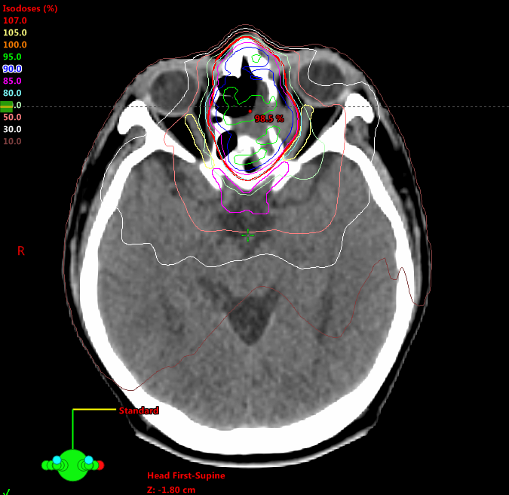
Serial organs that must be delineated, but not necessarily prioritized over target coverage
Optic nerve
Temporal lobe
PTV
'OnTeloPT'
Serial organs - What to evaluate?
Dmax = maximum dose
DG = dose gradient

Slide 18
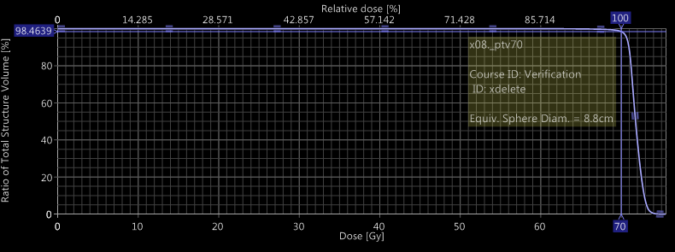
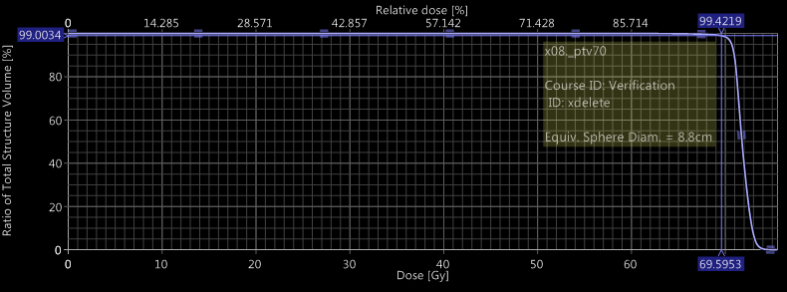
Serial organs that must be delineated, but not necessarily prioritized over target coverage
Optic nerve
Temporal lobe
PTV
'OnTeloPT'
PTV - What to evaluate?
Prescribed dose
Hot/Higher dose
PTV - What do u want to know?
How much PTV volume covered by 100% dose? – V100%
What is the min dose covering 99%/all PTV volume? - D99%

Slide 19
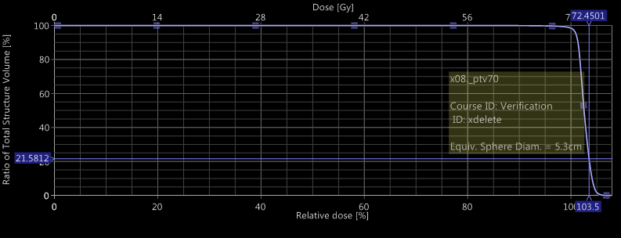
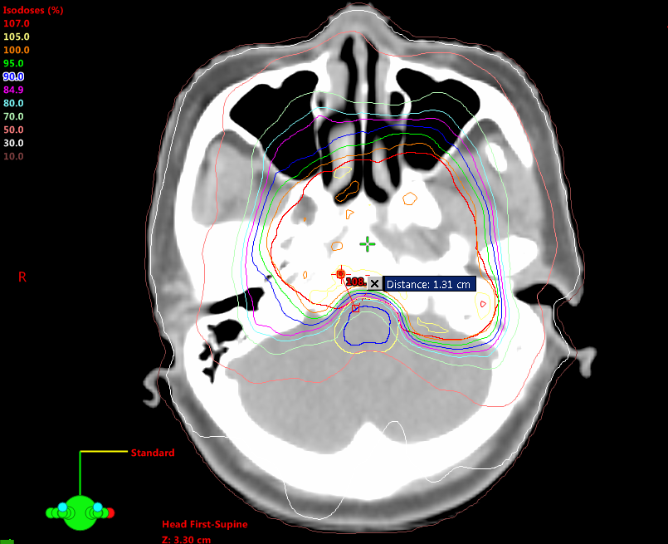
Serial organs that must be delineated, but not necessarily prioritized over target coverage
Optic nerve
Temporal lobe
PTV
'OnTeloPT'
PTV - What to evaluate?
Prescribed dose
Hot/Higher dose
PTV - What do u want to know?
Is it a HOT plan?
Where is the Dmax? - near/in BOchS?

Slide 20
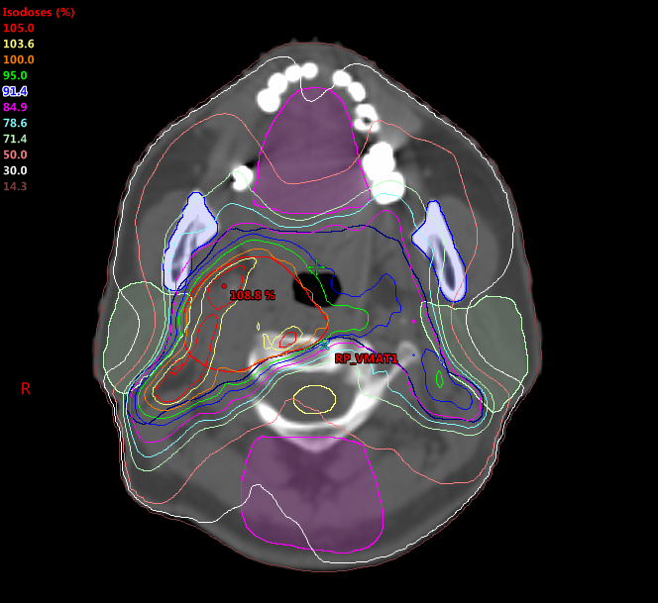
Ensure high doses island/hotspot small in size & away from any OARs (> 5mm)
Hotspot exist as consequence of pushing dose in OARs
Can be reduced & eliminated (if only 1 @ 2 OARs involved)
Can be reduced slightly BUT Cannot eliminate it (if many OARs involved)

Slide 21
Organs at risk with some evidence for sparring, with serious but manageable toxicity
Poor evidence, uncertain endpoints or manageable toxicity.
OARs mean dose - How to evaluate?
Dose gradient evaluation
ALARA concept – as low as reasonably achievable

Slide 22
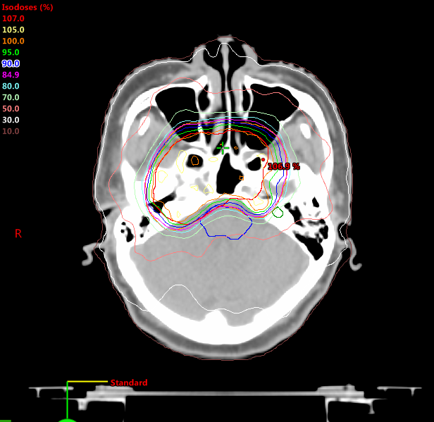
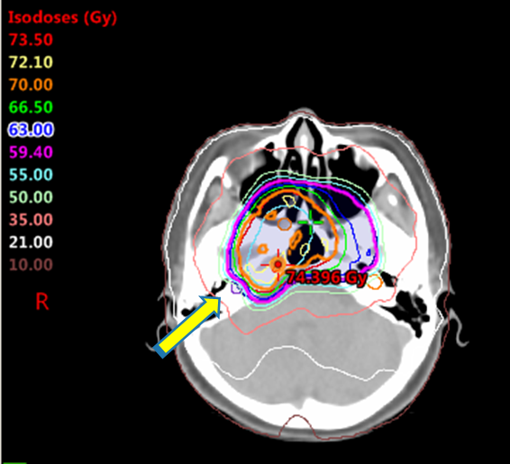
Dose gradient – cochlear
Axial view – Dose gradient
AShARA

Slide 23
Dose gradient – cochlear

Slide 24
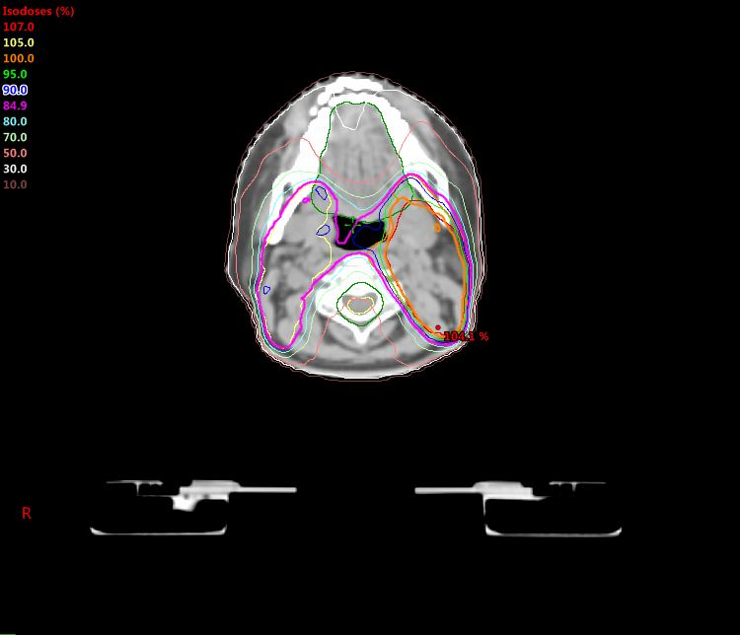
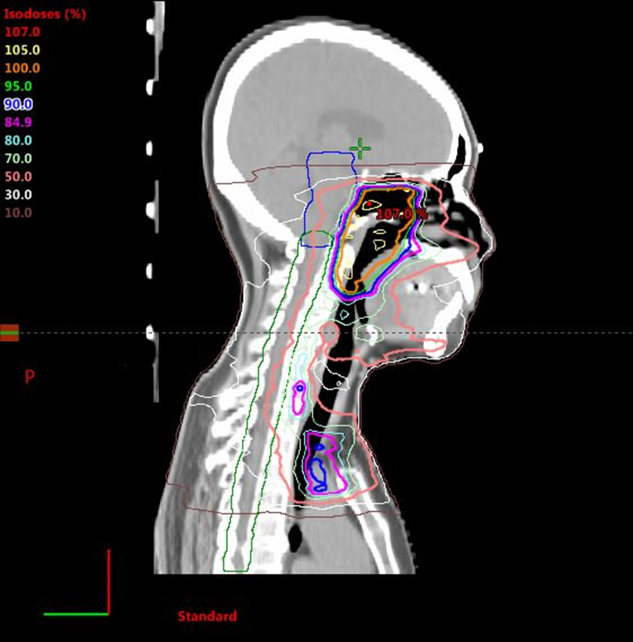
Dose gradient – oral cavity
Axial view – 50% isodose line - PUSH
Coronal view – 50% isodose line - PUSH

Slide 25
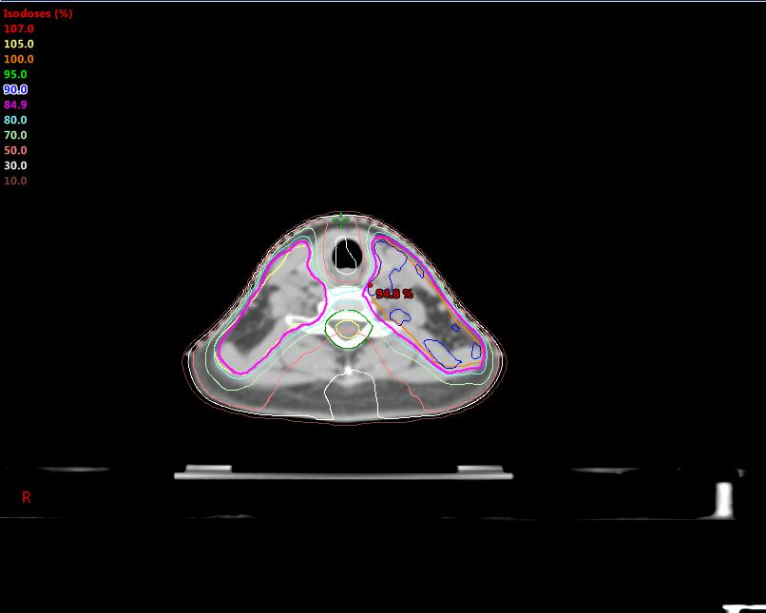
Dose gradient – larynx
Axial view:
50% isodose line – ALARA
NO 70% isodose line

Slide 26
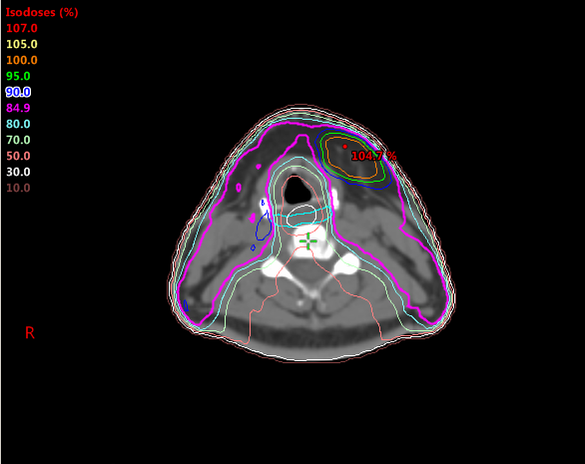
Dose gradient – constrictor muscle
Axial view:
50% isodose line – ALARA
NO 70% isodose line

Slide 27
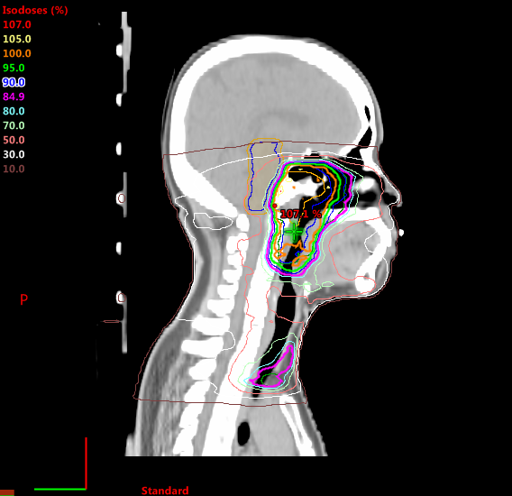
Dose gradient – post neck
Axial view:
NO 50% isodose line
Sagittal view:
NO 50% isodose line

Slide 28
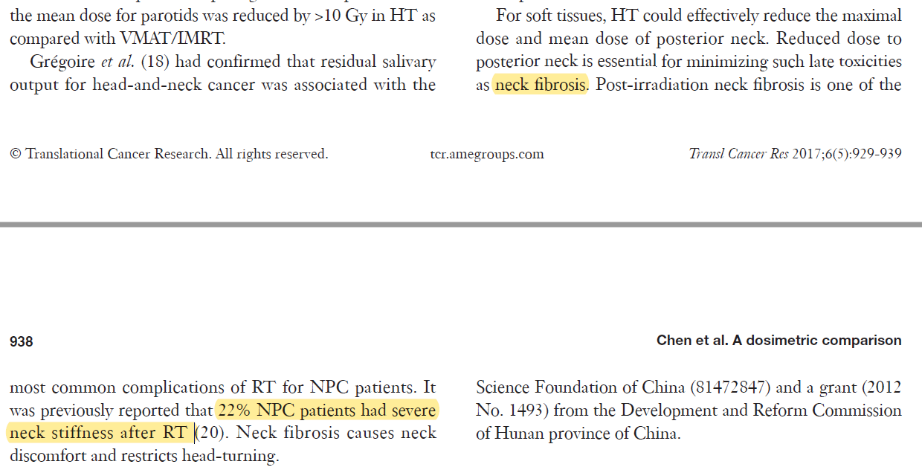
Dose gradient – post neck

Slide 29
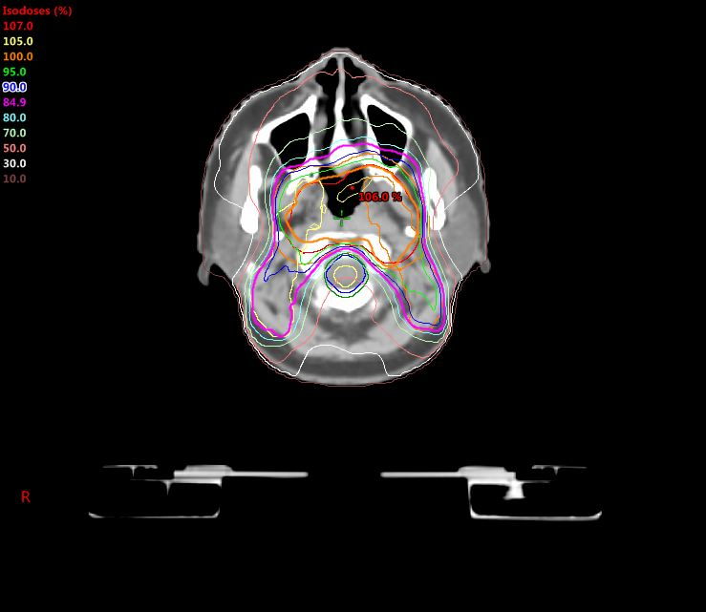
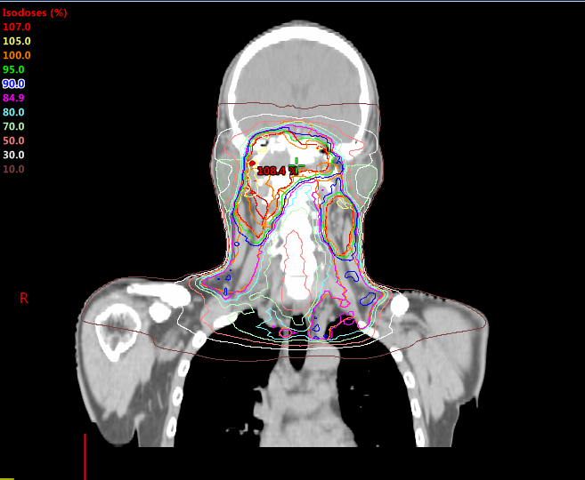
Dose gradient – parotid
Axial view – 30% isodose line - IN
Coronal view – 30% isodose line - IN

Slide 30
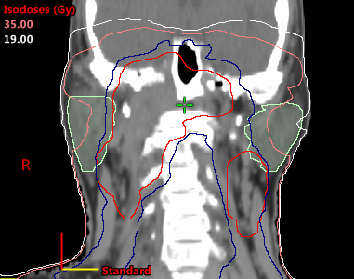
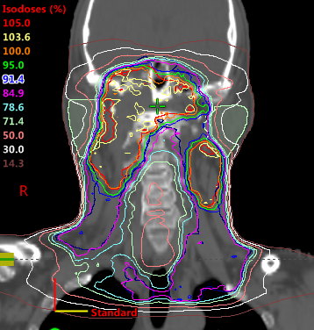
Volumetric tolerance, V30Gy ≤ 45%
Dose calculation:
(30Gy/70Gy)x100 = 43% isodose ~ 50% isodose
Volume calculation
45% volume ~ 50% volume = ½ parotid volume
Ideally ~ 50% isodose line placed at ½ parotid volume

Slide 31
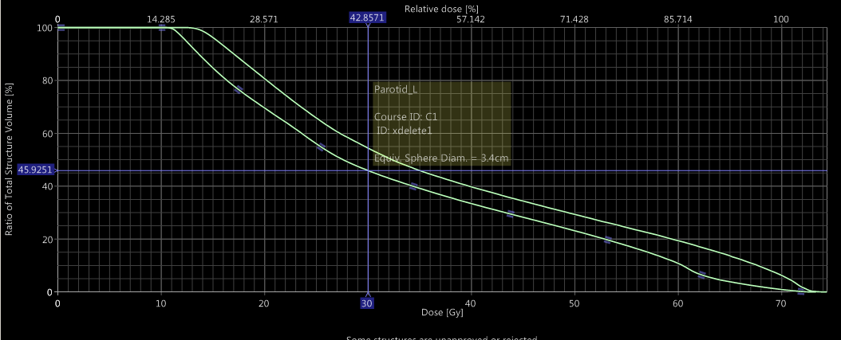

Slide 32
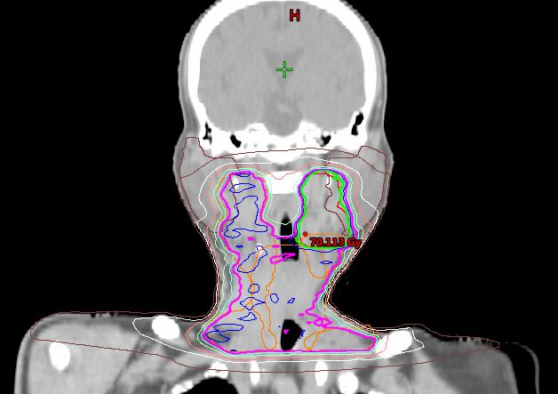
Larynx case parotid 30% - ALARA

Slide 33
Irradiated volume - reduce
50% isodose line – ALARA
70% isodose line – ALARA
Dose Gradient –
As ‘Sharp’ As Reasonably Achievable – AShARA

Slide 34
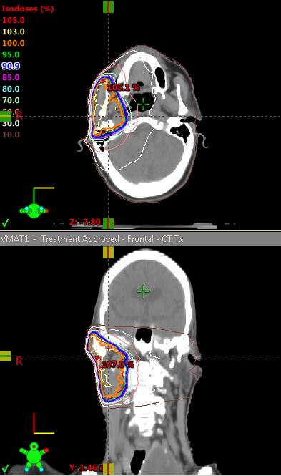
parotid case unilateral 50% isodose - ALARA

Slide 35
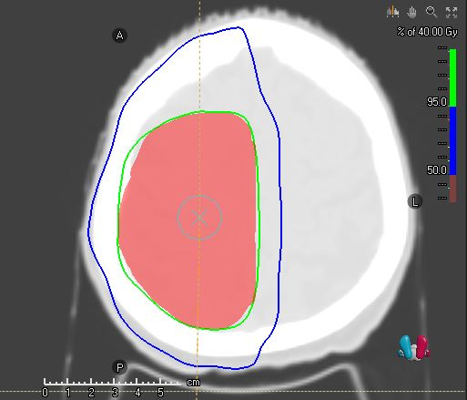
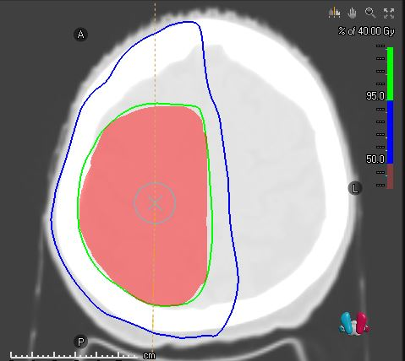
brain case – scalp 50% - ALARA

Slide 36
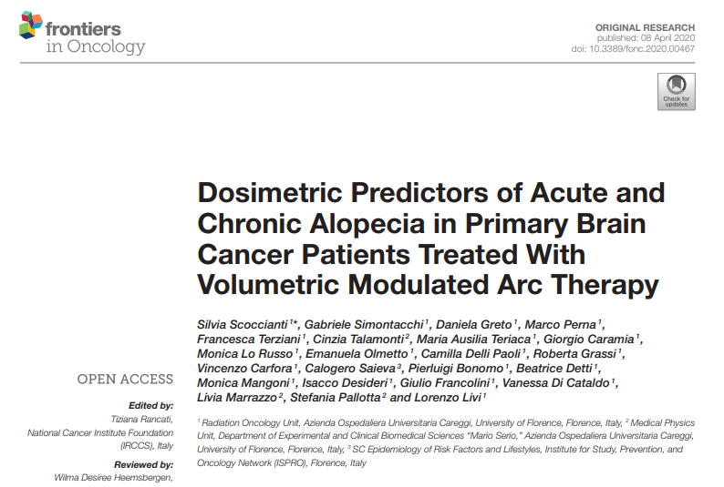
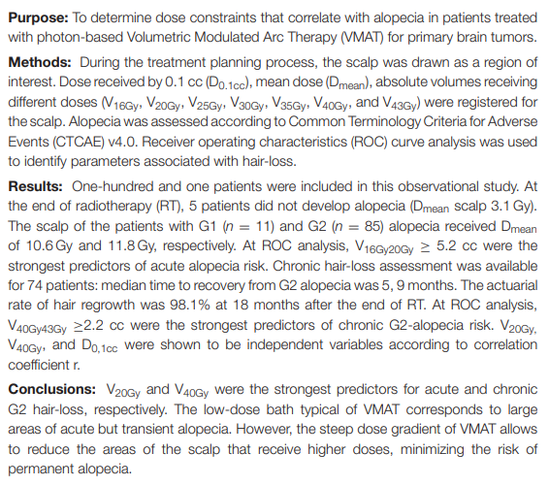
brain case – scalp 50% - ALARA

Slide 37
Npc imrt demand & supply

Slide 38
Demand & supply in npc imrt
demand
supply
(Oncologist)
(Physicist/Planner)
No demand / Under-demand
As long as achieve dose tolerance
Experience-related
No demand / under-demand
As long as achieve dose tolerance
Comfort zone
No idea of how far the system can push
Lack of understanding - Loose chance of plan quality improvement
Over-demand
Too ambitious – spare all, high dose
Illogical/not deliverable
Over-demand
Pushing the system
Algorithm can be pushed – is it mechanically deliverable?

Slide 39
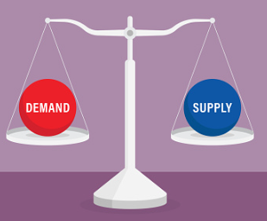
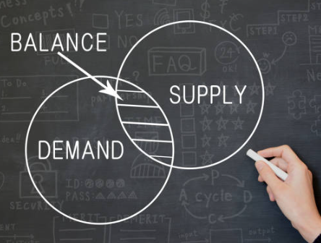
Demand & supply in npc imrt
demand
supply
(Oncologist)
(Physicist/Planner)

Slide 40
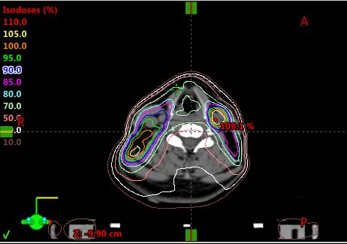
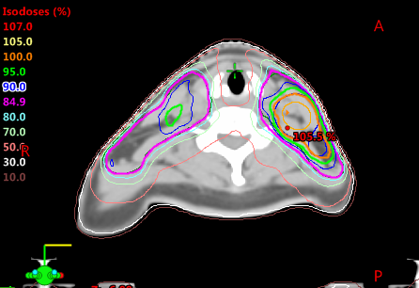
Once upon a time …. larynx 70% revisit (2016 vs current)

Slide 41
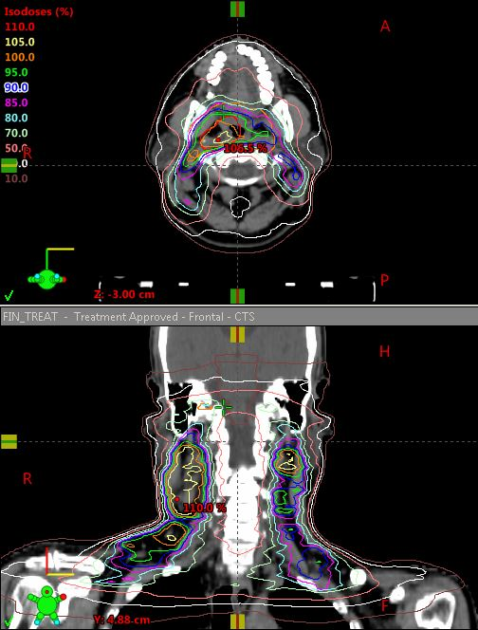
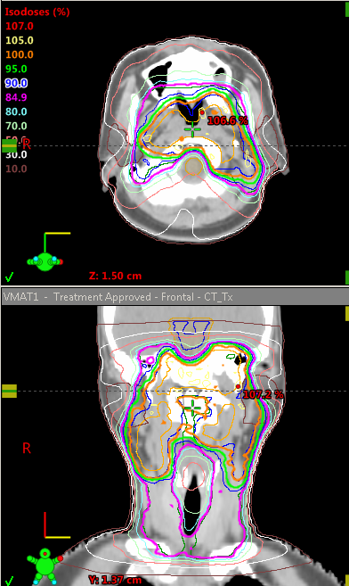
Once upon a time …. Parotid 30% revisit (2016 vs current)

Slide 42
Current rt considerations in npc

Slide 43
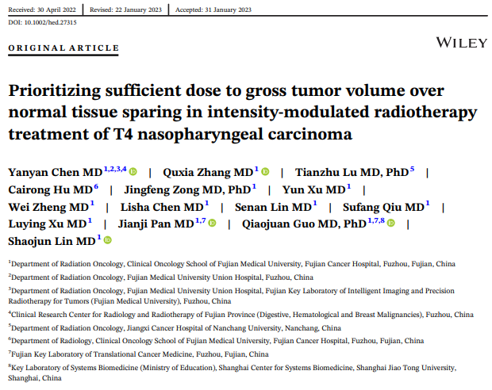
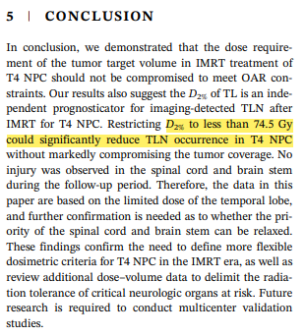
Loosening 'BOchS' & 'OnTeloPT'dose ?

Slide 44
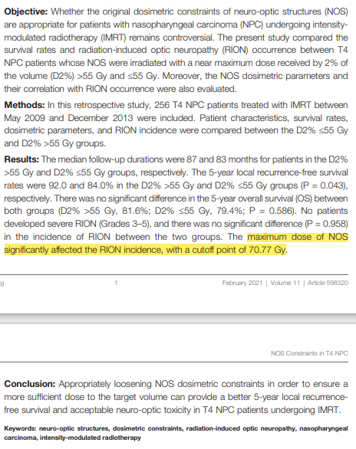
Loosening 'BOchS' & 'OnTeloPT'dose ?

Slide 45
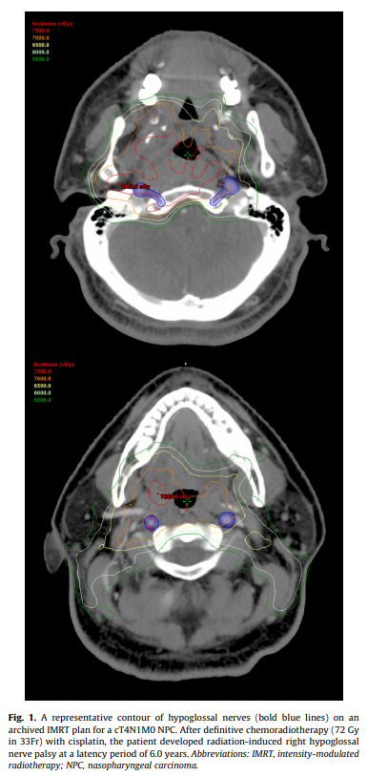
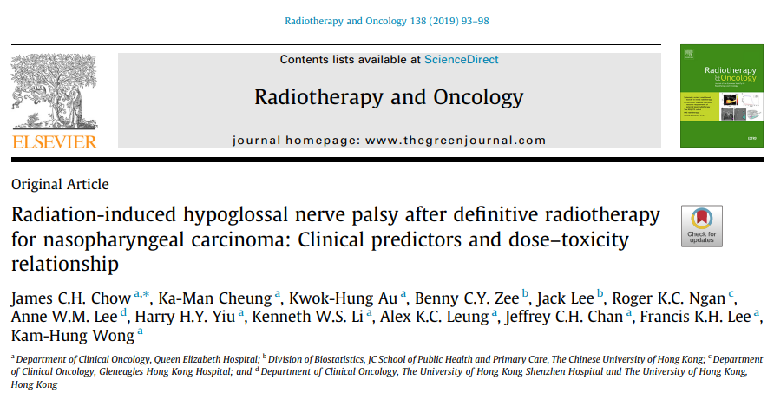
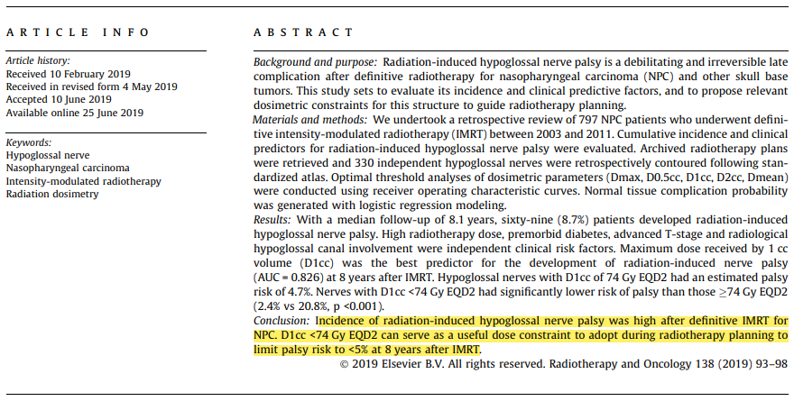
Hypoglossal dose ?

Slide 46
Take home messages…
Numbers of parameters taken into account to generate acceptable plan – physical paramaters, machine limitations & planner’s experience (knowledge & skills)
Common pitfall in training or practice is relying on plans generated without analysis & discussion on the produced plan - mistakes happen, and physicists/planners change with time and institution – upgrade in knowledge
Common to request a plan revision to improve target coverage or oar objective doses – generating a good plan is a teamwork process (physicists/planners & clinicians)
Demand & supply increase skills and experiences of both clinicians & physicists/planners

Slide 47
TQ

Slide 48
C
Contours:
Review target volumes and OARS
P
Prescription:
Total dose, dose per fraction, and image guidance
C
Coverage:
Evaluate on graphic plan and DVH
H
Heterogeneity/Hot Spots:
Value and location
O
Organs at Risk:
Review specified constraints, corresponding isodose lines on plan, and DVH
B
Beam Arrangements/Fields:
Appropriate & Reasonable
Check on total arcs numbers;
Round TV = 1-2 arcs (2 arcs preferable – movement/physiological changes uncertainty)
Long/Mass TV = 3-4 arcs
Arcs length
Check on colli angle – opposite direction for optimum use (except Monaco)
Check on beam/tx deliverability
Gantry hit couch? – couch kick plan and LT/RT isoc with full arc?
Rule of thumb for MU checking; MU Factor
Total MU determined the complexity level of IMRT plan
Less total MU = less modulation equal to open beam plan
High total MU = increase modulation complexity
Need to find optimum total MU = producing acceptable plan + pass QA + deliverable
Total MU = Dose/# x MU factor 2-4 (min to max)
Within MU factor 2-4 = acceptable beam complexity - pass QA

Slide 49
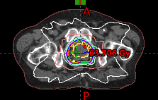
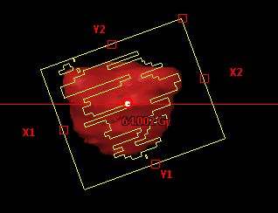
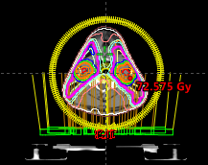
Total = 1115
60Gy/20# = 3Gy
300 cGy x 2 = total min 600 MU
300 cGy x 4 = total max 1200 MU
1115MU/300cGy = 3.7 MU factor
Total = 578
70Gy/33# = 2.121Gy
212 cGy x 2 = total min 424 MU
212 cGy x 4 = total max 848 MU
578MU/212.1cGy = 2.7 MU factor

