Slide 1

Management of Advanced RCC
Assoc Prof Ravindran Kanesvaran
Deputy Chair and Senior Consultant Medical Oncologist
National Cancer Centre Singapore
8th Feb 2023, UM Cancer Echo
Members of the SingHealth Group
Changi General Hospital • KK Women’s and Children’s Hospital • Singapore General Hospital
National Cancer Centre Singapore • National Dental Centre • National Heart Centre • National Neuroscience Institute • Singapore National Eye Centre
SingHealth Polyclinics
Members of the SingHealth Group
Changi General Hospital • KK Women’s and Children’s Hospital • Singapore General Hospital
National Cancer Centre Singapore • National Dental Centre • National Heart Centre • National Neuroscience Institute • Singapore National Eye Centre
SingHealth Polyclinics

Slide 2
Disclosures
Speaker Bureau: Pfizer, J&J, Sanofi, Novartis, MSD, Eisai, Astellas
Advisory Board/ Consultant: GSK, Novartis, Bayer, J&J, Mundipharma, Astellas, MSD, BMS, Eisai, Amgen
Research support: Sanofi, J&J, Astellas, Eisai

Slide 3
Outline
Introduction to mRCC
First line therapies for mRCC
Second line therapies for mRCC
Pan Asian Guidelines for mRCC management
Summary

Slide 4
Introduction to Kidney Cancer
Clear Cell RCCs (ccRCCs) are the most commonly diagnosed and make up approximately 75% of all cases¹
Non-Clear Cell RCCs (nccRCCs) have worse prognosis and treatment outcomes than ccRCCs²
ccRCC (~75%)¹
nccRCC (~15%)³
Papillary (~10%)
Chromophobe (~5%)
Cystic solid (~1% to 4%)
Collecting ducts of Bellini (~1%)
RCC
Medullary (variant of collecting duct) (~1%)
Xp11 translocations (rare)
Mucinous tubular and spindle cell (rare)
Associated with neuroblastoma (rare)
Unclassified RCC (~4% to 6%)³
1. Leibovich BC et al. J Urol. 2010;183(4):1309–1315. 2. de Velasco G et al. Clin Genitourin Cancer. 2017;15(3):652–660. 3. Muglia VF, Prando A. Radiol Bras. 2015;48(3):166–174.

Slide 5
Kidney Cancer: Worldwide Incidence and Mortality
Population | Incidence, n
Asia | 148,947
Europe | 136,515
NA | 67,424
LAC | 31,938
Africa | 13,420
Oceania | 5,018
Total | 403,262
14th most common cancerª
16th leading cause of cancer-related deathª
Ratio of mortality to incidence: 0.43
Population | Mortality, n
Asia | 79,149
Europe | 54,709
NA | 17,258
LAC | 14,288
Africa | 8,130
Oceania | 1,564
Total | 175,098
Oceania = Australia and New Zealand, Melanesia, Polynesia and Micronesia. ªIn both sexes.
International Agency for Research on Cancer World Health Organization (ICARC WHO). Kidney Cancer Fact Sheet. http://gco.iarc.fr/today/data/factsheets/cancers/29-Kidney-fact-sheet.pdf. Accessed September 18, 2020.

Slide 6
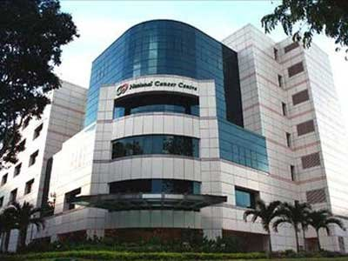
Metastatic RCC in NCCS GU clinic
No of new mRCC patients treated a month: 5-6 new patients (about 60 new mRCC patients/ year)
Agents available for mRCC: Sunitinib, Pazopanib, Sorafenib, Everolimus, Temsirolimus, HD IL2 , Bevacizumab+Interferon, Axitinib, Immune Checkpoint Inhibitors, Cabozantinib, Lenvatinib
Part of IMDC ( International Metastatic RCC Database Consortium)
Clinical Trials ( eg COSMIC 313)
*Temsirolimus is not approved in Malaysia

Slide 7
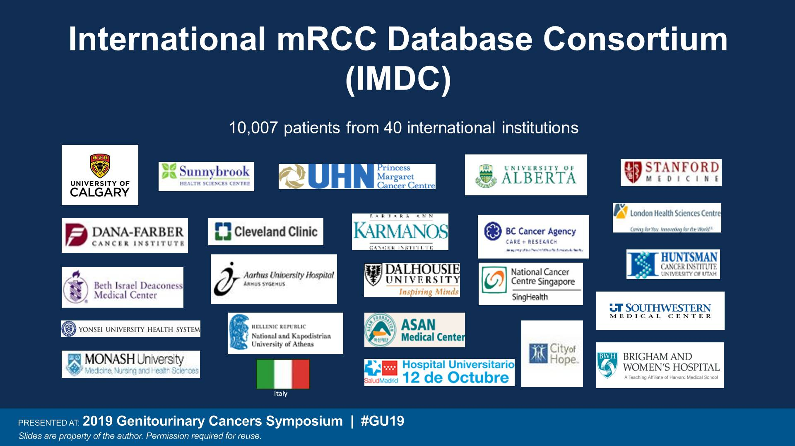
International mRCC Database Consortium<br />(IMDC)
Presented By Daniel Heng at 2019 Genitourinary Cancers Symposium

Slide 8
MSKCC and IMDC Prognostic Models
The MSKCC model is based on results from 463 patients who took part in interferon-α clinical trials;
it employs 5 risk factors¹
The IMDC model is based on results from 849 patients treated with first-line VEGF-targeted treatment;
it employs 6 risk factors²
MSKCC and IMDC Risk Groups for Previously Treated Patients
Risk group (no. of factors) | Median survival, months |  | Proportion of patients, %
 | MSKCC¹ | IMDC² | MSKCC¹ | IMDC²
Favorable (0) | 30 | 43 | 18 | 18
Intermediate (1 or 2) | 14 | 23 | 62 | 52
Poor (3–5) | 5 | 8 | 20 | 30
1.0
0.8
Favorable
0.6
Probability of OS
0.4
Intermediate
0.2
Poor
0
0
12
24
36
48
60
Mos Since Therapy Initiation
IMDC = International Metastatic Renal Cell Carcinoma Database Consortium; MSKCC = Memorial Sloan Kettering Cancer Center; VEGF = vascular endothelial growth factor.
1. Motzer RJ et al. J Clin Oncol. 2002;20(1):289‒296. 2. Heng DY et al. Lancet Oncol. 2013;14(2):141‒148.

Slide 9
Outline
Introduction to mRCC
First line therapies for mRCC
Second line therapies for mRCC
Pan Asian Guidelines for mRCC management
Summary

Slide 10
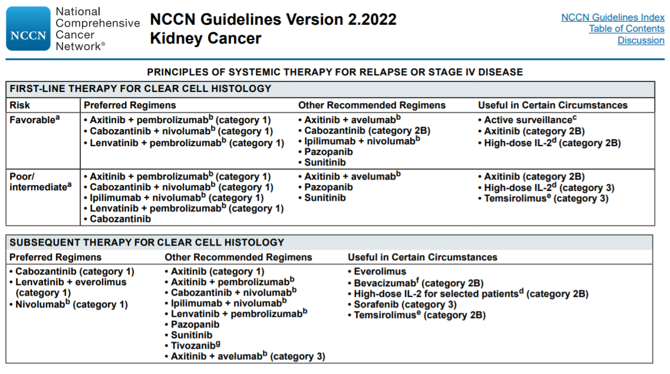
The Golden Age of mRCC
NCCN Clinical Practice Guidelines in Oncology (NCCN Guidelines®) for Kidney Cancer V2.2021. © National Comprehensive Cancer Network, Inc 2021. All rights reserved. Accessed March 23, 2021. To view the most recent and complete version of the guideline, go online to NCCN.org.
*The combination of Nivolumab + ipilimumab and Avelumab + Axitinib is not approved in Malaysia

Slide 11
CheckMate 214
CheckMate 214: nivo + ipi, 1L
Phase 3, randomized, open-label trial of nivolumab combined with ipilimumab vs sunitinib monotherapy in treatment-naïve patients with advanced or metastatic clear cell RCC¹
N=1,070
Key Inclusion Criteriaª
  Advanced/metastatic clear cell RCC
  No prior systemic therapy for RCC
  Prior adjuvant/neoadjuvant therapy allowed if the agent did not target the VEGF pathway, and recurrence occurred ≥6 months after last dose
  KPS ≥70%
  Available FFPE archival or recent tumor tissue sample
  No prior treatment with VEGF pathway agents or agents targeting T-cell
  co-stimulation or checkpoint pathways
  No current or history of CNS metastases
Nivolumab
3 mg/kg IV q3w for 4 doses, then q2w
Until progression,^{b} unacceptable toxicity, withdrawal of consent, or end of trial (up to
5 years)
R
1:1
Ipilimumab
1 mg/kg IV q3w for 4 doses
Sunitinib
50 mg PO qd for 4 weeks
(6-week cycles)
Start Date: October 2014
Estimated Trial Completion Date: TBD
Estimated Primary Completion Date: June 2019
Status: Ongoing, not recruiting
Study Director: Bristol-Myers Squibb
Primary Outcome Measures: PFS, OS, ORR in intermediate/poor
risk patients^{2,3}
Key Secondary Outcome Measures: PFS, OS, and ORR in any-risk patients, incidence of AEs^{2,3}
Select Exploratory Outcome Measures: PFS and OS in favorable risk patients, HRQoL^{2,3}
ªPlease see Clinicaltrials.gov for full inclusion/exclusion criteria.
^{b}Patients may continue treatment beyond progression (RECIST 1.1) if investigator-assessed clinical benefit is achieved and treatment is well tolerated.²
1. Clinicaltrials.gov. NCT02231749. Accessed June 6, 2017. 2. CA209-214 clinical protocol. August 4, 2016.
3. Motzer RJ et al. N Engl J Med 2018. doi: 10.1056/NEJMoa1712126.
*The combination of Nivolumab + ipilimumab is not approved in Malaysia
Notes:
CNS, central nervous system; IV, intravenous; FFPE, formalin-fixed paraffin embedded;
HRQoL, health-related quality of life; ipi, ipilimumab; nivo, nivolumab; ORR, objective response rate; OS, overall survival; PFS, progression-free survival; PO, orally; PS, performance status; qd, once daily; q2w, every 2 weeks; q3w, every 3 weeks; R, randomized; RCC, renal cell carcinoma; TBD, to be determined; VEGF, vascular endothelial growth factor.

Slide 12
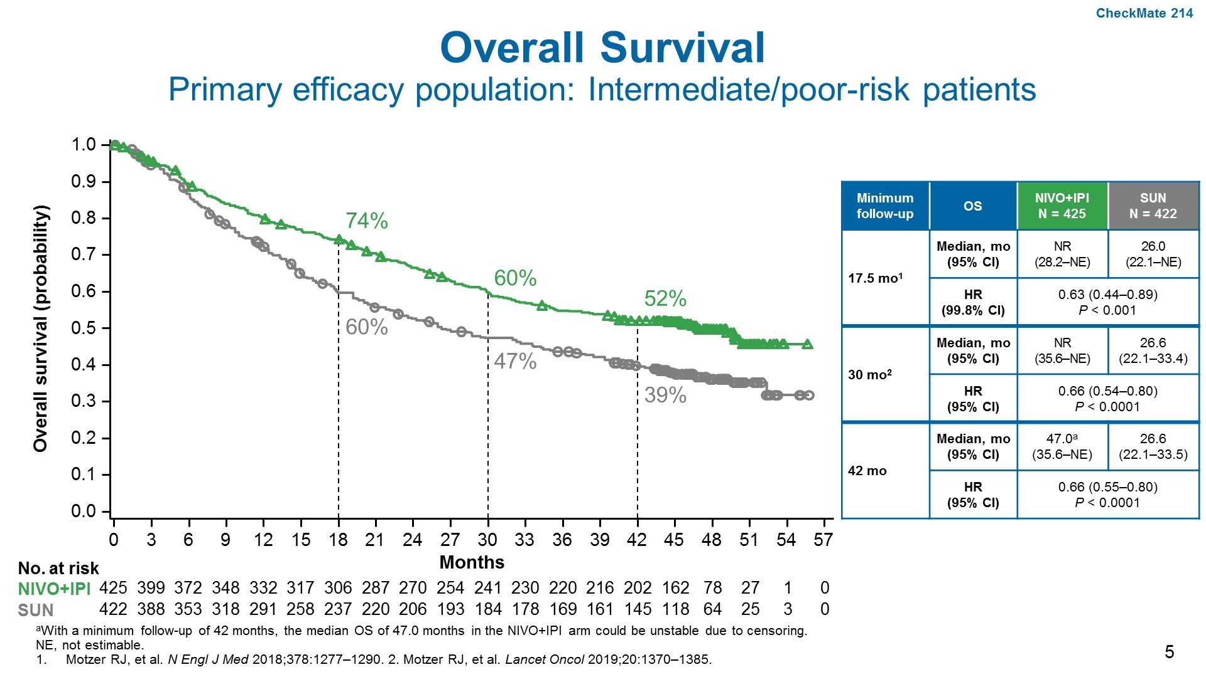
Overall Survival<br />Primary efficacy population: Intermediate/poor-risk patients
Presented By Nizar Tannir at 2020 Genitourinary Cancers Symposium
*The combination of Nivolumab + ipilimumab is not approved in Malaysia

Slide 13
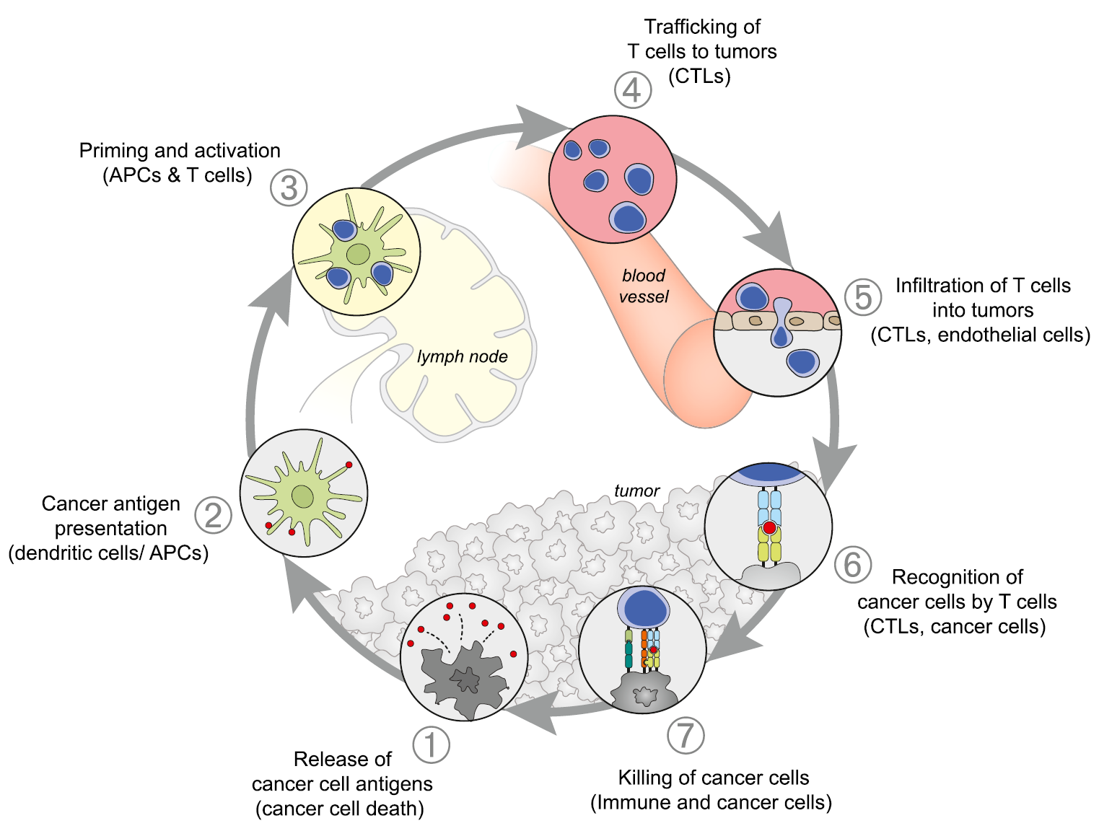
Rationale for Combining Immunotherapy with VEGF-targeted Therapy
4. Trafficking of T cells
to tumors (CTLs)
Normalization of the tumor vasculature for increased
T-cell tumor infiltration³⁻⁶
3. Priming and activation (APCs and T cells)
Promotion of T-cell priming and activation via
dendritic cell maturation¹⁻²
5. Infiltration of T cells into tumors
(CTLs, endothelial cells)
2. Cancer antigen presentation
(dendritic cells/APCs)
Establishing an
immune-permissive
tumor microenvironment
by decreasing MDSC and Treg populations⁶⁻¹⁰
6. Recognition of
cancer cells by T cells
(CTLs, cancer cells)
1. Release of cancer cell antigens
(cancer cell death)
7. Killing of cancer cells
(immune and cancer cells)
T-cell mediated cancer cell killing may be enhanced through reversal of VEGF-mediated immunosuppression
1. Gabrilovich DI, et al. Nat Med, 1996. 2. Oyama T, et al. J Immunol, 1998. 3. Goel S, et al. Physiol Rev, 2011. 4. Motz GT, et al. Nat Med, 2014. 5. Hodi FS, et al. Cancer Immunol Res, 2014.
6. Wallin JJ, et al. Nat Commun, 2016. 7. Gabrilovich DI, Nagaraj S. Nat Rev Immunol, 2009. 8. Roland CL, et al. PLoS One, 2009. 9. Facciabene A, et al. Nature, 2011. 10. Voron T, et al. J Exp Med, 2015.
Figure adapted from Chen DS, Mellman I. Immunity, 2013.

Slide 14
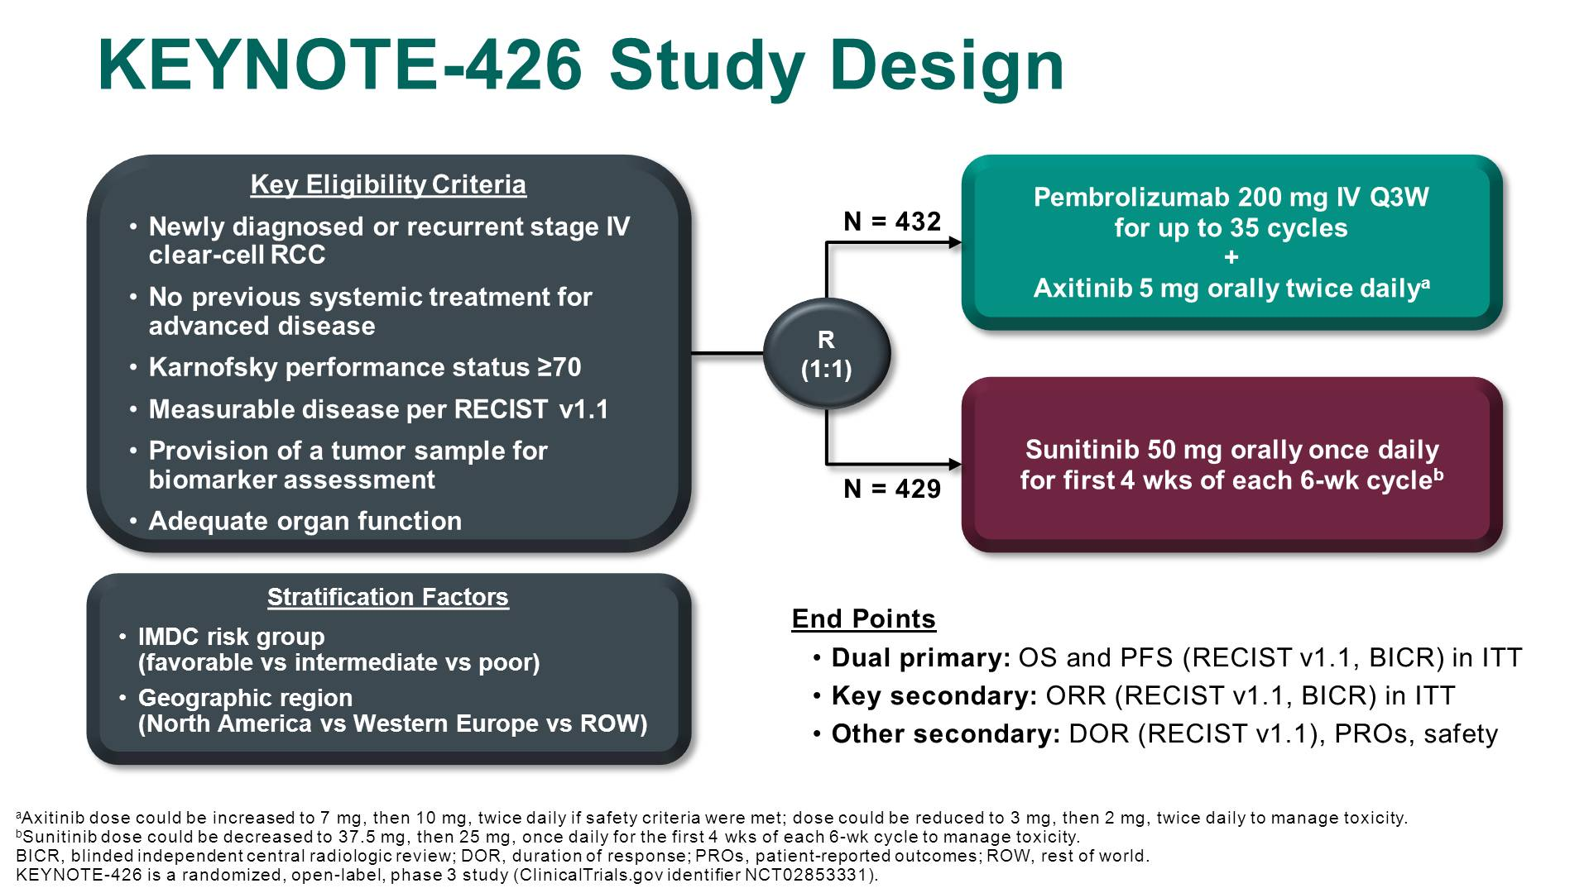
KEYNOTE-426 Study Design
Presented By Thomas Powles at 2019 Genitourinary Cancers Symposium

Slide 15
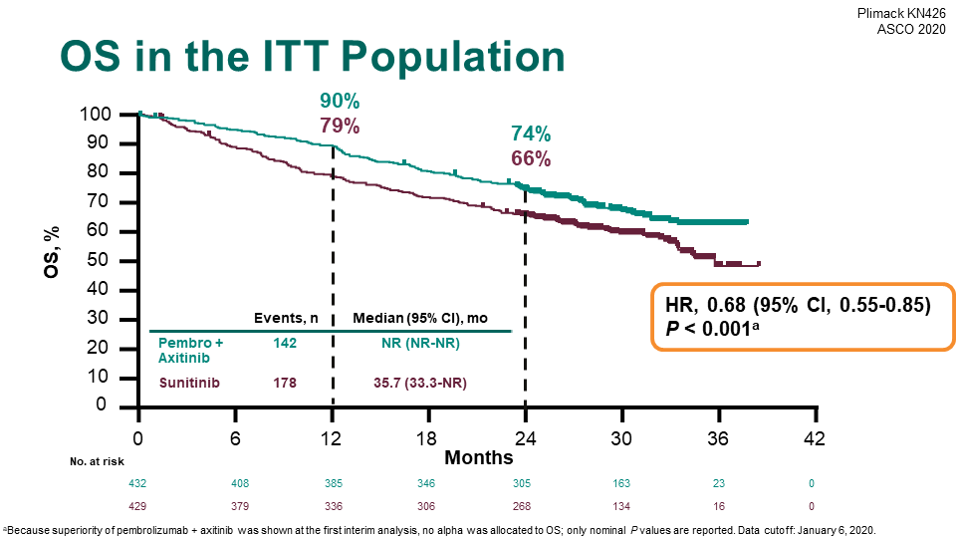
Update Analysis: ASCO 2020

Slide 16
^{Javelin Renal 101}
Key eligibility criteria:
Treatment-naive advanced RCC with a clear cell component
≥ 1 measurable lesion as defined by RECIST 1.1
Tumor tissue available for
PD-L1 staining
ECOG PS 0 or 1
Avelumab 10 mg/kg IV Q2W
+
Axitinib 5 mg PO BID
(6-week cycle)
Stratification:
ECOG PS (0 vs 1)
Geographic region (USA vs Canada/Western Europe vs rest of the world)
N = 886
R
1:1
Sunitinib 50 mg PO QD
(4 weeks on, 2 weeks off)
Independent primary endpoints
  PFS by RECIST 1.1 per BICR in patients with PD-L1+ tumors*
  OS in patients with PD-L1+ tumors
Key secondary endpoints
  PFS per BICR in the overall population
  OS in the overall population
Other secondary endpoints
  PFS per investigator assessment in patients with PD-L1+ tumors and in the overall population
  OR and DR by RECIST 1.1 per BICR and investigator assessment
  PFS2 by RECIST 1.1 per investigator
  Safety in all treated patients
* Defined as ≥1% expression on tumor-infiltrating immune cells using the Ventana PD-L1 (SP263) immunohistochemistry assay.
Motzer RJ, et al. Ann Oncol. 2018;29(Suppl8):Abstract LBA6.
*The combination of Avelumab + Axitinib is not approved in Malaysia
Notes:
Motzer_NEJM_
2019: D, L
Motzer_NEJM_
2019: P
Motzer_NEJM_
2019: N
Motzer_NEJM_
2019: Q
Motzer_NEJM_
2019: F, R, S
ANNONC-2020-0312.R1_Proof_hi: H
Motzer_NEJM_
2019: LL
ANNONC-2020-0312.R1_Proof_hi: I
Full list of secondary endpoints in nejmoa1816047_protocol: A
Motzer_NEJM_
2019: R, MM

Slide 17
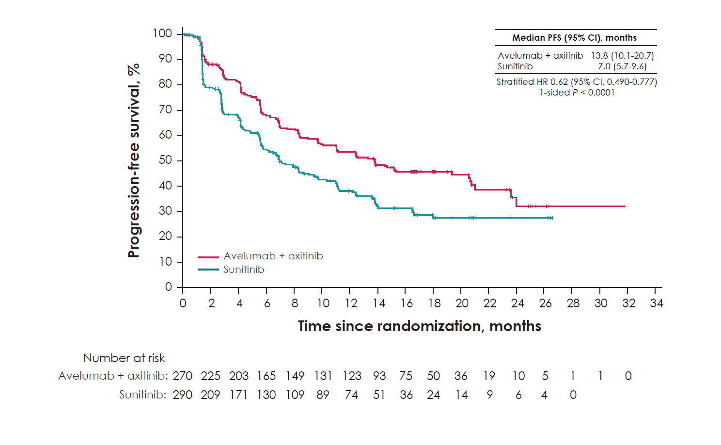
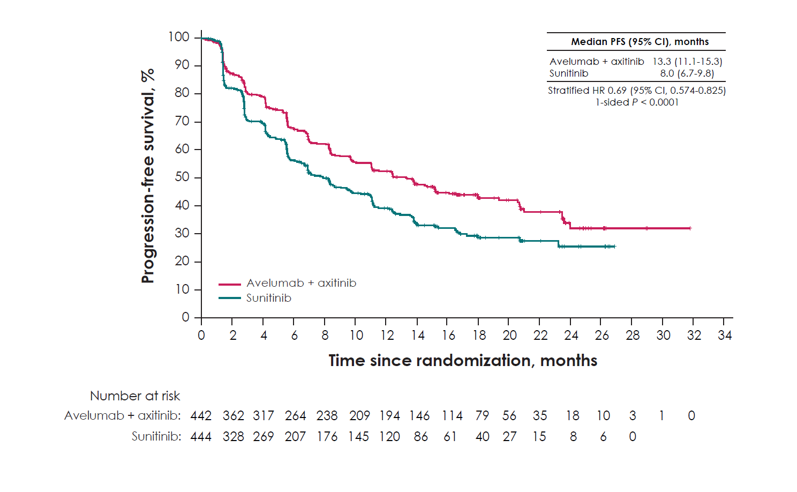
Results: Efficacy
PFS per BICR
PD-L1+ population
Primary
endpoint
Overall population
Key
secondary
endpoint
Avelumab + axitinib continues to demonstrate significantly prolonged PFS, both in the PD-L1+ (HR 0.62) and overall (HR 0.69) populations
Motzer RJ, et al. Ann Oncol. 2018;29(Suppl8):Abstract LBA6.
*The combination of Avelumab + Axitinib is not approved in Malaysia
Notes:
ANNONC-2020-0312.R1_Proof_hi: V,
W, X for HR
ANNONC-2020-0312.R1_Proof_hi: W
ANNONC-2020-0312.R1_Proof_hi: X

Slide 18
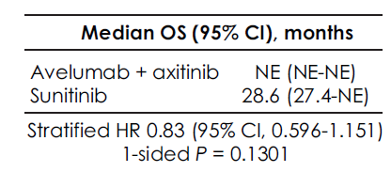
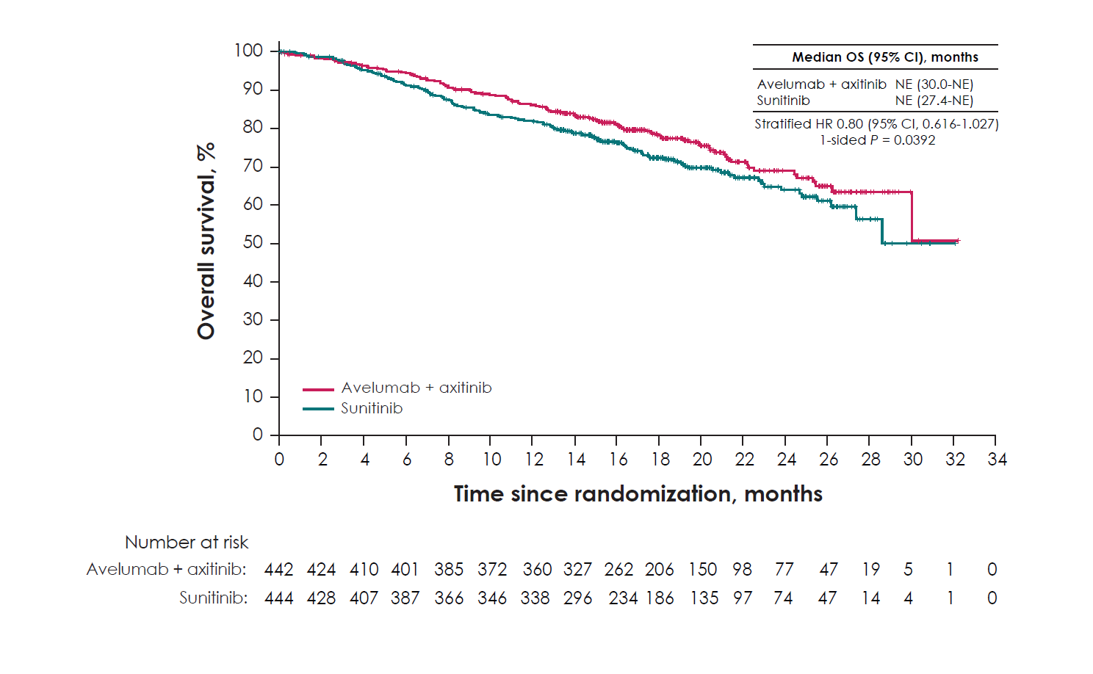
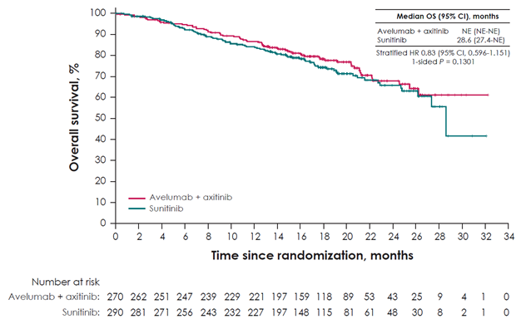
Results: Efficacy
PD-L1+ population*
Primary
endpoint
Overall population†
Key
secondary
endpoint
OS data were immature at the time of second interim analysis
HR for OS was 0.83 and 0.80 in the PD-L1+ and overall populations, respectively
The median duration of follow-up for OS was 19.3 months (95% CI, 18.6–20.0) in the combination arm and 19.2 months (95% CI, 18.3–19.8) in the sunitinib arm
* Death from any cause was observed in 66 patients (24.4%) in the combination arm and 79 patients (27.2%) in the sunitinib arm.
† Death from any cause was observed in 109 patients (24.7%) in the combination arm and 129 patients (29.1%) in the sunitinib arm.
Motzer RJ, et al. Ann Oncol. 2018;29(Suppl8):Abstract LBA6.
Notes:
ANNONC-2020-0312.R1_Proof_hi: Y
ANNONC-2020-0312.R1_Proof_hi: Z
ANNONC-2020-0312.R1_Proof_hi: AA
ANNONC-2020-0312.R1_Proof_hi: BB
ANNONC-2020-0312.R1_Proof_hi: CC, DD
ANNONC-2020-0312.R1_Proof_hi: Y, Z

Slide 19
CheckMate 9ER: Study design
CheckMate 9ER
Stratification factors:
IMDC risk score
Tumor PD-L1 expressionª
Geographic region
N = 651
Key inclusion criteria^{1,2}
  Previously untreated advanced or metastatic RCC
  Clear cell component
  Any IMDC risk group
NIVO 240 mg IV Q2W
+ CABO 40 mg PO QD
R
1:1
Treat until RECIST v1.1–defined progression or unacceptable toxicity^{b}
SUN 50 mg PO QD,
cycle of 4 weeks on/
2 weeks off
Primary endpoint: PFS
Secondary endpoints: OS, ORR, and safety
Median study follow-up, 18.1 months (range, 10.6–30.6 months)
ªDefined as the percent of positive tumor cell membrane staining in a minimum of 100 evaluable tumor cells per validated Dako PD-L1 immunohistochemistry 28-8 pharmDx assay.
^{b}NIVO dosing may not exceed a total of 2 years (from cycle 1); CABO and SUN treatment may continue beyond 2 years in the absence of progression or unacceptable toxicity.
Patients may be treated beyond progression.
IMDC, International Metastatic Renal Cell Carcinoma Database Consortium; IV, intravenously; ORR, objective response rate; PD-L1, programmed death ligand 1; PFS, progression-free survival; PO, orally; Q2W, every 2 weeks; QD, once daily; RECIST, Response Evaluation Criteria in Solid Tumors.
1. Clinicaltrials.gov/ct2/show/NCT03141177. Accessed June 8, 2020; 2. Choueiri TK et al. Poster presented at the American Society of Clinical Oncology Annual Meeting 2018. TPS4598.

Slide 20
Progression-free survival per BICR
CheckMate 9ER
Median PFS, months (95% CI)
NIVO+CABO | 16.6 (12.5–24.9)
SUN | 8.3 (7.0–9.7)
1.0
0.9
ival (probability)
0.8
HR, 0.51 (95% CI, 0.41–0.64)
P < 0.0001
0.7
0.6
v
0.5
0.4
0.3
Progression-free sur
0.2
0.1
0.0
0
3
6
9
12
15
18
21
24
27
No. at risk
Months
NIVO+CABO
323 | 279 | 234 | 196 | 144 | 77 | 35 | 11 | 4 | 0
328 | 228 | 159 | 122 | 79 | 31 | 10 | 4 | 1 | 0
SUN
Minimum study follow-up, 10.6 months.
Choueiri TK et al. Poster presented at the American Society of Clinical Oncology Annual Meeting 2018. TPS4598

Slide 21
Overall survival
CheckMate 9ER
1.0
0.9
0.8
0.7
ival (probability)
0.6
Median OS, months (95% CI)
NIVO+CABO | NR (NE)
SUN | NR (22.6–NE)
0.5
v
0.4
all sur
0.3
r
HR, 0.60 (98.89% CI, 0.40–0.89)
P = 0.0010
Ove
0.2
0.1
0.0
0
3
6
9
12
15
18
21
24
27
30
No. at risk
Months
NIVO+CABO
323 | 308 | 295 | 283 | 259 | 184 | 106 | 55 | 11 | 3 | 0
328 | 296 | 273 | 253 | 223 | 154 | 83 | 36 | 10 | 3 | 0
SUN
Minimum study follow-up, 10.6 months.
NE, not estimable; NR, not reached.
Choueiri TK et al. Poster presented at the American Society of Clinical Oncology Annual Meeting 2018. TPS4598

Slide 22
Overall survival in subgroups
CheckMate 9ER
Subgroup
NIVO+CABO
SUN
HR for death (95% CI)
Events/no. of patients
Overall
67/323
99/328
0.60 (0.44–0.82)
Region
US/Europe
26/158
45/161
0.48 (0.30–0.79)
Rest of world
41/165
54/167
0.71 (0.48–1.07)
IMDC prognostic risk
Favorable
10/74
11/72
0.84 (0.35–1.97)
Intermediate
40/188
51/188
0.70 (0.46–1.07)
Poor
17/61
37/68
0.37 (0.21–0.66)
PD-L1 expression
≥ 1%
28/83
30/83
0.80 (0.48–1.34)
< 1% or indeterminate
39/240
69/245
0.51 (0.34–0.75)
Age
< 65 years
31/191
66/210
0.44 (0.29–0.67)
≥ 65 years
36/132
33/118
0.90 (0.56–1.44)
Sex
Male
47/249
66/232
0.59 (0.40–0.85)
Female
20/74
33/96
0.68 (0.39–1.18)
Karnofsky performance status
90–100
45/257
56/241
0.69 (0.47–1.03)
≤ 80
22/66
43/85
0.52 (0.31–0.86)
Bone metastases
Yes
24/78
33/72
0.54 (0.32–0.92)
No
43/245
66/256
0.61 (0.41–0.89)
Previous nephrectomy
Yes
36/222
66/233
0.49 (0.33–0.74)
No
31/101
33/95
0.79 (0.48–1.29)
0.125
0.25
0.5
1
2
4
Choueiri TK et al. Poster presented at the American Society of Clinical Oncology Annual Meeting 2018. TPS4598
NIVO+CABO better
SUN better

Slide 23
ORR and BOR per BICR across subgroups by organ site of metastases
CheckMate 9ER: NIVO+CABO, 1L (minimum follow-up: 16.0 months)
Complete response
Partial response
Stable disease
Progressive disease
Unable to determine
100
6.3
7.5
4.4
11.1
90
18.5
80
25.1
47.9
41.8
70
40.3
48.3
31.5
60
Best overall response (%)
40.6
50
40
23.3
24.1
34.2
27.8
30
33.3
20
13.7
15.1
10
24.1
10.1
20.8
13.7
7.6
6.3
14.7
0
4.6
Liverª
Bone^{b}
Lung
NIVO+CABO
SUN
NIVO+CABO
SUN
NIVO+CABO
SUN
(n = 73)
(n = 54)
(n = 79)
(n = 72)
(n = 240)
(n = 251)
ORR (95% CI), %
49.3 (37.4–61.3) 20.4 (10.6–33.5) 48.1 (36.7–59.6) 11.1 (4.9–20.7) 55.8 (49.3–62.2) 29.5 (23.9–35.5)
mTTR (range), mo^{c}
2.8 (2.3–7.0) 4.1 (2.6–11.1) 2.9 (1.5–8.0) 5.7 (2.6–11.0) 2.8 (1.0–11.0) 4.2 (1.7–20.2)
mDOR (95% CI), mo^{c}
NR (9.6–NE) 11.7 (4.8–NE) 18.0 (15.5–NE) 6.9 (4.8–NE) 22.2 (17.3–NE) 11.1 (8.3–20.7)
ªOne patient in each arm reported a complete response (NIVO+CABO, 1.4%; SUN, 1.9%); ^{b}Zero patients achieved a complete response with SUN; ^{c}TTR and DOR were calculated only for patients who had a complete or partial response.
Included with permission from Apolo A, et al. Poster presentation at ASCO 2021. 4553.

Slide 24
Treatment-related AEs
CheckMate 9ER: NIVO+CABO, 1L (minimum follow-up: 10.6 months)
NIVO+CABO (n = 320)
SUN (n = 320)
Events, %ª | Any grade | Grade ≥ 3 | Any grade | Grade ≥ 3
Treatment-related AEs | 97 | 61 | 93 | 51
Grade 1–2
57
6
4
43
Hand-foot syndrome
38
8
8
40
Grade ≥ 3
30
11
12
33
33
< 1
< 1
28
27
3
4
30
Treatment-related AEs occurring in ≥ 20% of treated patients, %^{b}
21
< 1
25
19
< 1
3
25
22
20
16
2
2
23
20
1
< 1
17
23
< 1
3
9
5
25
< 1
6
ªIncludes events that occurred on therapy or within 30 days after the end of the treatment period of all treated patients. Treatment-related deaths per investigator: NIVO+CABO n = 1 (small intestine perforation), SUN n = 2 (pneumonia, respiratory distress); ^{b}Total bar represents treatment-related AEs of any grade ≥ 20% in either treatment arm; of these events, none were grade 5.
Included with permission from Choueiri T, et al. Oral presentation at ESMO 2020. 696O_PR.

Slide 25
TCD in FKSI-19 total and DRS subscale scores in all randomized patients
CheckMate 9ER: NIVO+CABO, 1L (minimum follow-up: 10.6 months)
FKSI-19 total score (deterioration threshold = 5)
FKSI-19 DRS score (deterioration threshold = 3)
100
100
90
90
80
80
`
70
70
60
60
NIVO+CABO
Patients without deterioration (%)
50
50
Patients without deterioration (%)
40
NIVO+CABO
40
SUN
30
SUN
30
20
20
10
HR (95% CI), 0.64 (0.50–0.81)
10
HR (95% CI), 0.62 (0.46–0.82)
0
P
= 0.0003
0
P
= 0.0006
0
3
6
9
12
15
18
21
24
27
30
0
3
6
9
12
15
18
21
24
27
30
No. at risk
Months
No. at risk
Months
NIVO+CABO
323
214
175
143
106
67
38
14
4
0
0
NIVO+CABO
323
236
206
172
130
90
47
18
4
0
0
SUN
328
172
113
86
61
32
13
4
3
1
0
SUN
328
203
152
115
80
43
20
7
3
1
0
TCD was defined as the duration of time from randomization to deterioration of at least 1 threshold unit versus the baseline score, which was confirmed at the next consecutive scheduled visit common for both arms (at least 6 weeks apart) or followed by dropout, resulting in missing data. Patients who did not experience a confirmed deterioration were censored at the date of the last PRO instrument completion (ie, the date of the last non-missing values). Patients with no baseline assessment were censored at the date of randomization. TCD was calculated from Kaplan–Meier estimates and HRs and 95% CIs were obtained from stratified Cox proportional hazards models. Sensitivity analyses were performed where the definition of the confirmed deterioration event included dropout, progression, or death and were consistent with the primary analysis (data not shown).
Included with permission from Cella D, et al. Poster presentation at ASCO GU 2021. 285.

Slide 26
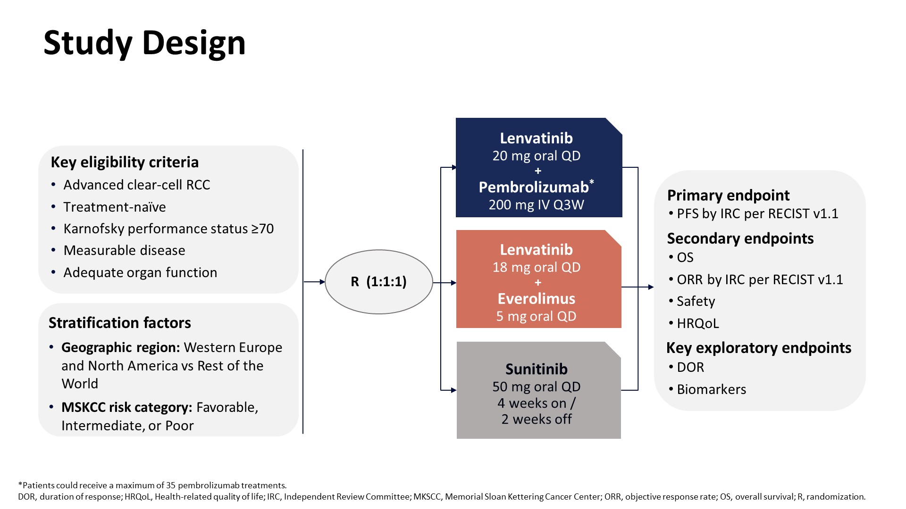
Slide 3
Presented By Robert Motzer at 2021 Genitourinary Cancers Symposium

Slide 27
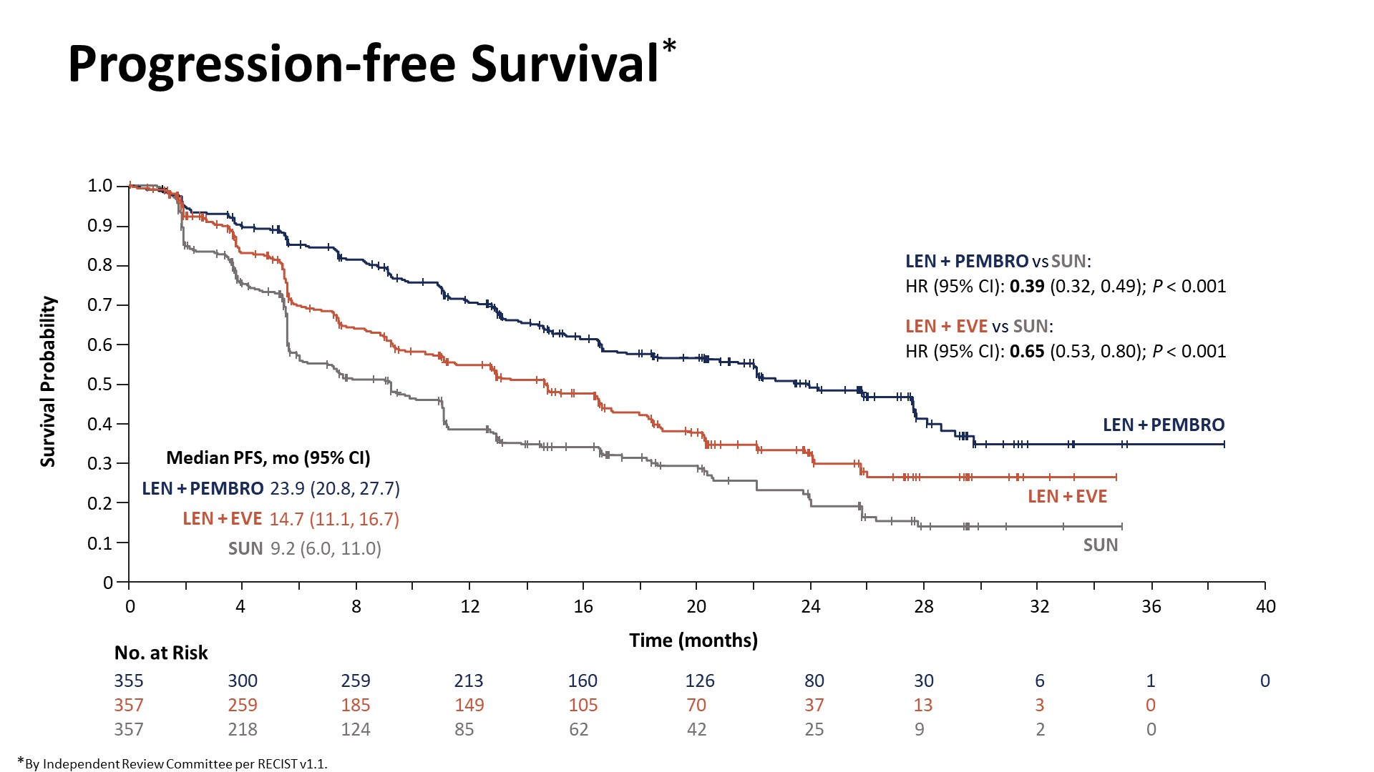
Progression-free Survival*
Presented By Robert Motzer at 2021 Genitourinary Cancers Symposium

Slide 28
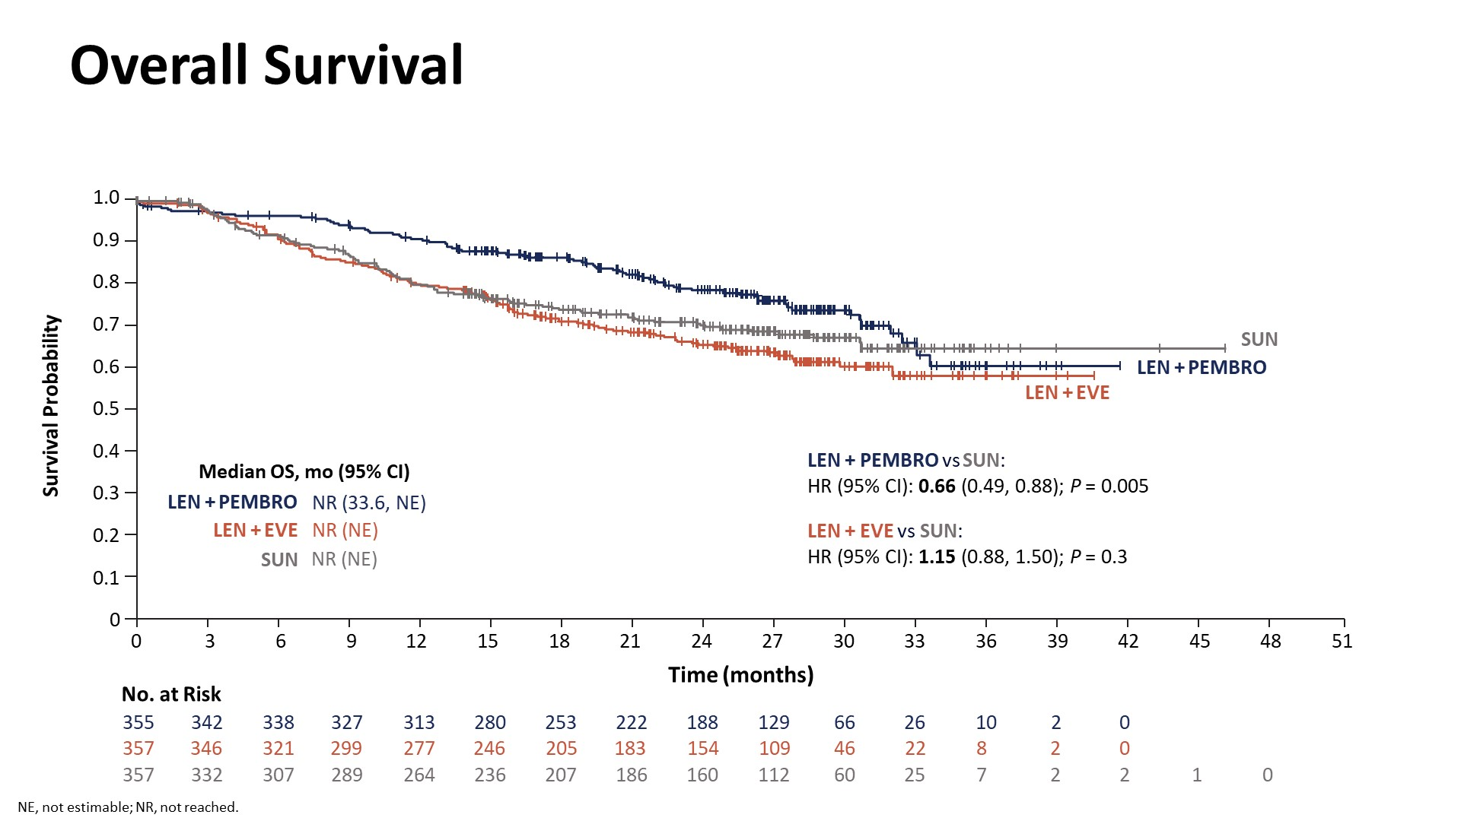
Overall Survival
Presented By Robert Motzer at 2021 Genitourinary Cancers Symposium

Slide 29
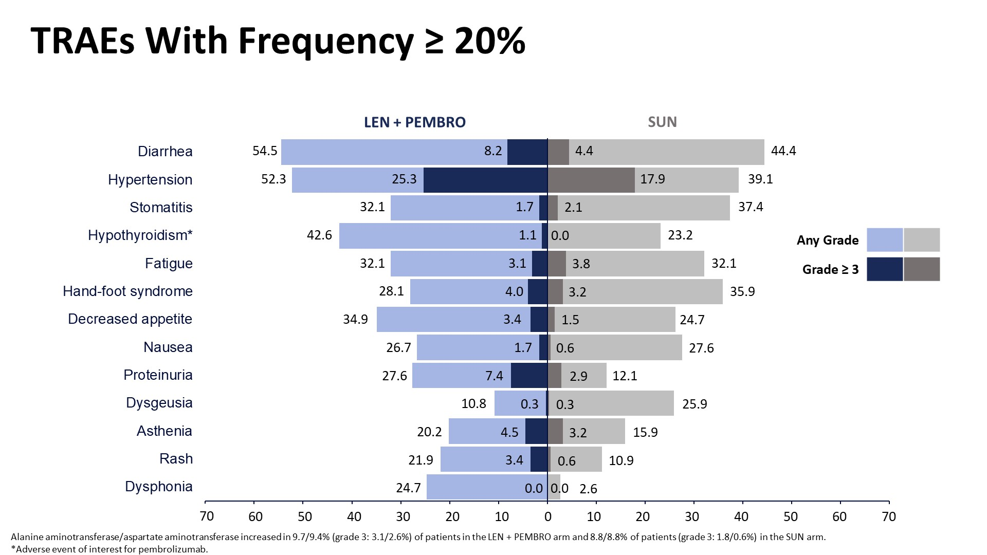
TRAEs With Frequency ≥ 20%
Presented By Robert Motzer at 2021 Genitourinary Cancers Symposium

Slide 30
COSMIC-313 Study Design
Cabo+Nivo+Ipi
Cabo 40 mg PO QD
+ Nivo 3 mg/kg IV Q3W ×4
+ Ipi 1 mg/kg IV Q3W ×4
ONC-FR-2200642-NP-Septembre 2022 BMS-REF-34614
Advanced RCC (N~840)
No prior systemic therapy* Clear cell component Intermediate or poor risk per IMDC criteria Measurable disease per RECIST v1.1 Karnofsky Performance Status ≥70%
Tumor assessment every 8 weeks per RECIST v1.1‡
Treatment until loss of clinical benefit or intolerable toxicity§
No crossover allowed
Cabo 40 mg PO QD
+ Nivo 480 mg IV Q4W†
R1:1
Stratification
IMDC risk
Region
Pbo+Nivo+Ipi
Pbo PO QD
+ Nivo 3 mg/kg IV Q3W ×4
+ Ipi 1 mg/kg IV Q3W ×4
Pbo PO QD
+ Nivo 480 mg IV Q4W†
*One prior systemic adjuvant therapy allowed for completely resected RCC and if recurrence occurred ≥6 months after the last dose of adjuvant therapy; adjuvant PD-1 or PD-L1 inhibitor in combination with a CTLA-4 inhibitor not permitted. †Nivolumab given for a maximum of 2 years. ‡Tumor assessment (RECIST v1.1) at week 10, then every 8 weeks through week 50, then every 12 weeks thereafter. §Discontinuation of one agent did not mandate discontinuation of all agents.
La présentation contient des informations hors AMM
Document scientifique pour lequel BMS a obtenu un droit d’exploitation de la part des auteurs et/ou du congrès, remis uniquement sur demande du PDS, réservé à la direction médicale BMS, ne peut être cédé ou copié.
Toni K. Choueiri, ESMO 2022, abstr LBA8.
*The combination of Cabozantinib + Nivo + Ipi is not approved in Malaysia

Slide 31

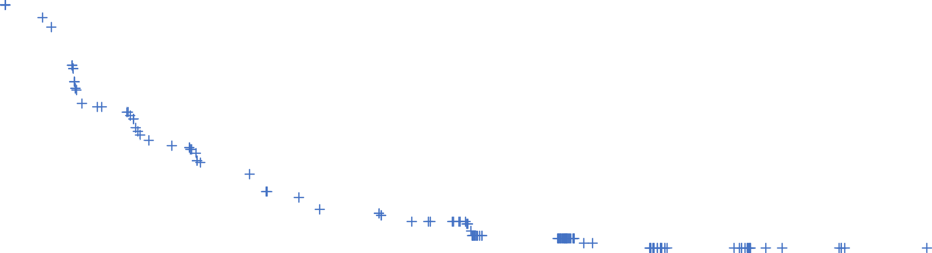
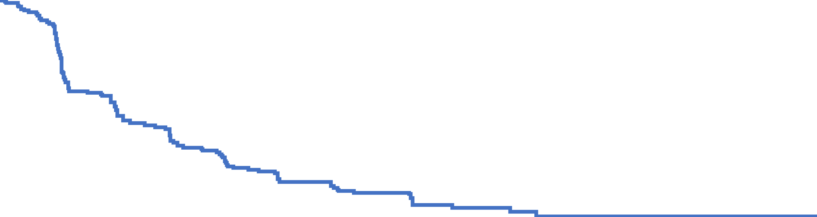

Progression-Free Survival: Final Analysis (PITT Population)
1.0
 | No. of Events | Median PFS mo (95% CI)
Cabo+Nivo+Ipi (N=276) | 116 | NR (14.0–NE)
Pbo+Nivo+Ipi (N=274) | 133 | 11.3 (7.7–18.2)
0.9
0.8
ONC-FR-2200642-NP-Septembre 2022 BMS-REF-34614
0.7
Hazard ratio 0.73 (95% CI 0.57–0.94); p=0.013
0.6
57%
0.5
Probability of PFS
49%
0.4
0.3
0.2
0.1
0.0
0
3
6
9
12
15
18
21
24
27
30
Number at Risk
Cabo+Nivo+Ipi
Pbo+Nivo+Ipi
Months
276
274
234
185
170
136
145
115
119
98
97
69
56
37
33
19
10
5
1
1
0
0
Date of the 249th event: Aug 23, 2021
PFS per RECIST v1.1 by BIRC.
La présentation contient des informations hors AMM
Document scientifique pour lequel BMS a obtenu un droit d’exploitation de la part des auteurs et/ou du congrès, remis uniquement sur demande du PDS, réservé à la direction médicale BMS, ne peut être cédé ou copié.
Toni K. Choueiri, ESMO 2022, abstr LBA8.
*The combination of Cabozantinib + Nivo + Ipi is not approved in Malaysia

Slide 32
Progression-Free Survival Subgroup Analyses (PITT Population)
Subgroup
N/events
HR (95% CI)
Subgroup
N/events
HR (95% CI)
Overall* | 550/249 |  |  | 0.73 (0.57–0.94)
Age
<65 years | 366/164 |  |  | 0.68 (0.50–0.93)
≥65 years | 184/85 |  |  | 0.81 (0.53–1.24)
Sex
Male | 417/184 |  |  | 0.72 (0.54–0.96)
Female | 133/65 |  |  | 0.74 (0.45–1.21)
Geographic region
US, CAN, EU, AU, NZ | 387/169 |  |  | 0.71 (0.53–0.97)
Latin America or Asia | 163/80 |  |  | 0.75 (0.48–1.16)
KPS
100 or 90 | 340/138 |  |  | 0.72 (0.52–1.01)
80 or 70 | 208/111 |  |  | 0.68 (0.47–0.99)
IMDC risk group
Poor | 133/67 |  |  | 1.04 (0.65–1.69)
Intermediate | 417/182 |  |  | 0.63 (0.47–0.85)
Prior nephrectomy
Yes | 353/160 |  |  | 0.78 (0.57–1.06)
No | 197/89 |  |  | 0.62 (0.41–0.94)
Overall* | 550/249 |  |  |  | 0.73 (0.57–0.94)
Sarcomatoid
Yes | 35/16 |  |  |  | 0.87 (0.30–2.52)
No | 515/233 |  |  |  | 0.71 (0.55–0.92)
SoD of target lesions
<Median | 264/112 |  |  |  | 0.65 (0.45–0.94)
≥Median | 264/126 |  |  |  | 0.80 (0.57–1.14)
Visceral metastasis
Yes | 481/216 |  |  |  | 0.73 (0.56–0.96)
No | 69/33 |  |  |  | 0.60 (0.30–1.20)
Liver metastasis
Yes | 86/42 |  |  |  | 0.64 (0.35–1.17)
No | 464/207 |  |  |  | 0.73 (0.56–0.97)
Bone metastasis
Yes | 90/47 |  |  |  | 0.82 (0.45–1.49)
No | 460/202 |  |  |  | 0.72 (0.55–0.95)
Tumor PD-L1 status
<1% | 350/160 |  |  |  | 0.76 (0.56–1.04)
≥1% | 112/50 |  |  |  | 0.87 (0.50–1.53)
ONC-FR-2200642-NP-Septembre 2022 BMS-REF-34614
Favors Cabo+Nivo+Ipi
Favors Pbo+Nivo+Ipi
Favors Cabo+Nivo+Ipi
Favors Pbo+Nivo+Ipi
La présentation contient des informations hors AMM
Document scientifique pour lequel BMS a obtenu un droit d’exploitation de la part des auteurs et/ou du congrès, remis uniquement sur demande du PDS, réservé à la direction médicale BMS, ne peut être cédé ou copié.
*Stratified. PFS per RECIST v1.1 by BIRC. Geographic region and IMDC risk group are per IxRS. SoD; sum of diameters.
Toni K. Choueiri, ESMO 2022, abstr LBA8.
*The combination of Cabozantinib + Nivo + Ipi is not approved in Malaysia

Slide 33
Summary of Adverse Events (Safety Population)
 | Cabo+Nivo+Ipi (N=426) |  | Pbo+Nivo+Ipi (N=424)
 | Any Grade | Grade 3–4 | Any Grade | Grade 3–4
Treatment-related adverse events
Any event,* % | 99 | 73 | 91 | 41
Alanine aminotransferase increased | 46 | 26 | 17 | 6
Aspartate aminotransferase increased | 44 | 20 | 16 | 5
Diarrhea | 41 | 4 | 18 | 3
Palmar-plantar erythrodysesthesia | 28 | 3 | 4 | 0
Hypothyroidism | 24 | <1 | 15 | 0
Hypertension | 23 | 8 | 5 | 2
Fatigue | 22 | 2 | 21 | 1
Lipase increased | 22 | 9 | 13 | 6
Amylase increased | 20 | 5 | 12 | 2
Rash | 20 | 2 | 20 | 1
Pruritus | 20 | 0 | 26 | <1
ONC-FR-2200642-NP-Septembre 2022 BMS-REF-34614
Grade 5 TRAEs occurred in 3 patients (1%) with Cabo+Nivo+Ipi (gastrointestinal hemorrhage, hepatic failure, and respiratory failure) and 3 patients (1%) with Pbo+Nivo+Ipi (renal failure, myocarditis, and sudden death) ≤30 days after last dose; through 100 days after last dose, two additional patients had grade 5 TRAEs with Cabo+Nivo+Ipi (immune-mediated hepatitis and acute hepatic failure) and one additional patient with Pbo+Nivo+Ipi (perforated ulcer)
Use of high-dose corticosteroids (≥40 mg of prednisone or equivalent) for AEs was 58% with Cabo+Nivo+Ipi and 35% with Pbo+Nivo+Ipi
Data cut-off: Jan 31, 2022
*Occurring in ≥20% of either treatment group.
La présentation contient des informations hors AMM
Document scientifique pour lequel BMS a obtenu un droit d’exploitation de la part des auteurs et/ou du congrès, remis uniquement sur demande du PDS, réservé à la direction médicale BMS, ne peut être cédé ou copié.
Toni K. Choueiri, ESMO 2022, abstr LBA8.
*The combination of Cabozantinib + Nivo + Ipi is not approved in Malaysia
Notes:
An overview of adverse events is shown. Treatment-related AEs occurring in at least 20% of patients in either treatment group are summarized in the table. Most patients experienced a treatment-related AE in both treatment groups.
Overall, the safety profile of Cabo+Nivo+Ipi was consistent with the known safety profile for each component, with no new safety signals identified. However, the incidence of treatment-related events including elevated liver transaminases, diarrhea, and skin toxicity was higher with Cabo+Nivo+Ipi versus the control group.
Treatment-related deaths occurred in 5 patients with Cabo+Nivo+Ipi and 4 patients with Placebo+Nivo+Ipi within 100 days after last dose.
High-dose corticosteroids for AEs, defined as at least 40 mg of prednisone or equivalent, were received by 58% with Cabo+Nivo+Ipi versus 35% with Placebo+Nivo+Ipi.

Slide 34
 | CheckMate 214 (int/poor) | KEYNOTE 426 | JAVELIN Renal 101 | CheckMate 9ER | CLEAR (KN5815)
Arms | Nivolumab/Ipilimumab VS Sunitinib | Pembrolizumab/Axitinib VS Sunitinib | Avelumab/Axitinib VS Sunitinib | Nivolumab/Cabozantinib VS Sunitinib | Pembrolizumab/Lenvatinib VS Everolimus/Lenvatinib VS Sunitinib
CR Rate with Combination | 9% | 10% | 4.4% (PDL1+) 3.4% (ITT) | 8% | 16%
ORR with combination | 39% | 59.3% | 55% (PDL1+) 51% (ITT) | 57% | 71%
Benefit in Risk Group | Int/Poor | All | All | All | All
HR for OS P value | 0.65 (0.54-0.78) P<0.001 | 0.68 (0.55-0.85) P=0.003 | 0.78 (0.55-1.08) P=0.068 | 0.66 (0.50-0.87) P=0.0034 | 0.66 (0.49-0.88) P=0.005
TRAEs G3-G5 | 47.9% vs 64.1% | 62.9% vs 58.1% | 56.7% vs 55.4% | 61% vs 51% | 71.6% vs 58.8%
Discontinue Tx | 22.7% | 25% | 25% | 15% | 29%
Sarcomatoid Features | At least 10% (up to 23% of pathology unavailable) | 17.9% | 12.2% | NA | 7.9%
Duration Of Response | Not Reached | Not Reached | Not Reached | 20.2 months | 25.8 months
Median Time to Response | 2.8 months | 2.8 months | 1.6 months (PDL1+) 2.6 months (ITT) | 2.8 months | -
Proportion of Good Risk | 23% | 31% | 20% | 22% | 27%
This slide provides summary of data for presentation only. Cross-trial comparison is not intended.
*The combination of Nivolumab + ipilimumab is not approved in Malaysia

Slide 35
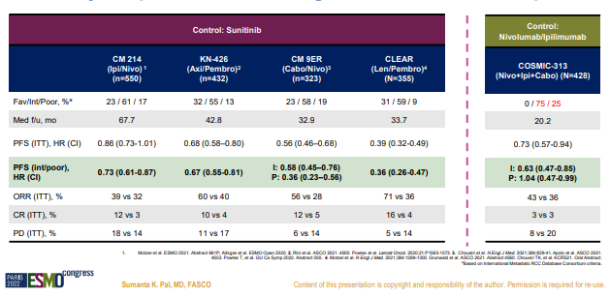

Comparison of COSMIC 313 with other doublet phase 3s
*The combination of Cabozantinib + Nivo + Ipi is not approved in Malaysia

Slide 36
How do I choose a therapy in the 1st line?
Approved options by local regulator
Efficacy and safety
Co-morbidities / Contra-indications
Reimbursement
Rarely opt for single agent TKI even in favourable risk setting ( low ORR)
Triple option not SOC yet , awaiting OS data

Slide 37
Outline
Introduction to mRCC
First line therapies for mRCC
Second line therapies for mRCC
Pan Asian Guidelines for mRCC management
Summary

Slide 38
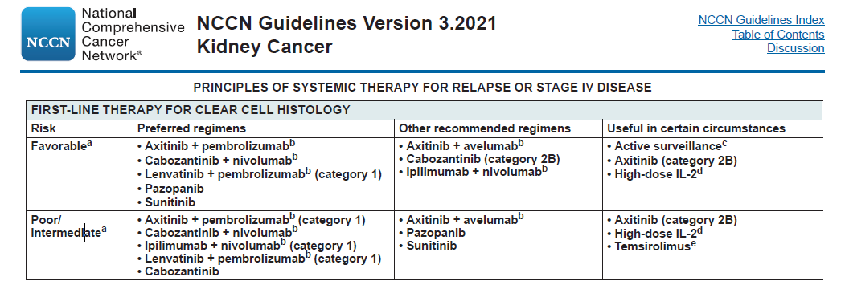
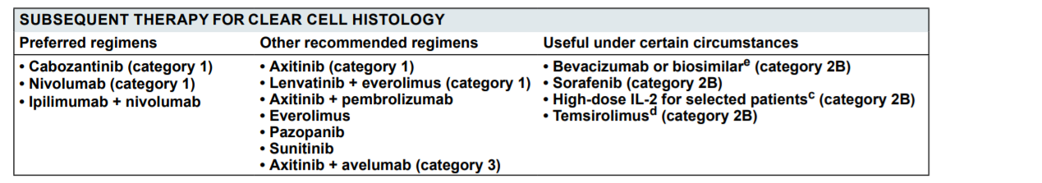
NCCN Clinical Practice Guidelines in Oncology (NCCN Guidelines®) for Kidney Cancer V2.2021. © National Comprehensive Cancer Network, Inc 2021. All rights reserved. Accessed March 23, 2021. To view the most recent and complete version of the guideline, go online to NCCN.org.

Slide 39
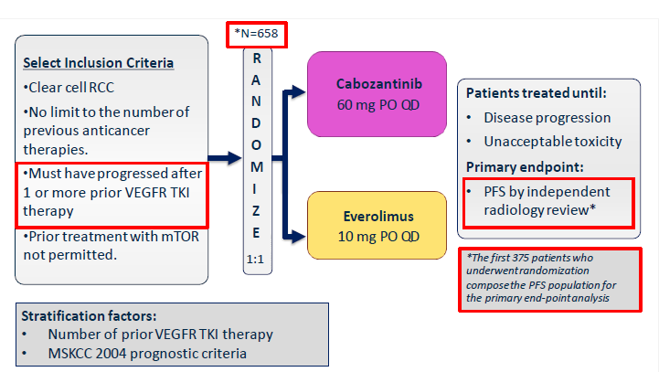
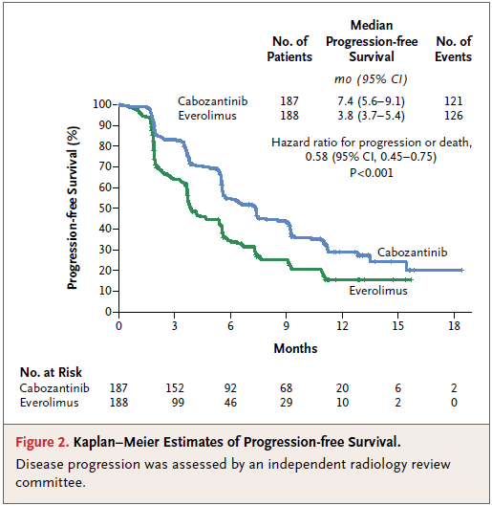
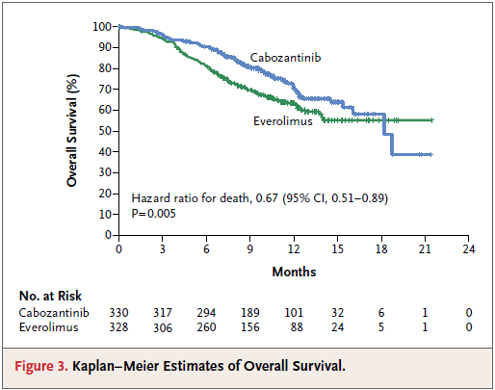
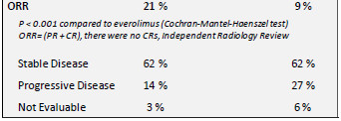
Cabozantinib- METEOR Ph3 Trial in 2L+ aRCC
Choueri2015,NEnglJMed.2015Nov5;373(19):1814-23

Slide 40
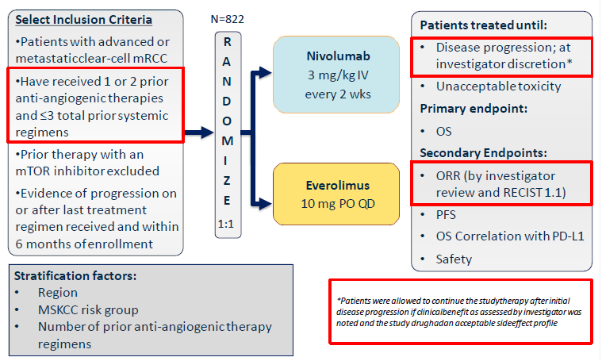
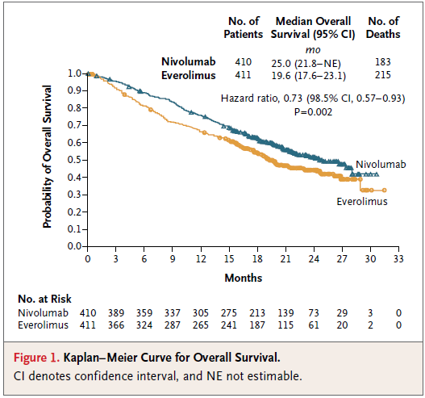
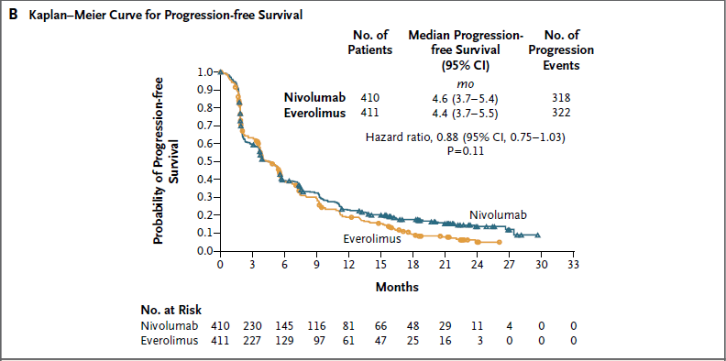
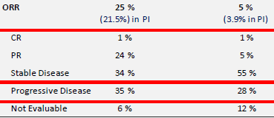
Nivolumab - CheckMate 025 Ph3 Trial in 2L+ aRCC
https://clinicaltrials.gov/ct2/show/NCT01668784?term=NCT01668784&rank=1 MotzerR.et.al.NEnglJMed.2015Nov5;373(19):1803-13

Slide 41
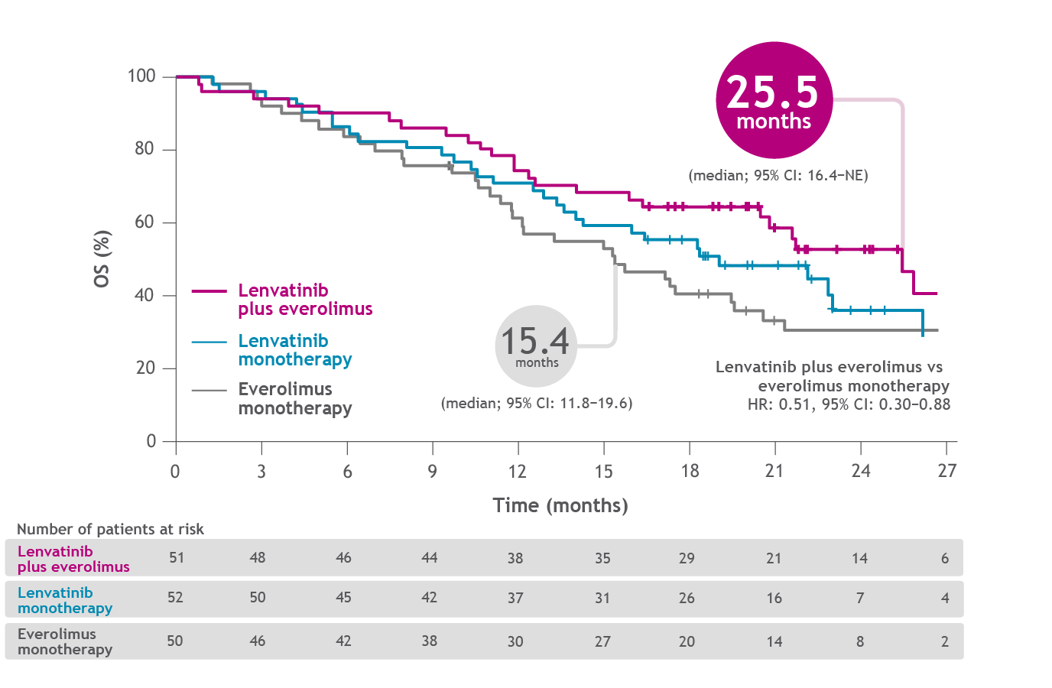
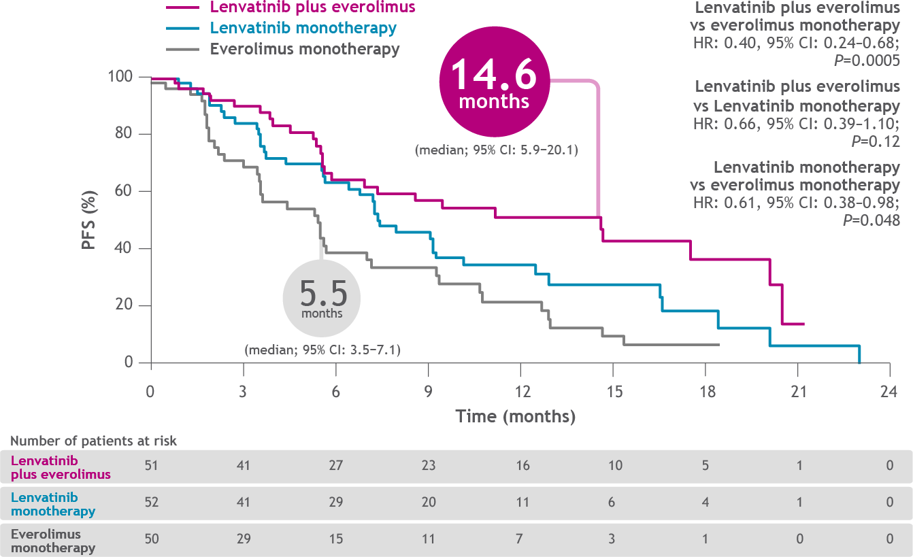
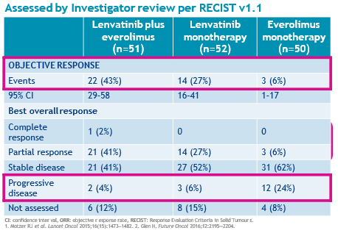
Lenvatinib + Everolimus – Study 205 Ph2 Randomized Trial in 2L aRCC
1. Motzer RJ et al. Lancet Oncol 2016;17(1):e4‒5.

Slide 42
Pivotal Randomized Trials in Clear-Cell RCC
Post TKI Therapy – Efficacy summary
Parameter | RECORD-1^{[1,2]} | AXIS^{[3,4]} | METEOR^{[5,6]} | CheckMate 025^{[7]} | LEN EVE^{[8]}
 | Everolimus vs Placebo | Axitinib vs Sorafenib | Cabozantinib vs Everolimus | Nivolumab vs Everolimus | Lenvatinib + Everolimus vs Everolimus
Patients, n | 410 | 723 | 658 | 821 | 153
Median PFS, mos | 4.9 vs. 1.9 | 6.7 vs. 4.7 | 7.4 vs. 3.9 | 4.6 vs. 4.4 | 14.6 vs. 5.5
Median OS, mos | 14.8 vs 14.0 | 20.1 vs 19.2 | 21.4 vs 17.1 | 25.0 vs 19.6 | 25.5 vs 15.4
ORR, % | 2% vs 0% | 19% vs 9% | 21% vs 5% | 25% vs 5% | 43% vs 3%
PD (Progressive Disease) | NR | 22% vs. 21% | 12% vs. 27% | 35% vs. 28% | 4% vs. 24%
Median Duration of Treatment | 4.7 vs. 2 | 6.4 vs. 5 | 7.6 vs. 4.4 | 5.5 vs.3.7 | 7.6 vs. 4.1
Duration of Response, mos | NR | 11 vs. 10.6 | NR | 23 vs. 13.7 | 13 vs. 8.5
Time to Response, mos | NR | NR | NR | 3 vs. 3.7 | 1.9 vs. 1.8
Head to head cross-trial comparison is not recommended. For demonstration purpose only. Conclusions drawn should be used with caution
1. Motzer. Lancet. 2008;372:449. 2. Motzer. Cancer 2010;116:4256. 3. Rini. Lancet. 2011;378:1931. 4. Motzer. Lancet Oncol. 2013;14:552. 5. Choueiri. NEJM. 2015;373:1814. 6. Motzer. Br J Cancer. 2018;118:1176. 7. Motzer. NEJM. 2015;373:1803. 8. Motzer. Lancet. 2015;16:1473.

Slide 43
Outline
Introduction to mRCC
First line therapies for mRCC
Second line therapies for mRCC
Pan Asian Guidelines for mRCC management
Summary

Slide 44
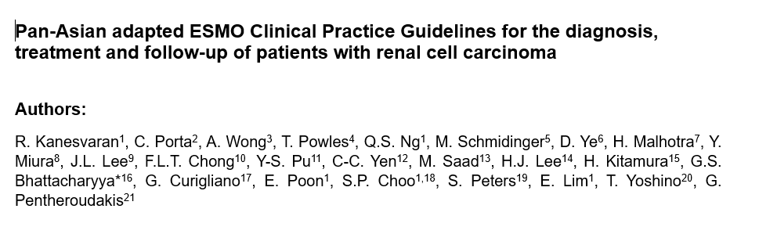
Kanesvaran et al ESMO OPEN 2021

Slide 45

SCOPE of pan Asian adaptation
To help Asian Oncologists in their practice with a focus on Asian ethnicity particularities (as well as Asian patient care worldwide)
To achieve a more standardized and harmonized approach within and across Asian countries
To provide a joint reference document to help drug registration and favor Evidence-based Medicine

Slide 46
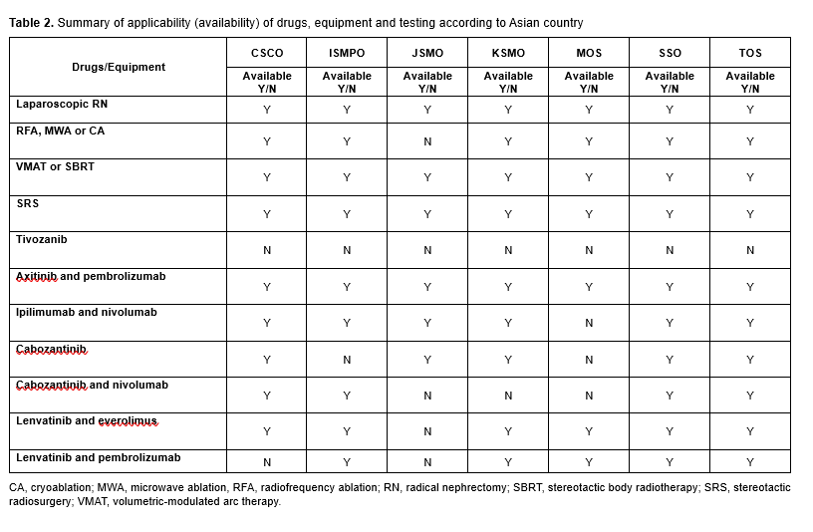
Kanesvaran et al ESMO OPEN 2021

Slide 47
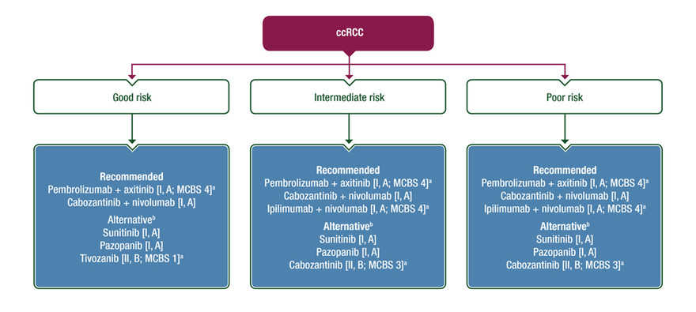
Metastatic RCC MAnagement
Kanesvaran et al ESMO OPEN 2021

Slide 48
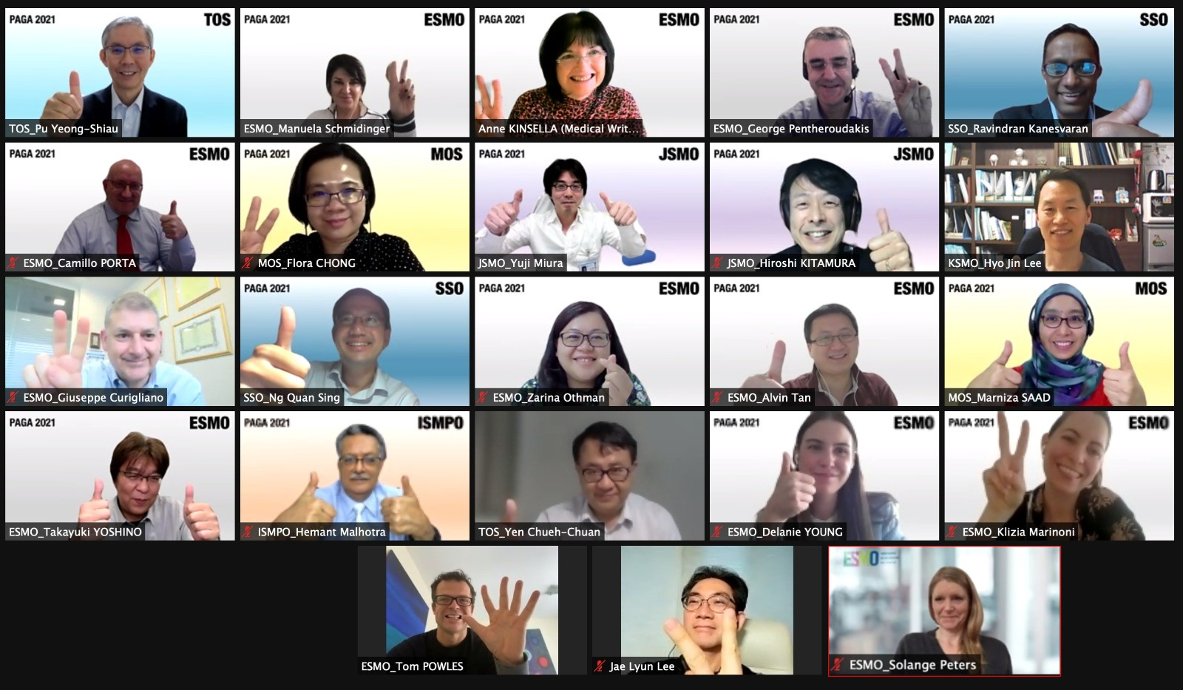

Slide 49
Outline
Introduction to mRCC
First line therapies for mRCC
Second line therapies for mRCC
Pan Asian Guidelines for mRCC management
Summary

Slide 50
Summary
Numerous treatment options available for mRCC patients
First line treatment choice will depend on IMDC risk stratification, co-morbidities , and cost/ reimbursement
Triple therapy data has been reported with PFS benefit
Second line treatment choices will depend on what was given in the first line
No predictive biomarkers are used clinically in mRCC at present

Slide 51

THANK YOU
Ravindran.Kanevaran@singhealth.com.sg
Members of the SingHealth Group
Changi General Hospital • KK Women’s and Children’s Hospital • Singapore General Hospital
National Cancer Centre Singapore • National Dental Centre Singapore • National Heart Centre Singapore • National Neuroscience Institute • Singapore National Eye Centre
SingHealth Polyclinics

